Slide 1
IAP 2024
Third lecture on 1/18 at 12:00p ET in Room 2-190

Slide 2
Today’s lecture:
Advanced Confident Learning
Focus: Theory + Applications

Slide 3
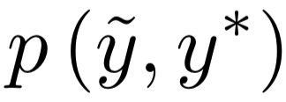
How does confident learning work?
To estimate and find label errors, confident learning requires two inputs:
Noisy labels,
Predicted probabilities,
Note: CL is scale-invariant w.r.t. outputs, i.e. raw logits work as well

Slide 4
How does confident learning work?
Key idea: First we find thresholds as a proxy for the machine’s self-confidence, on average, for each task/class

Slide 5
How does confident learning work?
For each example,
estimate if its an error, correctly labeled, or an outlier based on:

Slide 6
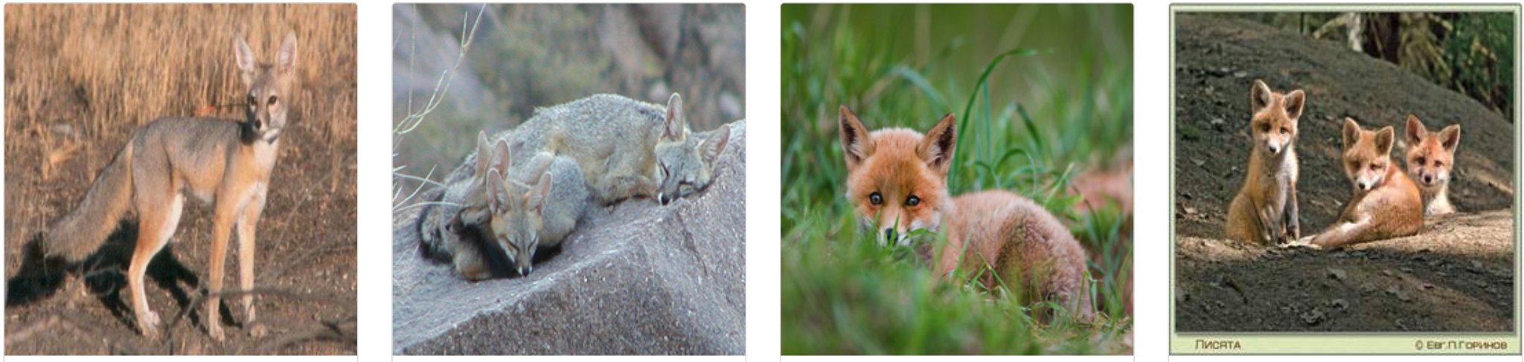
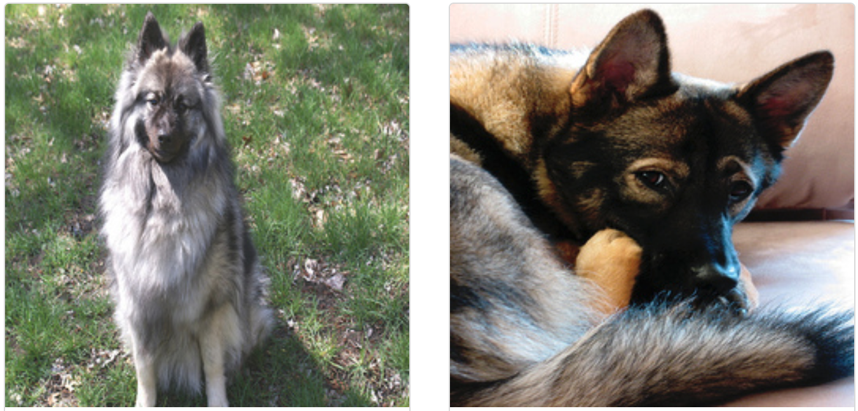
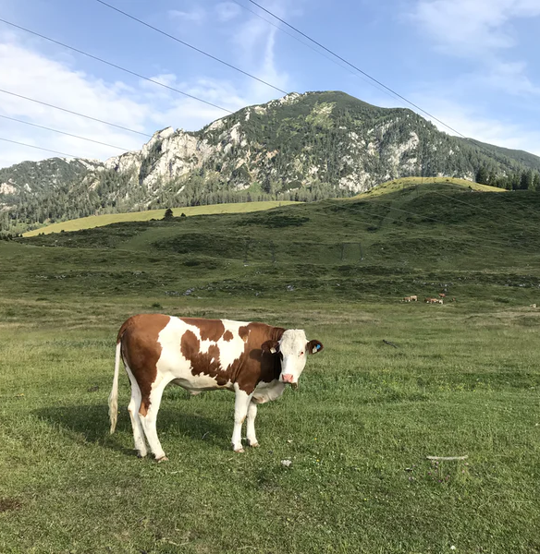
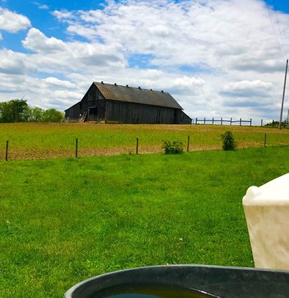
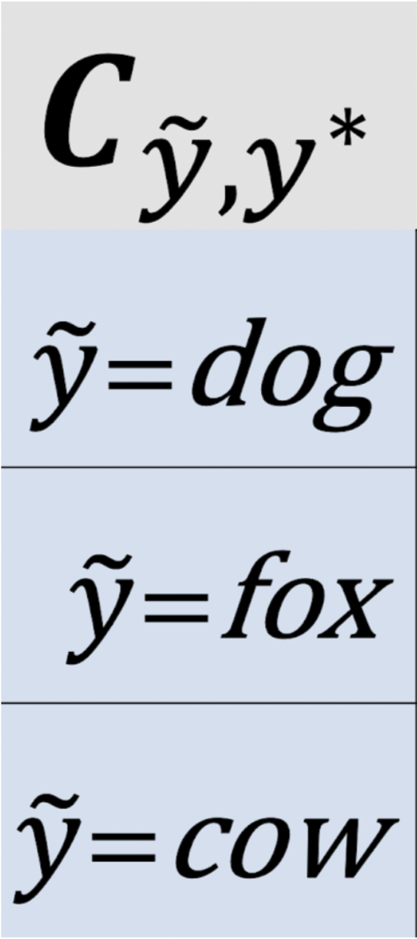
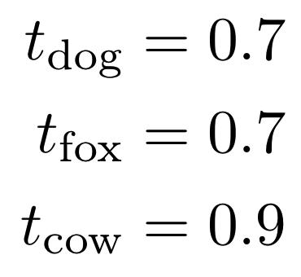
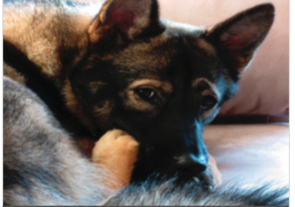
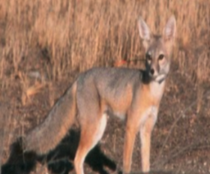
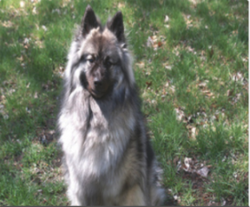
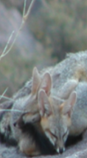
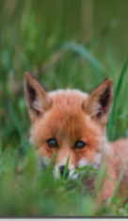
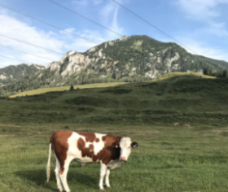
How does confident learning work? (in 10 seconds)
Noisy label: dog
Noisy label: fox
Noisy label: fox
Noisy label: fox
Noisy label: fox
Noisy label: dog
Noisy label: cow
Noisy label: cow
0.7
0.7
0.9
0.8
0.7
0.9
0.9
0.3
0.3
0.3
0.3
0.5
0.1
0.2
0.2
0.1
0.1
0.1
0.2
0.0
0.0
0.0
0.0
0.0
0.0
0.0
0.0
dog
fox
cow
dog
fox
cow
dog
fox
cow
dog
fox
cow
dog
fox
cow
dog
fox
cow
dog
fox
cow
dog
fox
cow
 | 1 | 1 | 0
 | 1 | 3 | 0
 | 0 | 0 | 1
Off diagonals are CL-guessed label errors

Slide 7
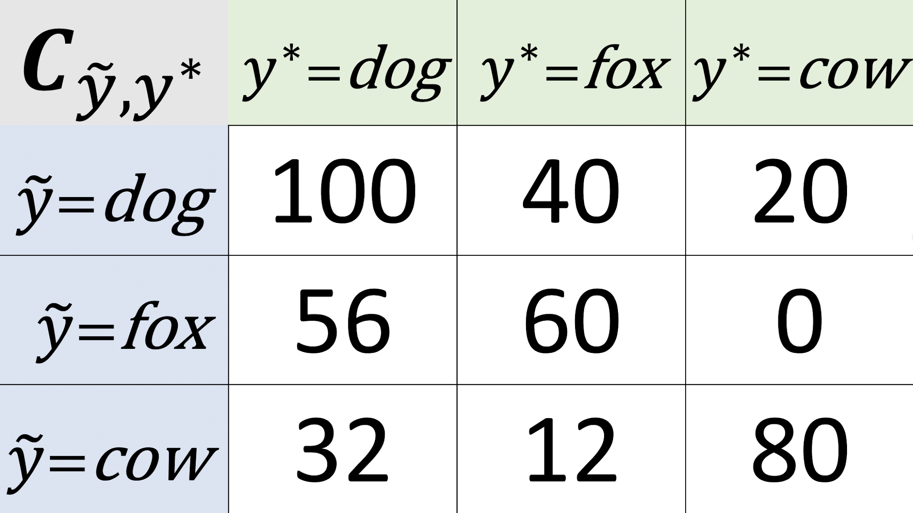
After looking through the entire dataset, we have:
Notes:
Need to see a real-world result. Use color coded.

Slide 8
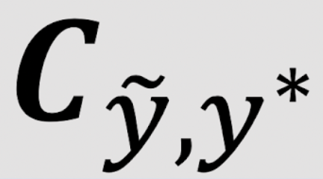
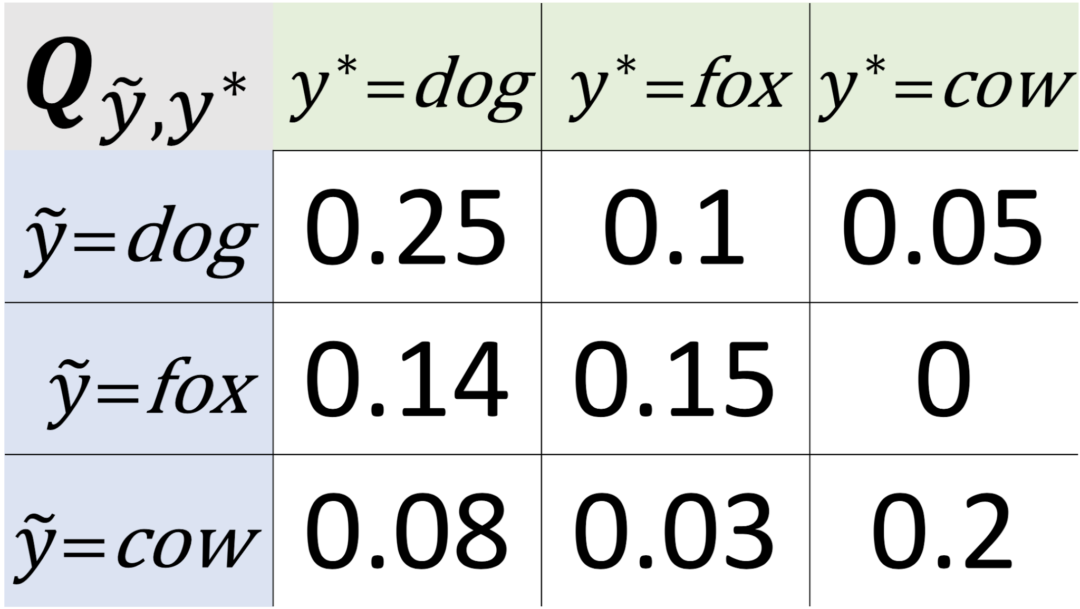
From we obtain the joint distribution of label noise
Estimated
Notes:
estimate

Slide 9
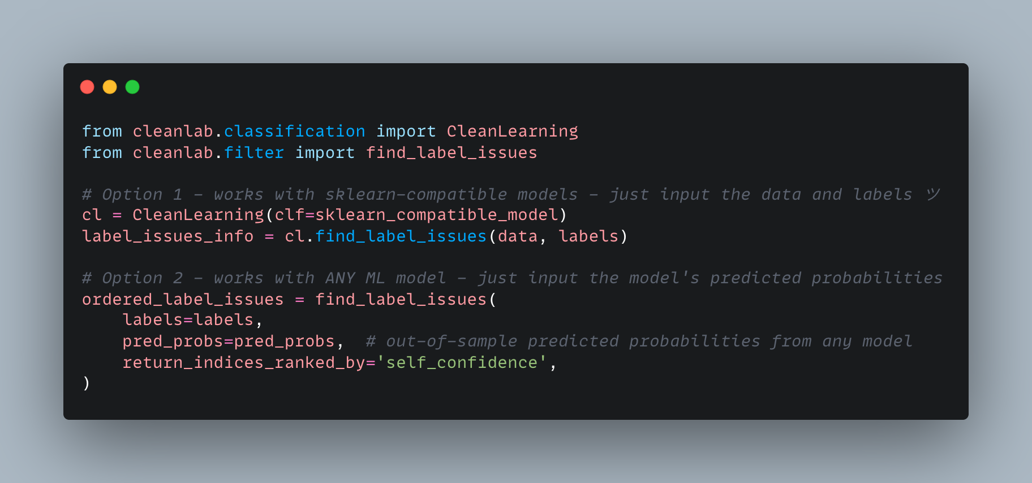
You can do this in 1 import and 1 line of code
https://github.com/cleanlab/cleanlab

Slide 10
Ranking label errors
self-confidence (chalk board)
Normalized margin (chalk board)

Slide 11
Organization for this part of the talk:
What is confident learning?
Situate confident learning
Noise + related work
How does CL work? (methods)
Comparison with other methods
Why does CL work? (theory)
Intuitions
Principles
Label errors on ML benchmarks
✓
✓
✓

Slide 12
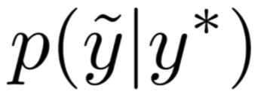
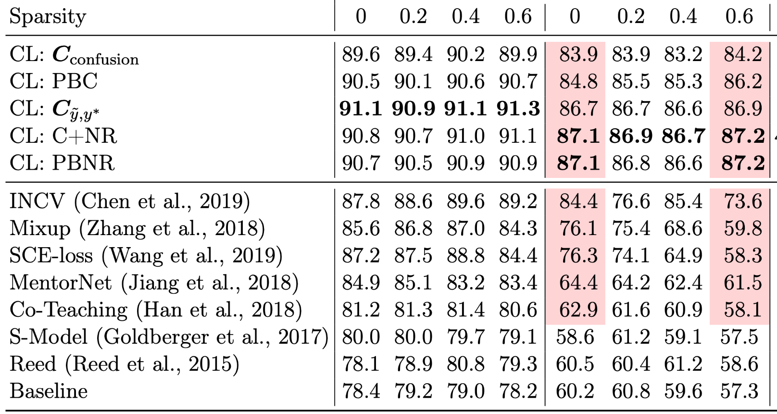
Compare Accuracy: Learning with 40% label noise in CIFAR-10
Fraction of zeros in the off-diagonals of
← More realistic (e.g. ImageNet)
Baseline (remove prediction != label)
Data-centric
Train with errors removed
“Change the dataset”
Confident learning methods
Same perf
Model-centric
Train with errors
“adjust the loss”
Perf drop-off
Notes:
ORDER TO PRESENT THINGS IN THIS SLIDE:
Noise 40% in cifar-10
Cl is robust to change in sparsity
Cl methods perform well compared to recent top performing approaches
(now hit enter and show how data-centric vs model-centric)
Show that the baseline which is simple actually does quite well
Evidence that data-centric thinking is fruitful
Data-centric vs model-centric? What about both?
In practice...
CL methods remove errors first, then use co-teaching for the final training to combine the benefits of both approaches

Slide 13
Organization for this part of the talk:
What is confident learning?
Situate confident learning
Noise + related work
How does CL work? (methods)
Comparison with other methods
Why does CL work? (theory)
Intuitions
Principles
Label errors on ML benchmarks
✓
✓
✓
✓

Slide 14
Theory of Confident Learning
To understand CL performance, we studied conditions where CL exactly finds label errors, culminating in the following Theorem:
As long as examples in class i are labeled i more than any other class, then...
We prove realistic sufficient conditions (allowing significant error in all model outputs)
Such that CL still exactly finds label errors.

Slide 15
Intuition: CL theory builds on three principles
The Prune Principle
remove errors, then train
Chen et al. (2019), Patrini et al. (2017), Van Rooyen et al. (2015)
The Count Principle
use ratios of counts, not noisy model outputs
Page et al. (1997), Jiang et al. (2018)
The Rank Principle
use rank of model outputs, not the noisy values
Natarajan et al. (2017), Forman (2005, 2008), Lipton et al. (2018)
Notes:
assembles prior work

Slide 16
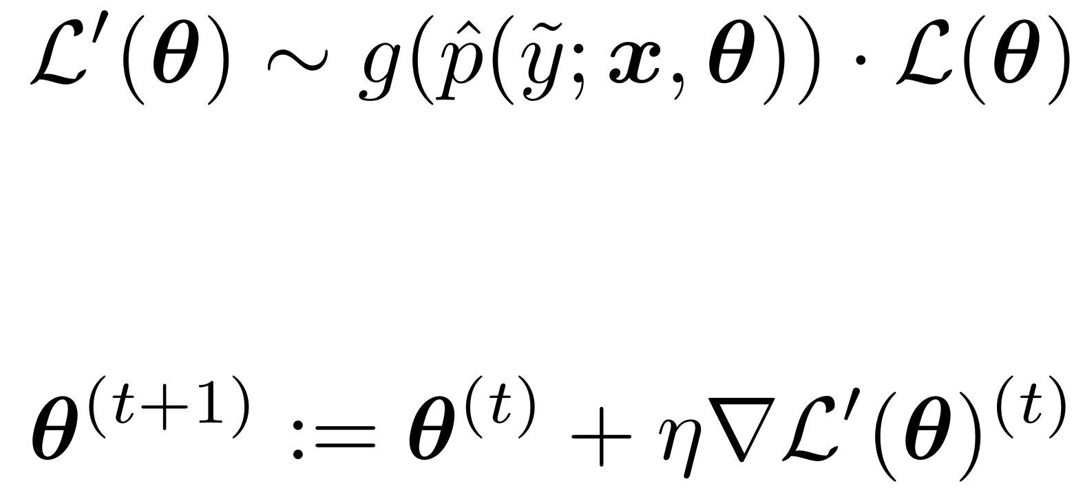
CL Robustness Intuition 1: Prune
Key Idea:
Pruning enables robustness to stochastic/imperfect predicted probabilities
Prior work modifies the loss: (e.g. importance reweighting) (Liu & Tao, 2015; Patrini et al., 2017; Reed et al., 2015; Shu et al., 2019; Goldberger & Ben-Reuven, 2017)
Pred probs are stochastic/erroneous for real-world models!!
Takeaway
CL methods
↓
Prune Label Errors
↓
Avoid loss reweighting
↓
Avoid this form of error propagation
Error propagation
SGD weights update:
Error propagation
Notes:
We prove this in the paper, but here is the key idea.

Slide 17
CL Robustness Intuition 2: Count & Rank
Takeaway
CL methods
↓
Robust statistics to estimate with counts based on rank
↓
Robust to imperfect probabilities from model
Same idea: Counting and Ranking enable robustness to erroneous probabilities
But this time: Let’s look at noise transition estimation
Other methods: (Elkan & Noto, 2008; Sukhbaatar et al., 2015)
Confident Learning:
Enables CL to disambiguate aleatoric (label noise) from epistemic (model noise)
Robust statistic w/ counts + rank (1 step removed erroneous probs)
e.g. Median of Means
Notes:
Consider the median of the means
Same concept is true of thresholds, counts, ranks -- allows you to avoid the effects of outliers.
Look for the class of these methods - names for them

Slide 18
What do “ideal” (non-erroneous) predicted probs look like?
Equipped with this understanding of ideal probabilities
And the prune, count, and rank principles of CL
We can see the intuition for our theorem (exact error finding with noisy probs)

Slide 19
Theorem Intuition
Let “ideal” = 0.9.
The model can be up to (0.9 - 0.6) / 0.9 = 33% wrong in its estimate of
And will be correctly counted.
Does this result still hold for systematic miscalibration (common in neural networks)?
Guo, Pleiss, Sun, & Weinberger (2017) “On Calibration of Modern Neural Networks.” ICML

Slide 20
Final Intuition: Robustness to miscalibration
Exactly finds label errors for “ideal” probabilities
(Ch. 2, Thm 1, in thesis)
But neural networks have been shown (Guo et al., 2017) to be over-confident for some classes:
What happens to ?
→ is unchanged - still exactly finds errors

Slide 21
Enough intuition, let’s see some results
First we’ll look at examples for dataset curation in ImageNet.
Then we’ll look at CL with various distributions/models
Then we’ll look at failure modes
Finally, we’re ready for part 3: “label errors”
Organization for this part of the talk:
What is confident learning?
Situate confident learning
Noise + related work
How does CL work? (methods)
Comparison with other methods
Why does CL work? (theory)
Intuitions
Principles
Label errors on ML benchmarks
✓
✓
✓
✓
✓

Slide 22
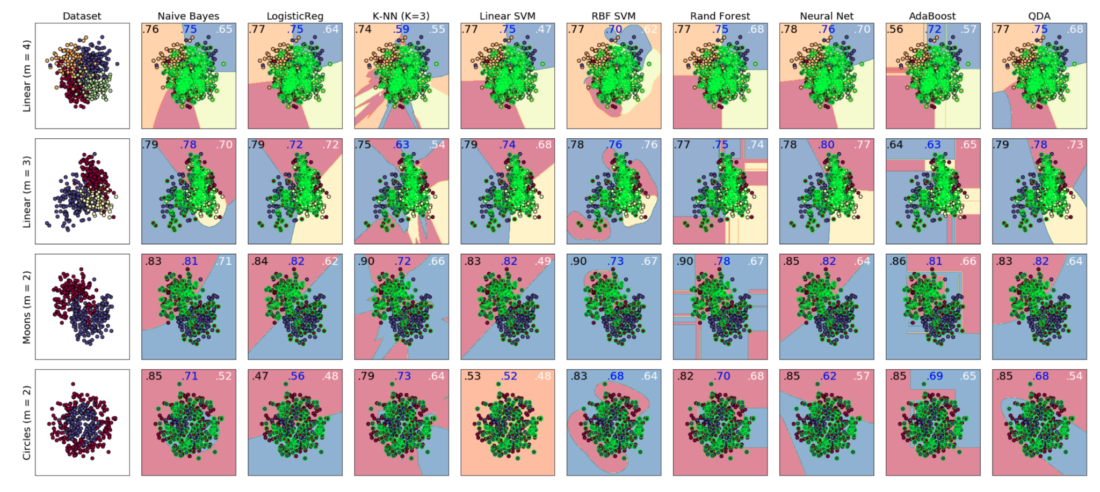
CL is model-agnostic
9 different types of models x 4 types of distributions
In each of case, CL increases accuracy
compared with learning with the given noisy (class-conditional) labels.

Slide 23
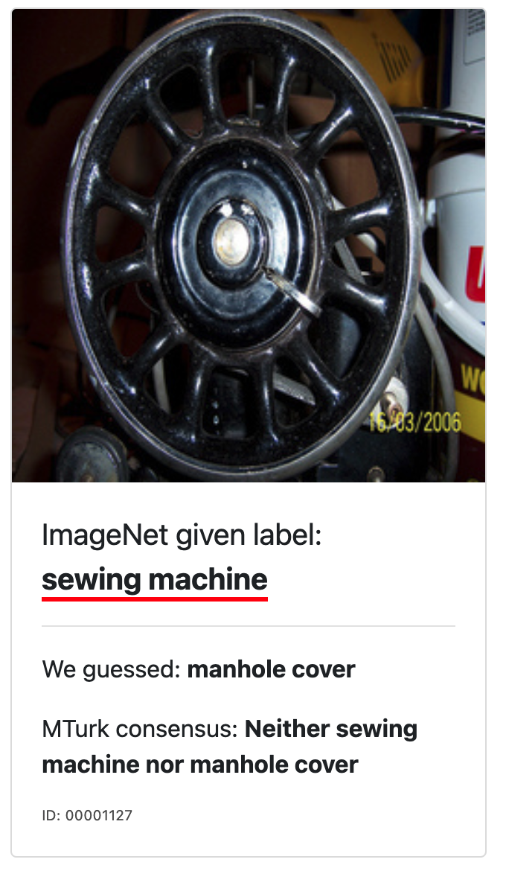
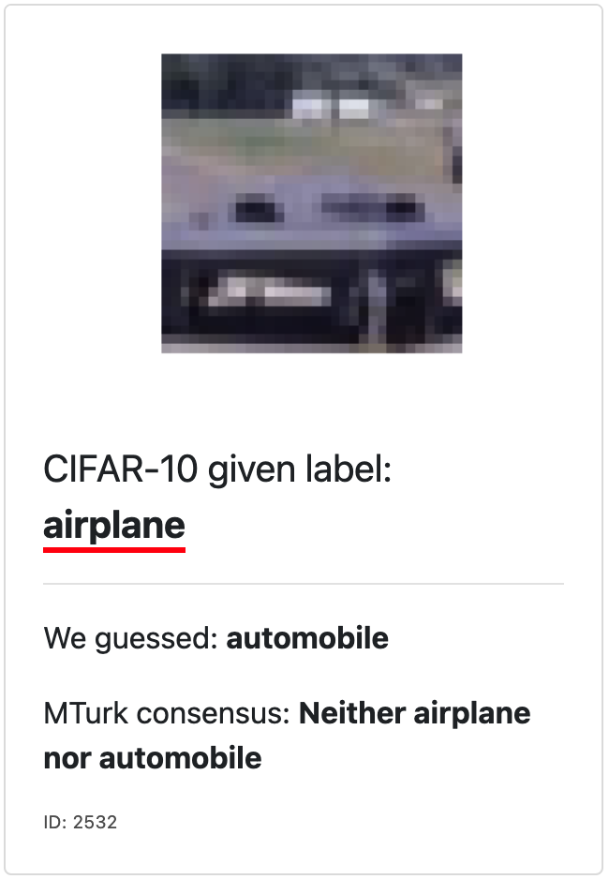
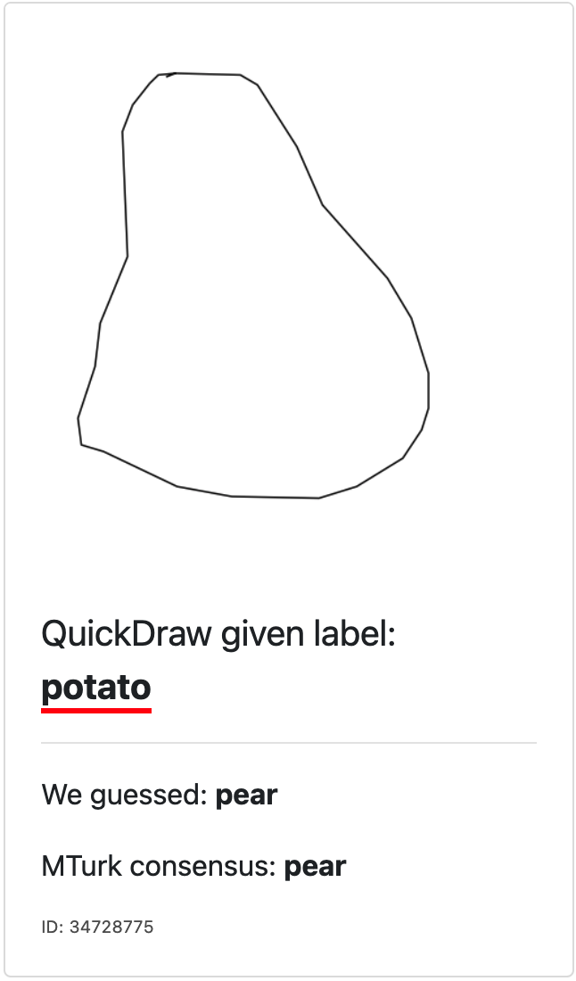
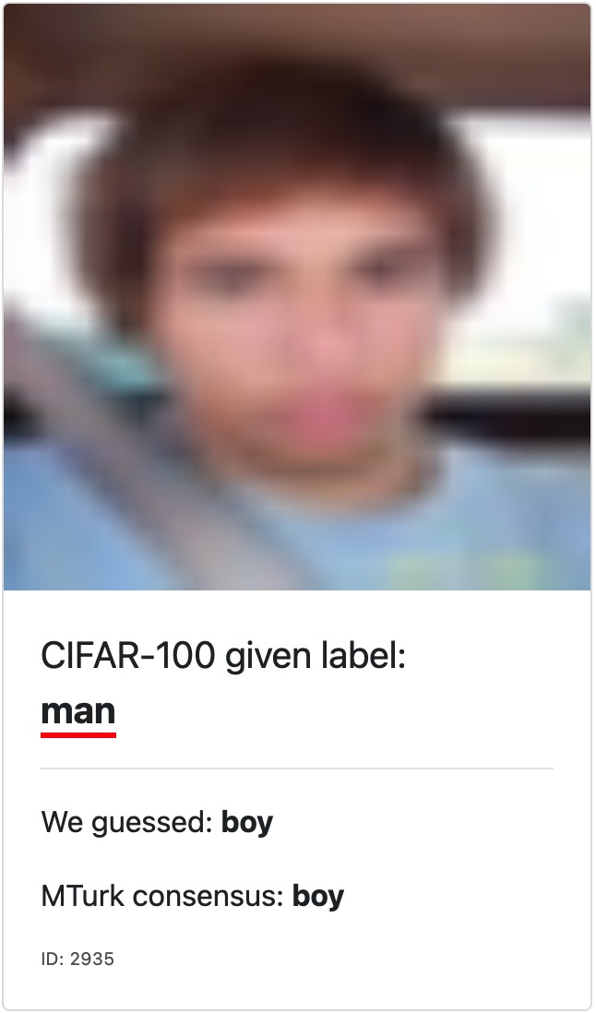
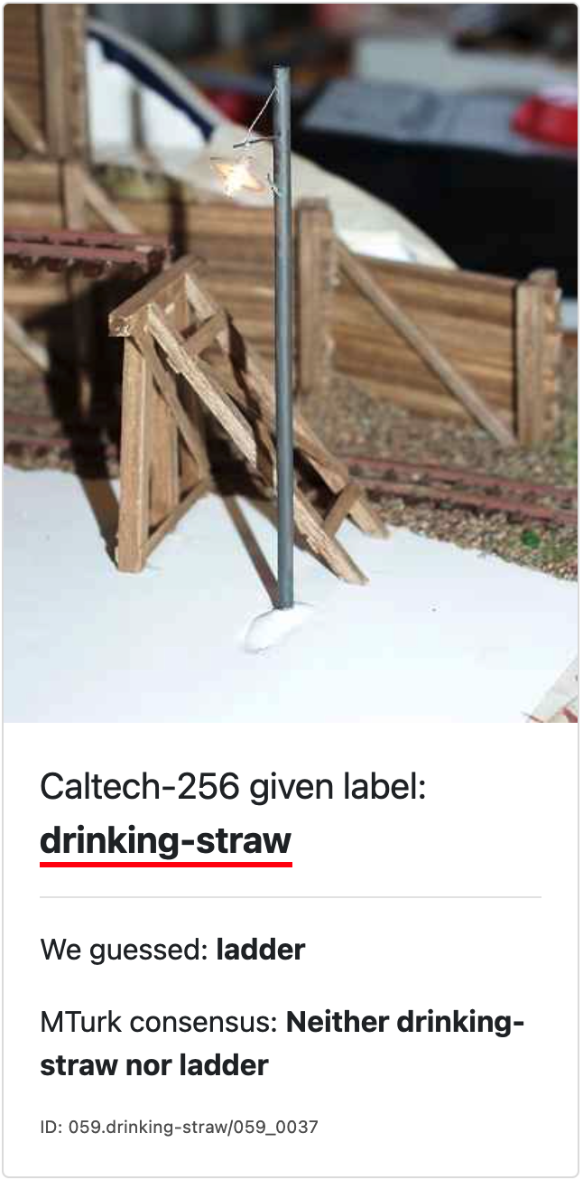
Hard examples. Often there is no good ‘true’ label.
(a)
(b)
(c)
(d)
(e)
(f)

Slide 24
3.4% of labels in popular ML test sets are erroneous
https://labelerrors.com/
Images →
Text →
Audio →
There are pervasive label errors in test sets, but what are the implications for ML?

Slide 25
Are practitioners unknowingly benchmarking ML using erroneous test sets?
To answer this, let’s consider how ML traditionally creates test sets...
and why it can lead to problems for real-world deployed AI models.

Slide 26
A traditional view
Data Set

Slide 27
A traditional view
Train Set
Test Set

Slide 28
A traditional view
Train Set
Test Set

Slide 29
A traditional view
Train Set
Test Set
GREEN
RED
BLUE

Slide 30
A traditional view
Train Set
Test Set
GREEN
GREEN
RED
RED
BLUE
BLUE

Slide 31
A real-world view
Data Set

Slide 32
A real-world view
Data Set

Slide 33
A real-world view
Train Set
Test Set

Slide 34
A real-world view
Train Set
Test Set

Slide 35
A real-world view
Train Set
Test Set

Slide 36
A real-world view
Train Set
Test Set
GREEN
RED
BLUE

Slide 37
A real-world view
Train Set
Test Set
GREEN
GREEN
100% accuracy!
RED
RED
BLUE
BLUE

Slide 38
A real-world view
Trained Model with 100% test accuracy.
GREEN
RED
BLUE

Slide 39
A real-world view
Trained Model with 100% test accuracy.
Real-world distribution (the test set you actually care about)
GREEN
GREEN
BLUE
RED
RED
BLUE

Slide 40
A real-world view
Trained Model with 100% test accuracy.
Real-world accuracy ~ 67%
Key Takeaway:
Need to benchmark on a corrected test set
GREEN
GREEN
BLUE
RED
RED
BLUE

Slide 41
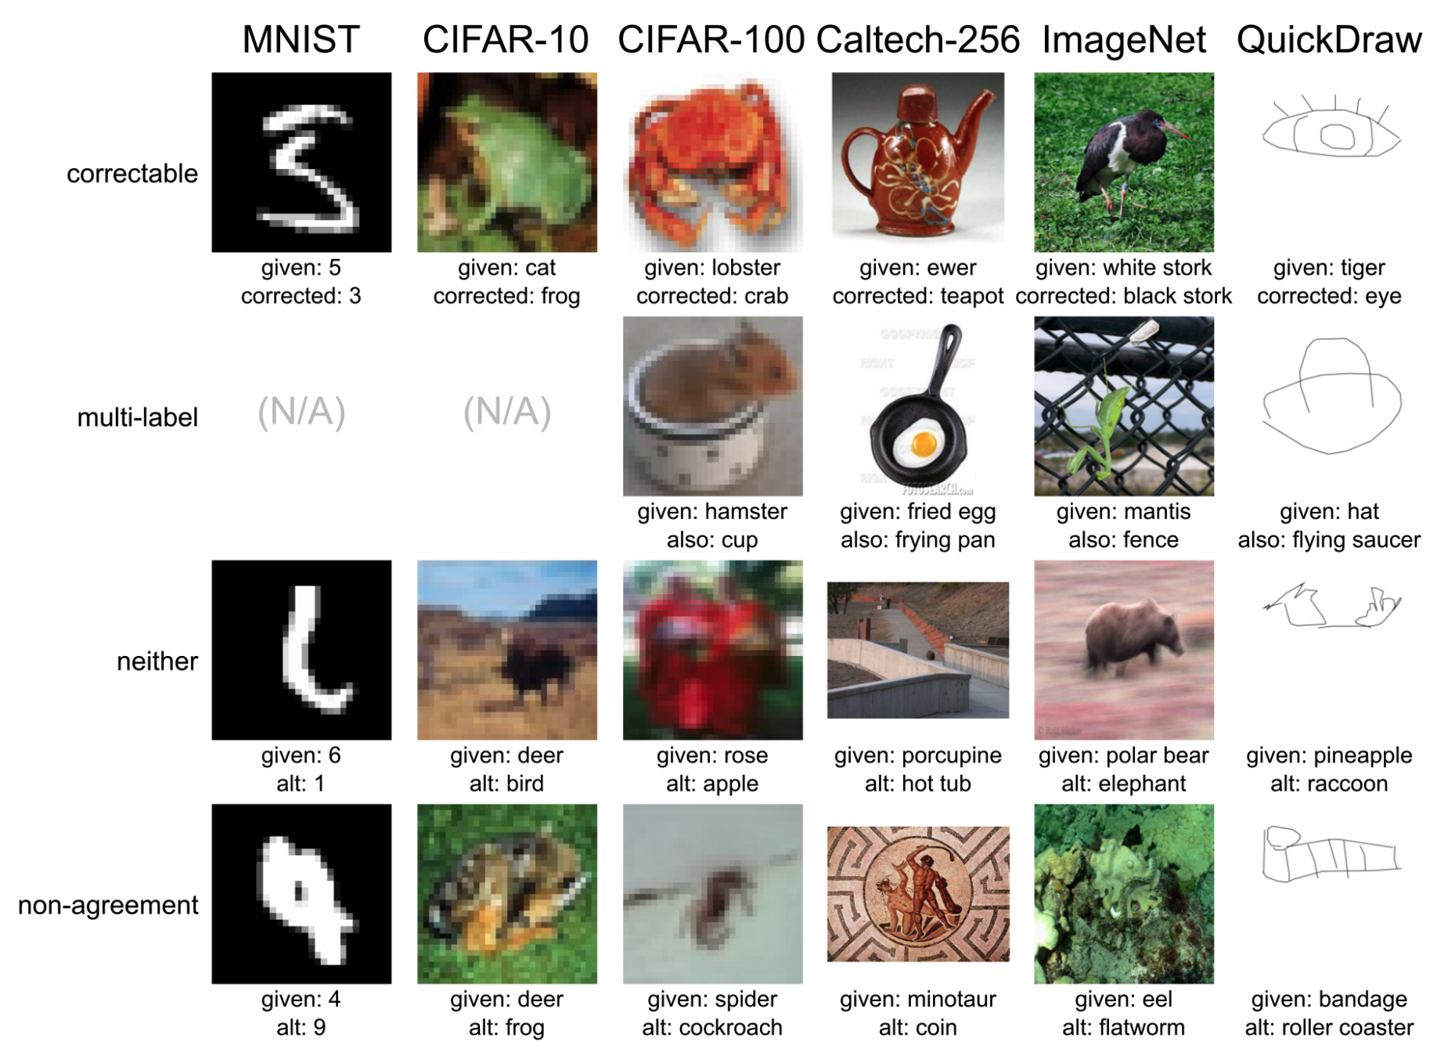
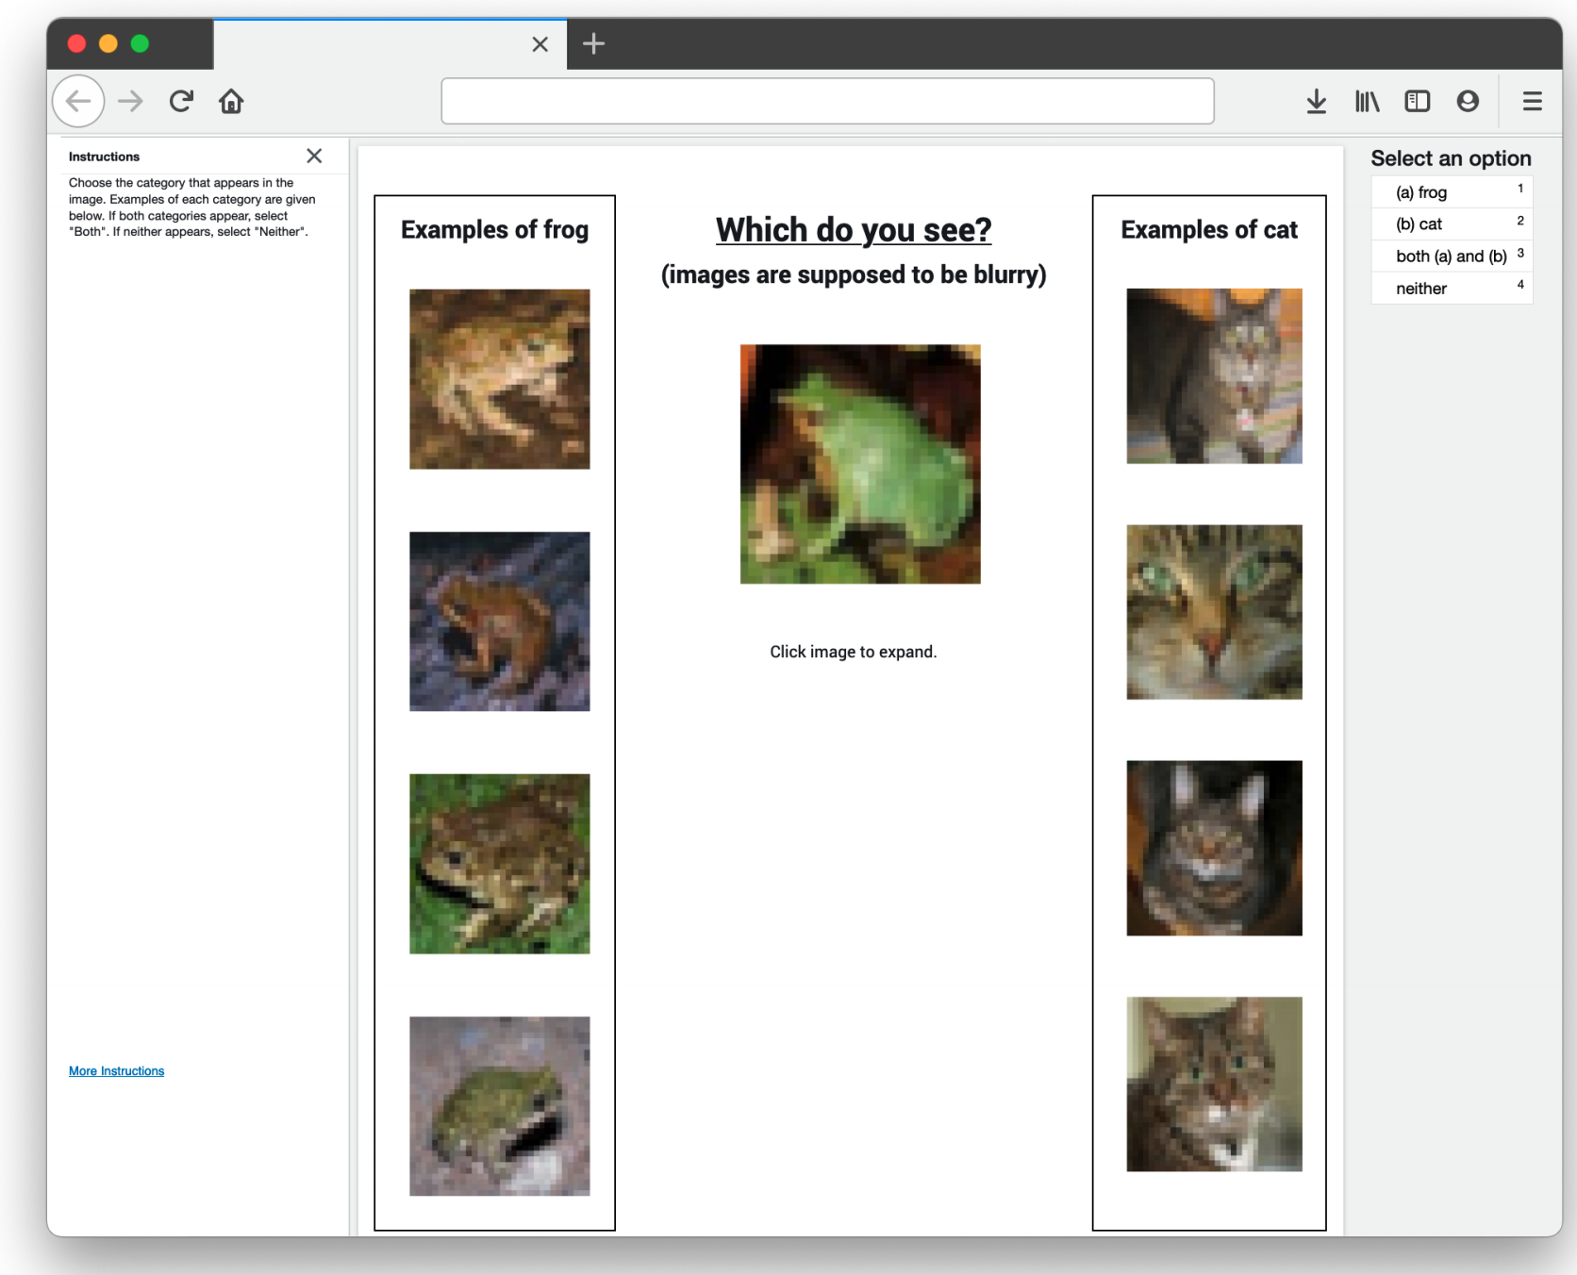
Correcting the test set

Slide 42
Correcting the test sets
Correct the label if a majority of reviewers:
agree on our proposed label
Do nothing if a majority of reviewers:
agree on the original label
Prune the example from the test set if the consensus is:
Neither
Both (multi-label)
Reviewers cannot agree

Slide 43
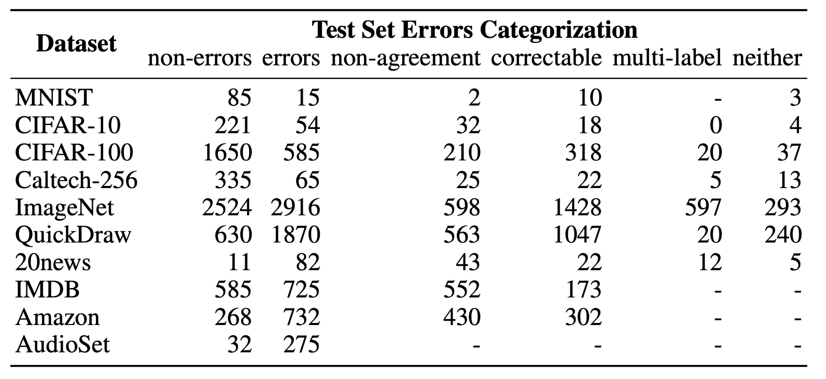
Test Set Errors Categorization
Remember our two questions? Now we have the tools (corrected test sets) to answer Q2:

Slide 44
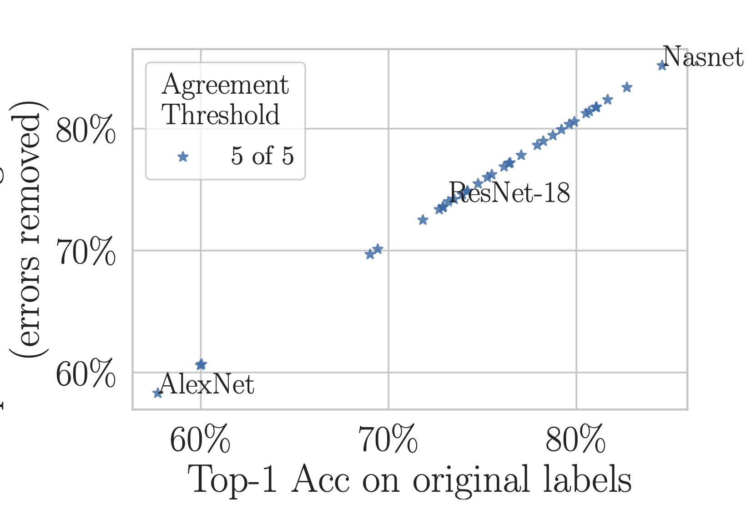
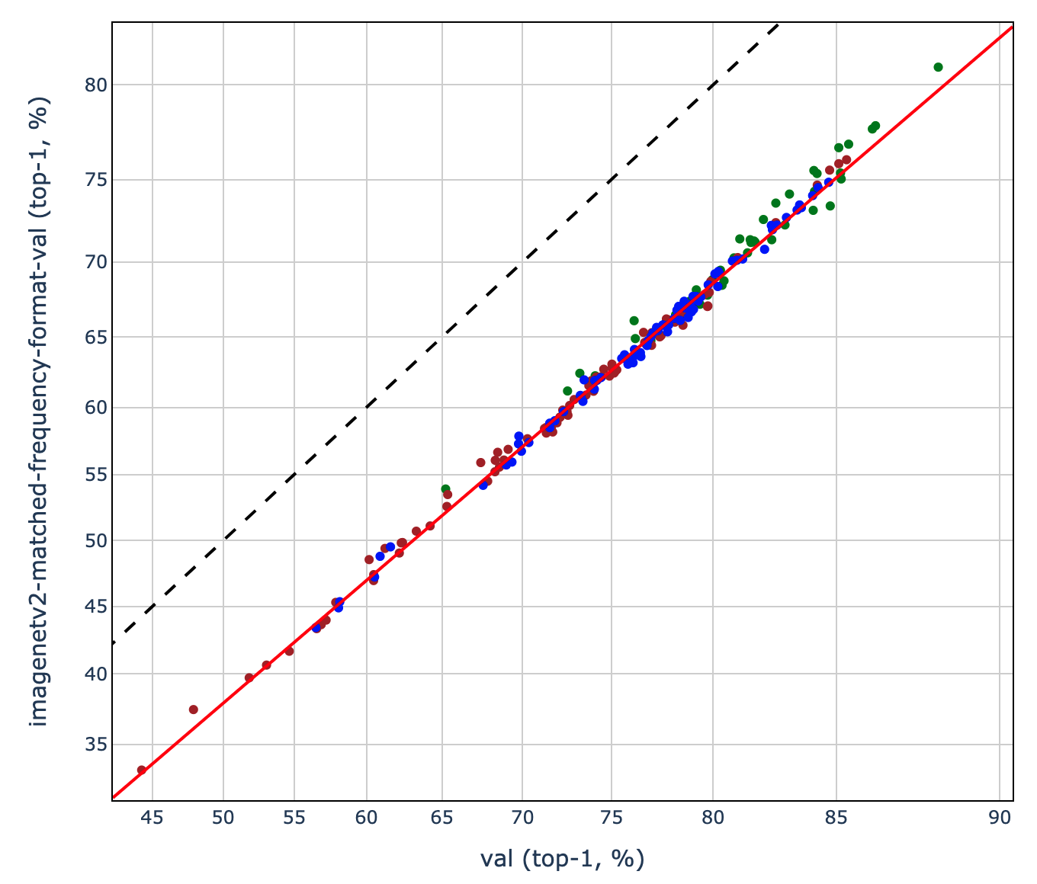
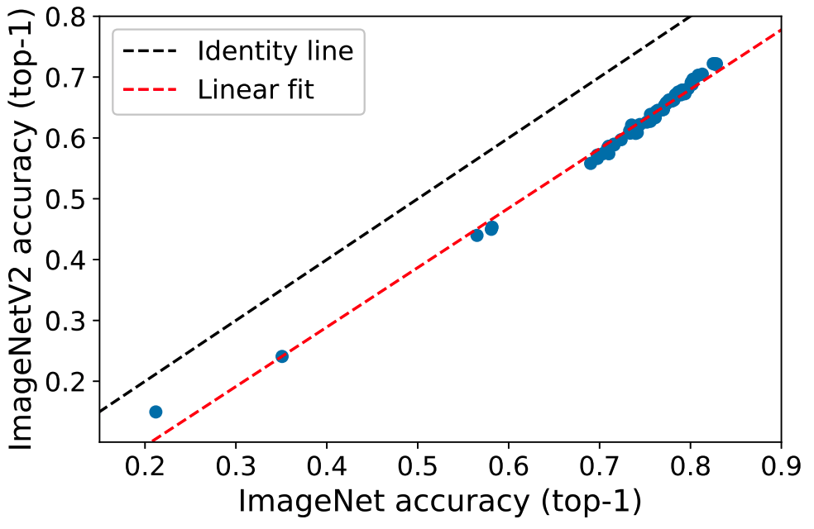
34 pre-trained black-box models on ImageNet
But what if instead of looking at the entire validation set, we compare performance on the (much smaller) subset of examples with corrected labels?
Pervasive Label Errors in Test Sets Destabilize Machine Learning Benchmarks
(Northcutt, Athalye, & Mueller 2021)
Measuring Robustness to Natural
Distribution Shifts in Image Classification
(Taori, Dave, Shankar, Carlini,
Recht, & Schmidt, 2021)
From ImageNet to Image Classification: Contextualizing Progress on Benchmarks
(Tsipras, Santurkar, Engstrom, Ilyas, Madry, 2020)
Do ImageNet classifiers generalize to ImageNet?
(Recht, Roelofs, Schmidt, & Shankar, 2019)
Why do classifier accuracies show linear trends under distribution shift?
(Mania & Sra, 2021)
Notes:
http://proceedings.mlr.press/v97/recht19a/recht19a.pdf
Do ImageNet Classifiers Generalize to ImageNet?
Benjamin Recht, Rebecca Roelofs, Ludwig Schmidt, Vaishaal Shankar
http://proceedings.mlr.press/v119/shankar20c/shankar20c.pdf

Slide 45
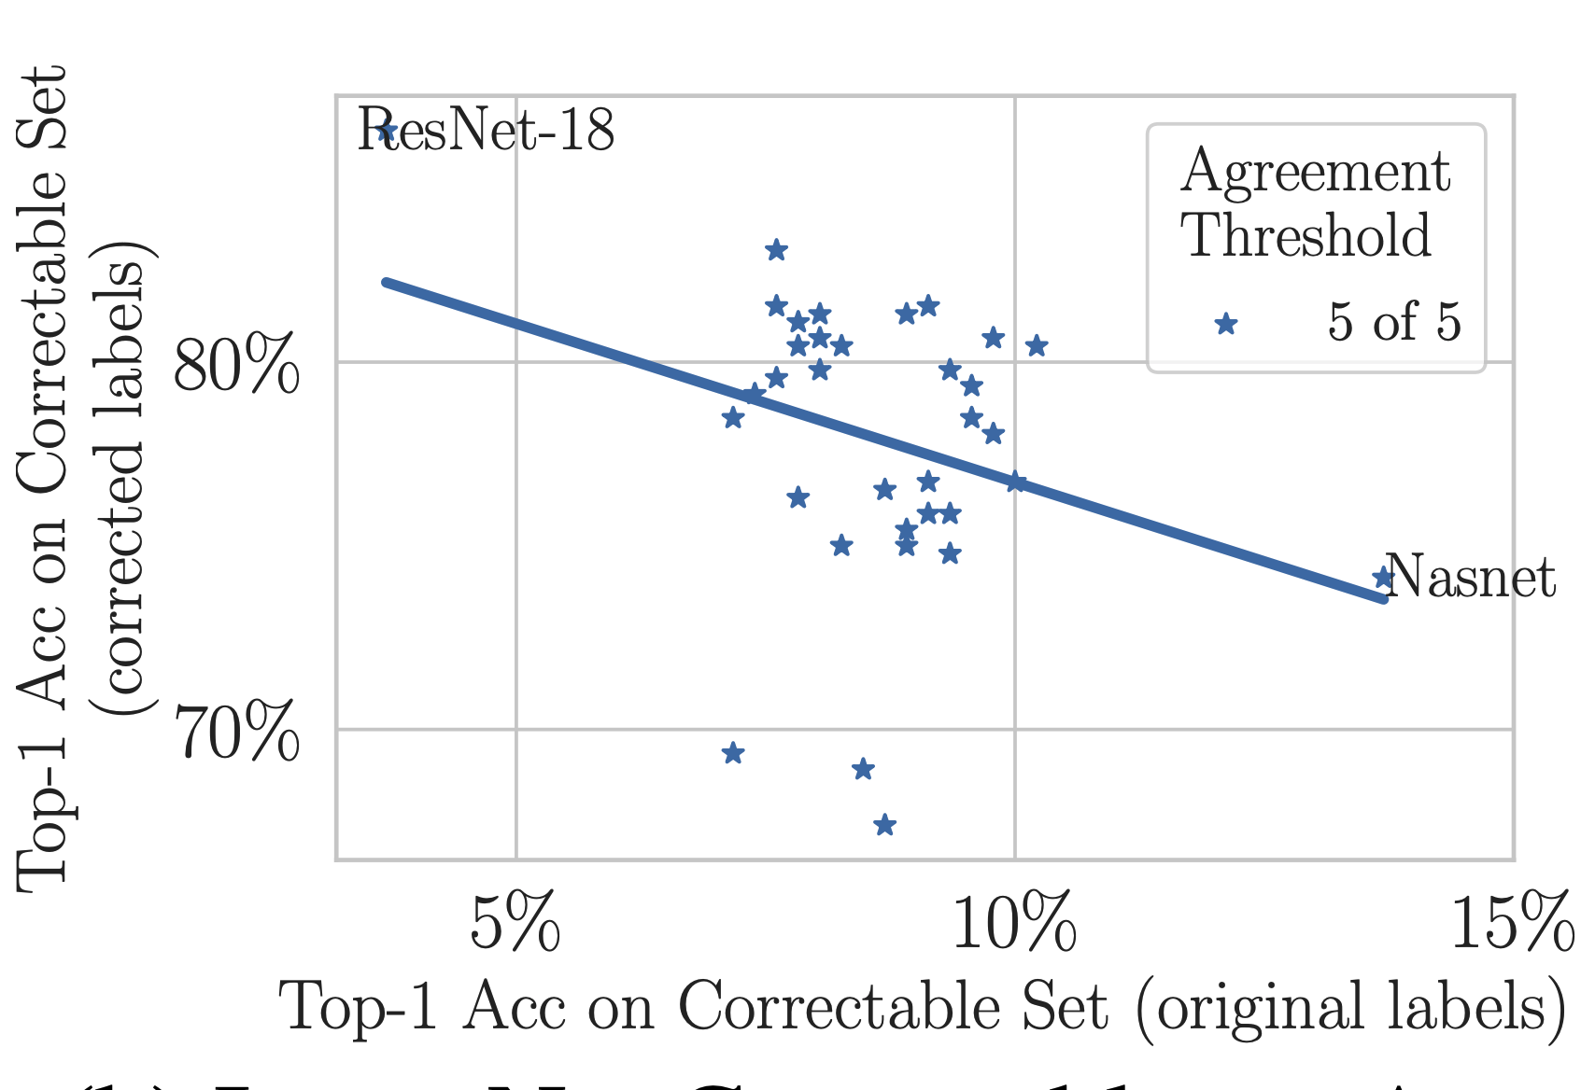
34 pre-trained black-box models on ImageNet
Is the result is specific to ImageNet?

Slide 46
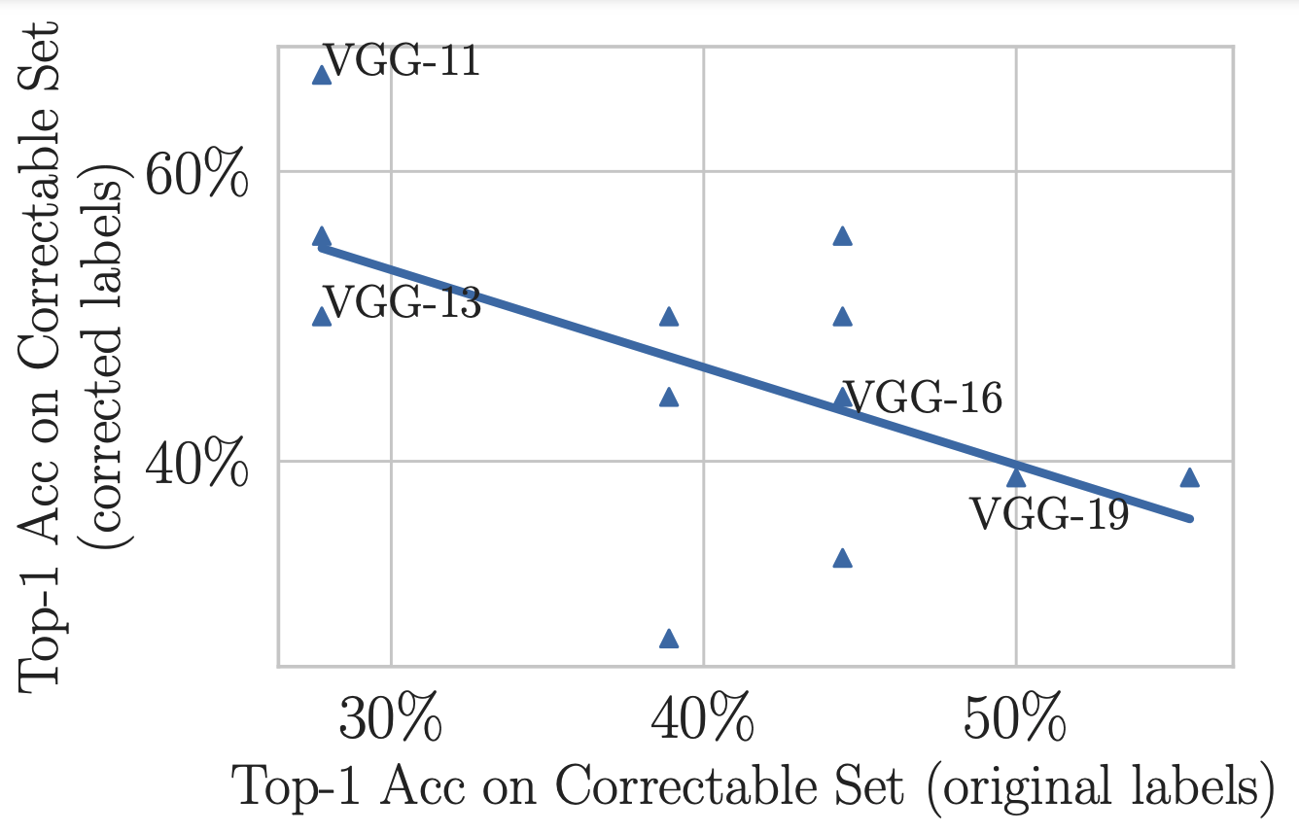
The same finding, this time on CIFAR-10

Slide 47
2.9% noise prevalence ~50k examples
100% noise prevalence
~1.5k examples
At what noise prevalence do the rankings start to change?

Slide 48
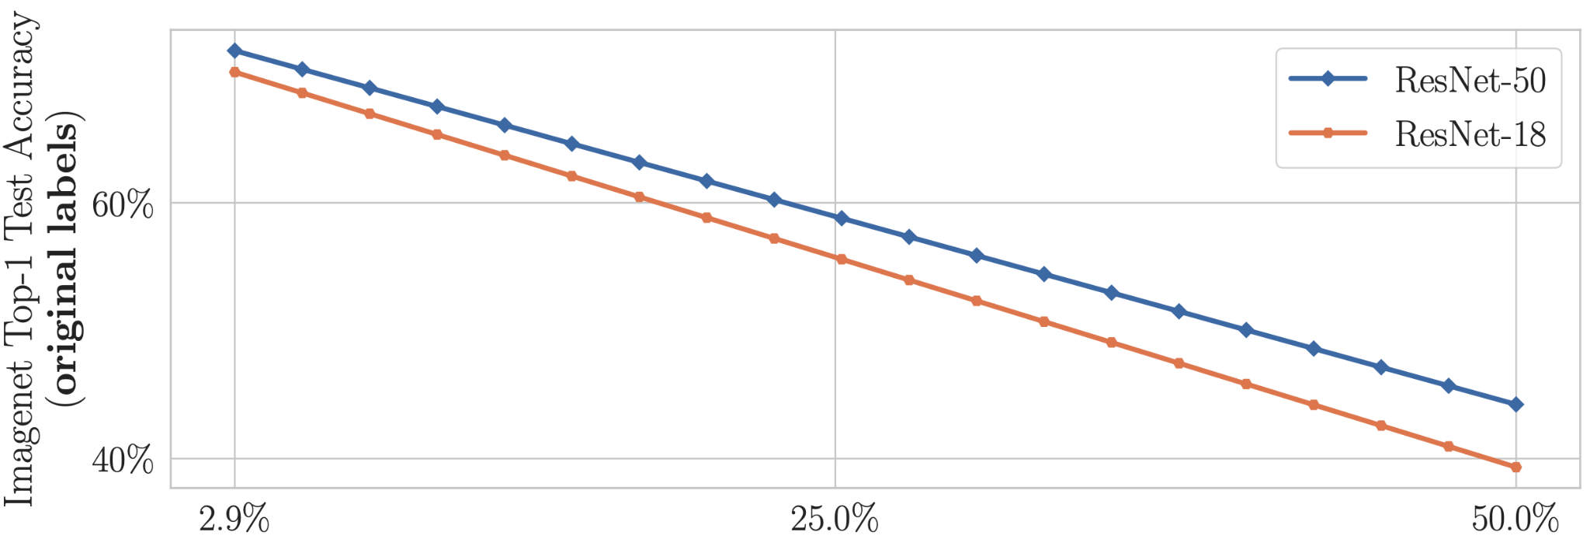
Two pre-trained ImageNet models tested on original (noisy) labels
What happens when we
correct the test labels?
Notes:
Explain how noise is increased on this slide (not later)
Interpolating toward the smaller subset
Define x axis at very beginning (context with suvrits work)

Slide 49
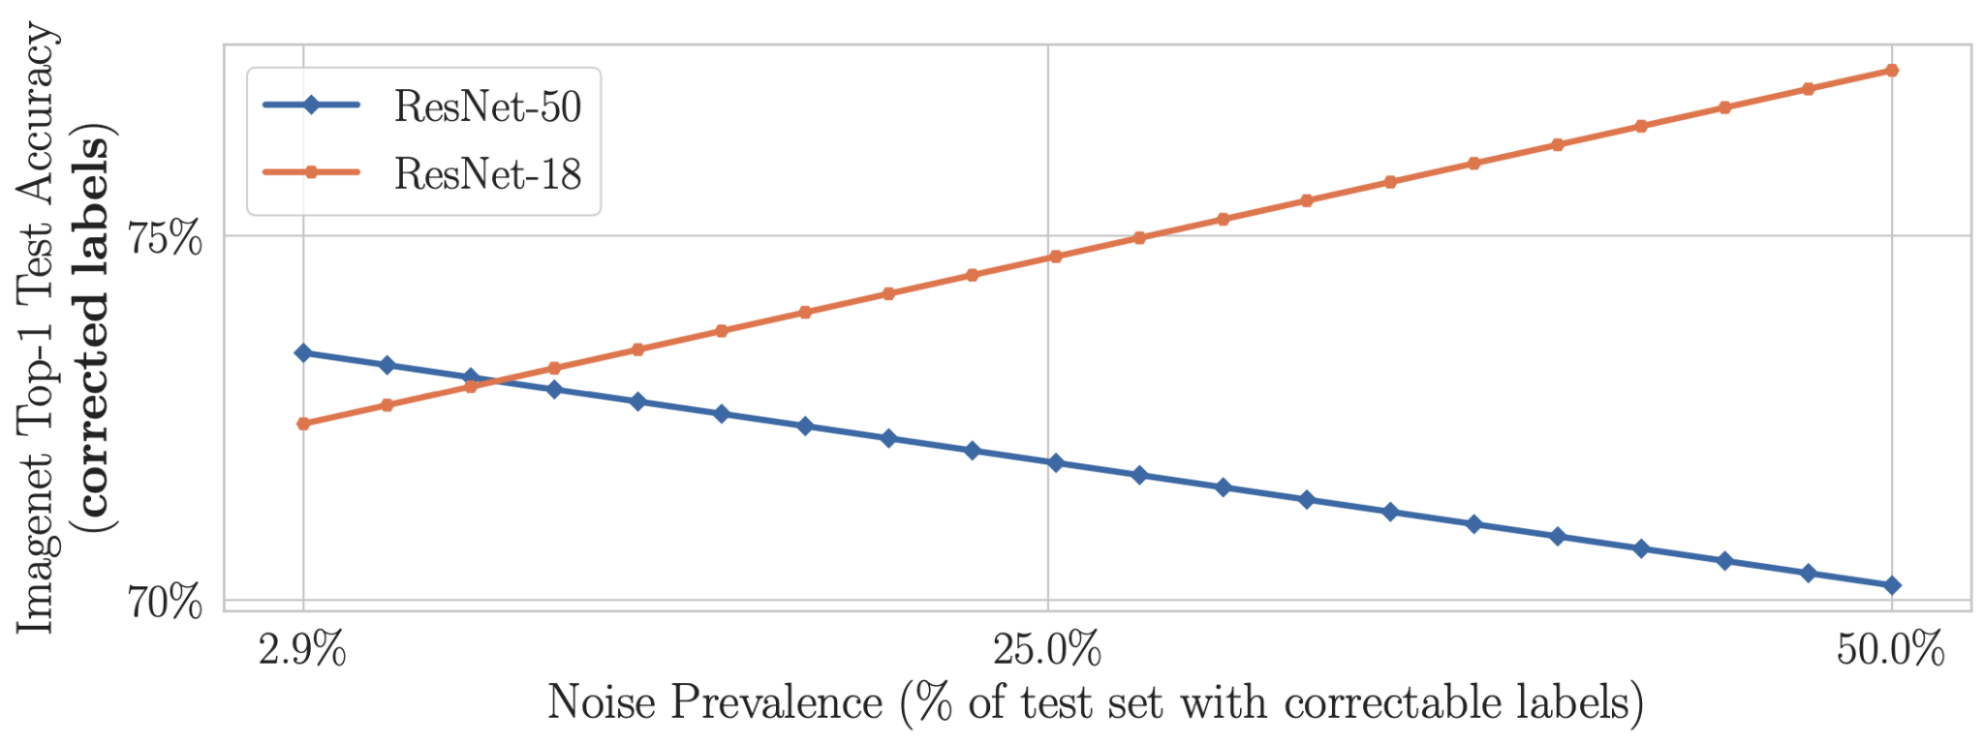
But when we correct the test set, benchmark rankings destabilize

Slide 50
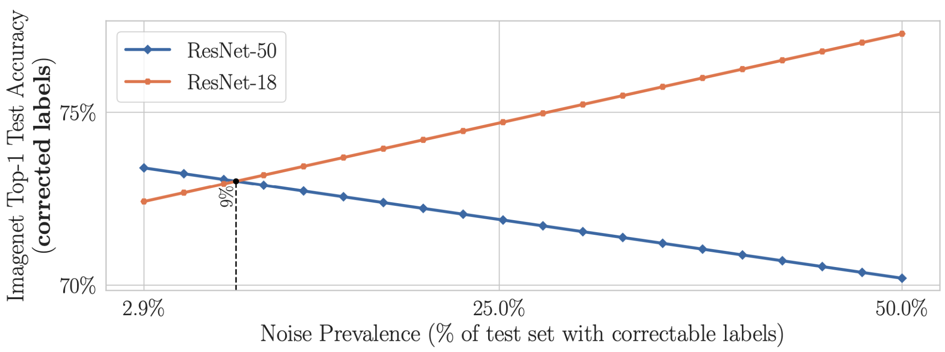
But when we correct the test set, benchmark rankings destabilize
Again we asked, is the result is specific to ImageNet?

Slide 51
Are practitioners unknowingly benchmarking ML using erroneous test sets?
Conclusions
Model rankings can change with just 6% increase in noise prevalence (even in these highly-curated test sets)
ML practitioners cannot know this unless they benchmark with corrected test set labels.
The fact that simple models regularize (reduce overfitting to label noise) is not surprising. (Li, Socher, & Hoi, 2020)
The surprise -- test sets are far noisier than the ML community thought (labelerrors.com)
An ML practitioner’s “best model” may underperform other models in real-world deployment.
For humans to deploy ML models with confidence -- noise in the test set must be quantified
confident learning addresses this problem with realistic sufficient conditions for finding label errors -- and we have shown its efficacy for ten of the most popular ML benchmark test sets.
Notes:
Real world deployment which can have dire consequences for self driving cars

Slide 52
Take a break for questions

Slide 53
Confident Learning + Generative AI
We’ll consider use cases for:
Image
Text

Slide 54
The ‘ins’ and ‘outs’ of Generative AI models
The ‘ins’
Generative AI model
Lots of data, containing
Errors
Bad labels
Outliers
Data shift
training
The ‘outs’
Generative AI model
Generated data, containing
Errors
Bad labels
Outliers
Data shift
Poor coverage
inference

Slide 55
The ‘ins’ and ‘outs’ of Generative AI models
The ‘ins’
Lots of data, containing
Errors
Bad labels
Outliers
Data shift
Generative AI model
Confident
Learning
Improved
data and
labels
training
The ‘outs’
Generative AI model
Generated data with
Errors
Bad labels
Outliers
Data shift
Poor coverage
Confident
Learning
Improved
data and
label outputs
generate/infer

Slide 56
Generative AI: Image (e.g. Dall-E, GPT-4)
For improving reliability in Image generation, ideally run confident learning on the data prior to training to avoid this issue we saw in the first lecture:

Slide 57
Generative AI: Image (e.g. Dall-E, GPT-4)
If you need to improve outputs from generative AI models, the key is to work backwards.
Let’s look at an example of a cat/dog generated dataset where we want to improve the reliability of our dataset, post generation.

Slide 58
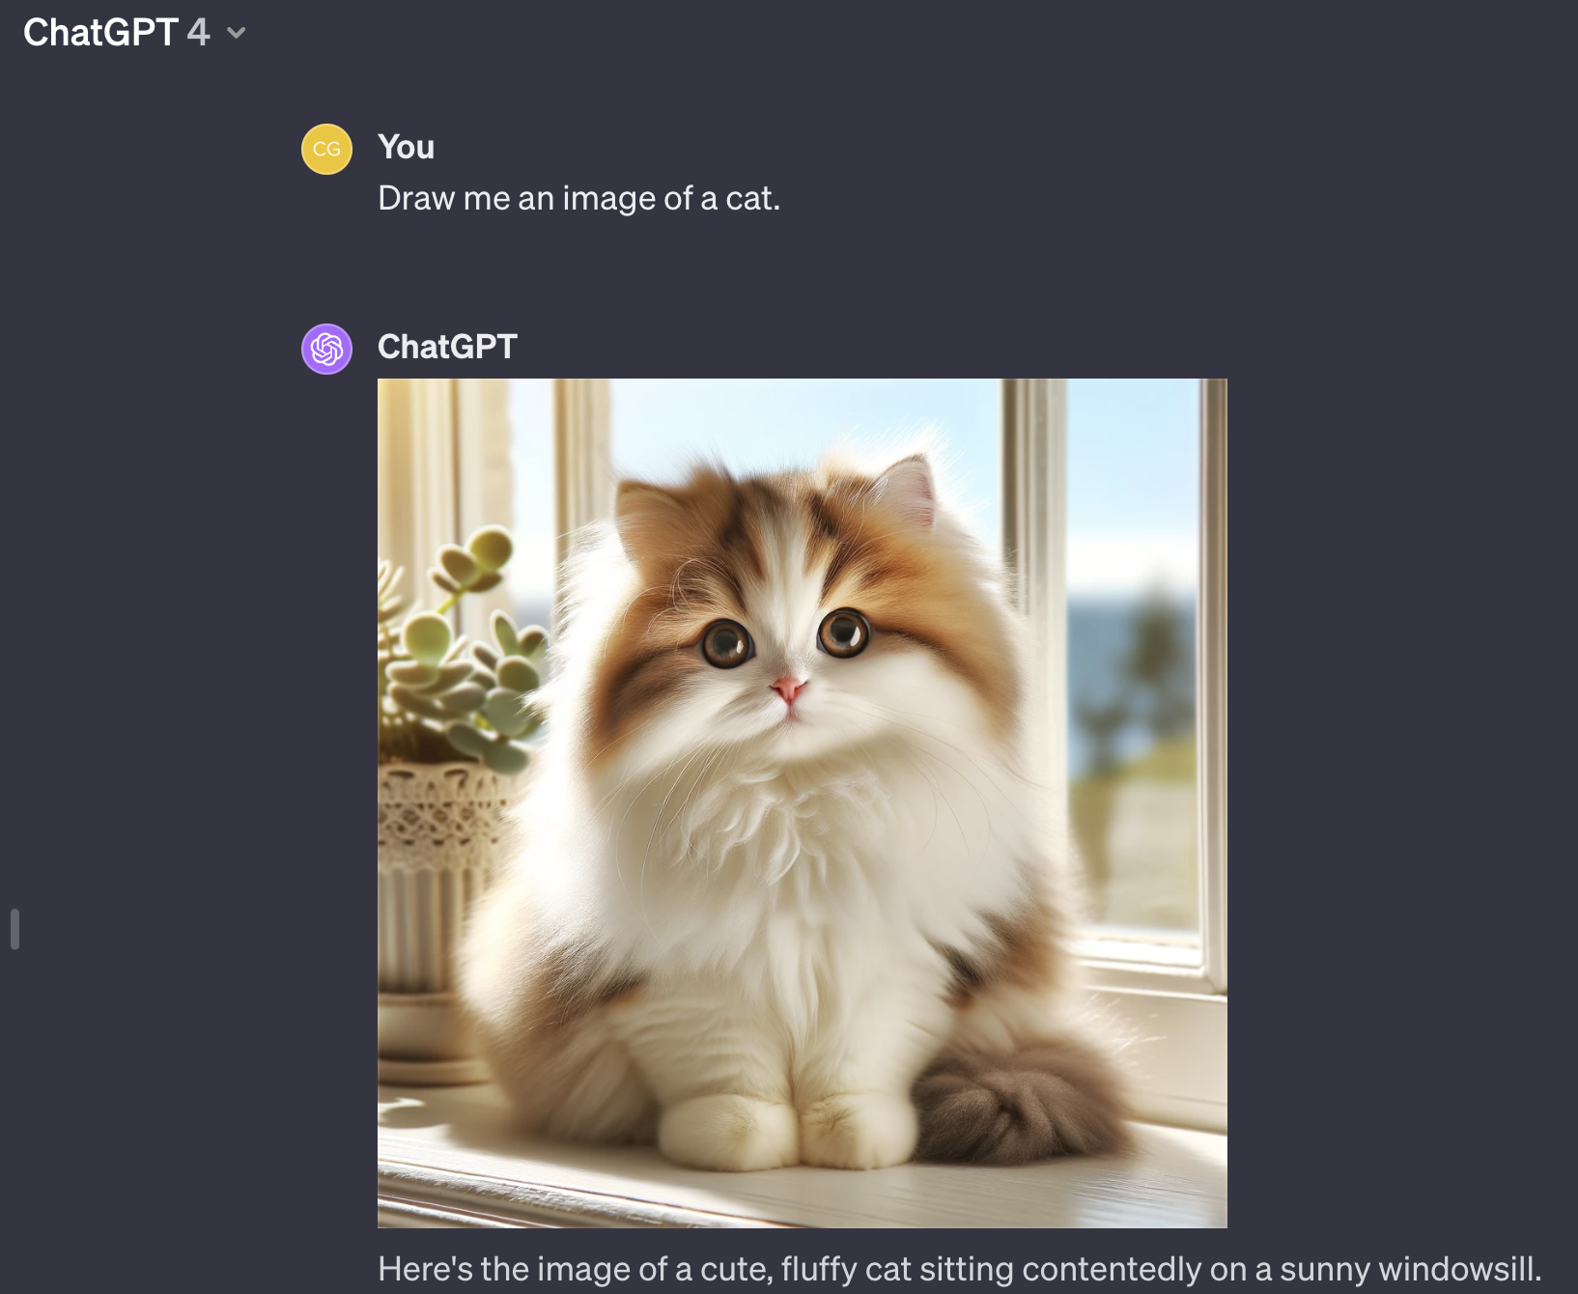
Generative AI: Image (e.g. Dall-E, GPT-4)

Slide 59
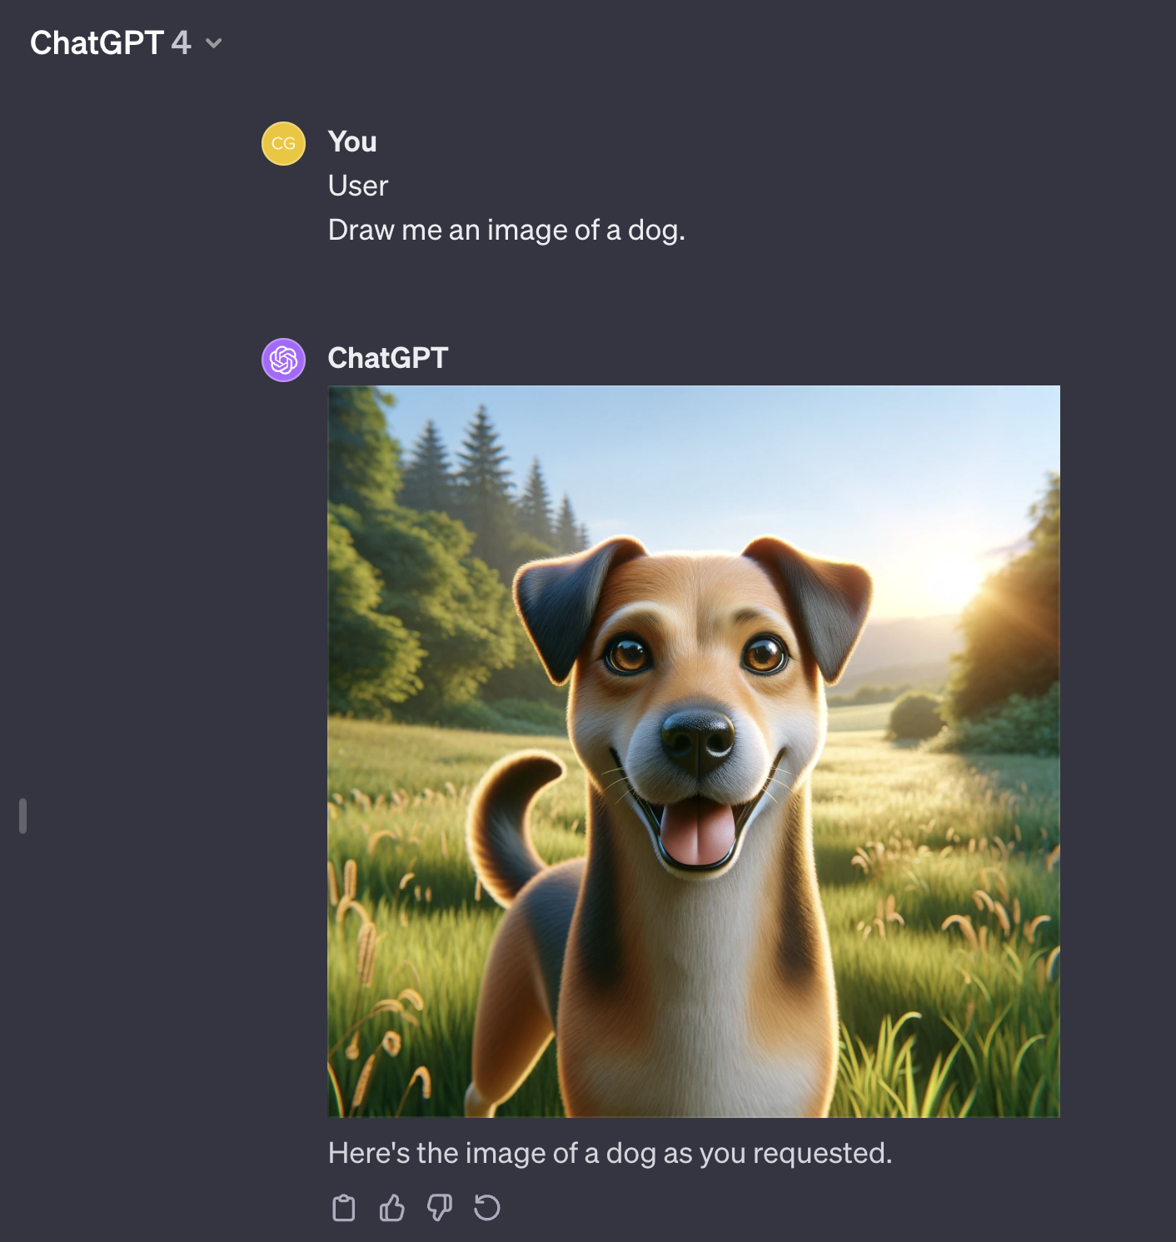
Generative AI: Image (e.g. Dall-E, GPT-4)

Slide 60
Improve dataset post generation
Steps:
Generate 1000 cats
Generate 1000 dogs
Run the 2000 images through confident learning with the labels (dog, cat) from generation time.
Auto-remove/fix errors
In practice, this doesn’t matter a lot for cat/dog images, but it does for more challenging images… Let’s look at one.

Slide 61
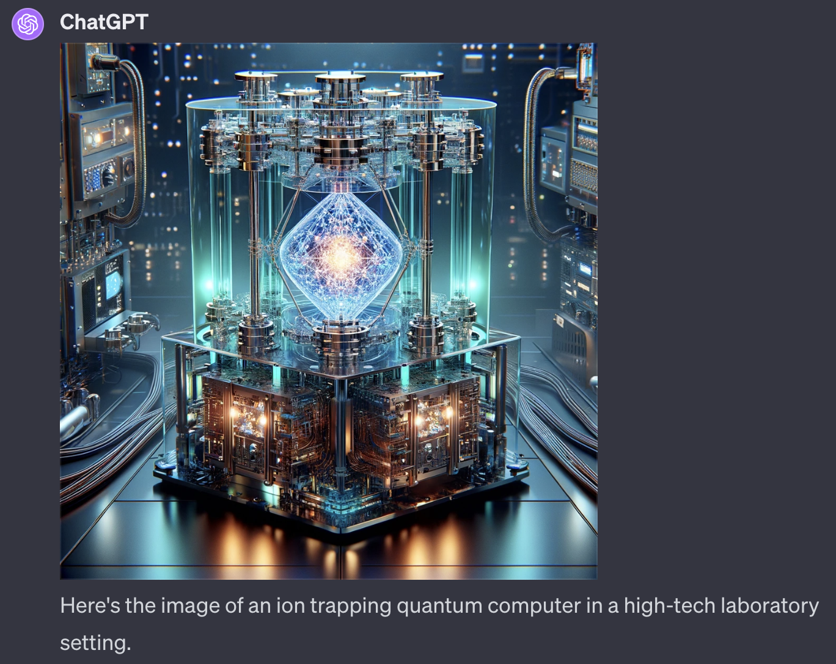
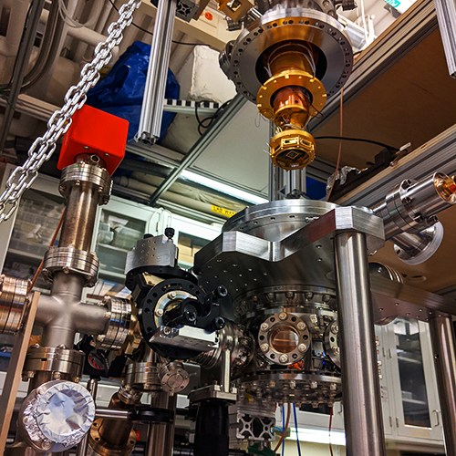
Improve image dataset – post generation
Actual ion trapping quantum computer (Ike Chuang lab, MIT)

Slide 62
Generative AI for Text (e.g. Large Language Models - LLMs)
The same concepts apply as with image. Preferably, improve the data with confident learning prior to training the language model.
In practice, you likely will download an open-source LLM from the internet with no way to retrain a massive 1B+ model yourself from scratch. So reliability/acc improvement will be on inference side.
We’ll consider two use cases:
LLM + RAG + CL
TLM

Slide 63
LLM + RAG + CL
What is RAG? Look up answers from a database using an LLM (retrieval augmented generation)
Steps:
Use LLM queries to find labels from an imperfect database (1000s of times)
Use CL to improve the resulting labels found

Slide 64
TLM (Trustworthy Language Model)
Goal: Generate a quality/confidence score for every output from a LLM
Demo: (in lecture)
Link.
Ref: (Chen & Mueller, 2023, arXiv)

Slide 65
THIS SLIDE
INTENTIONALLY LEFT BLANK

Slide 66
Find label errors in your own dataset (1 import + 1 line of code)
https://github.com/cleanlab/cleanlab

Slide 67
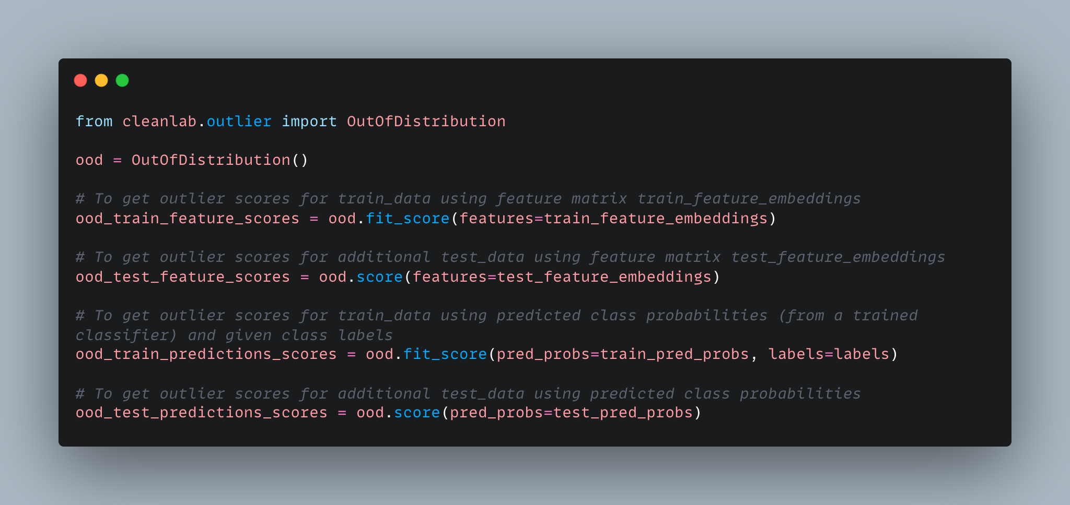
Find data errors in your own dataset (1 import + 1 line of code)
https://github.com/cleanlab/cleanlab

Slide 68
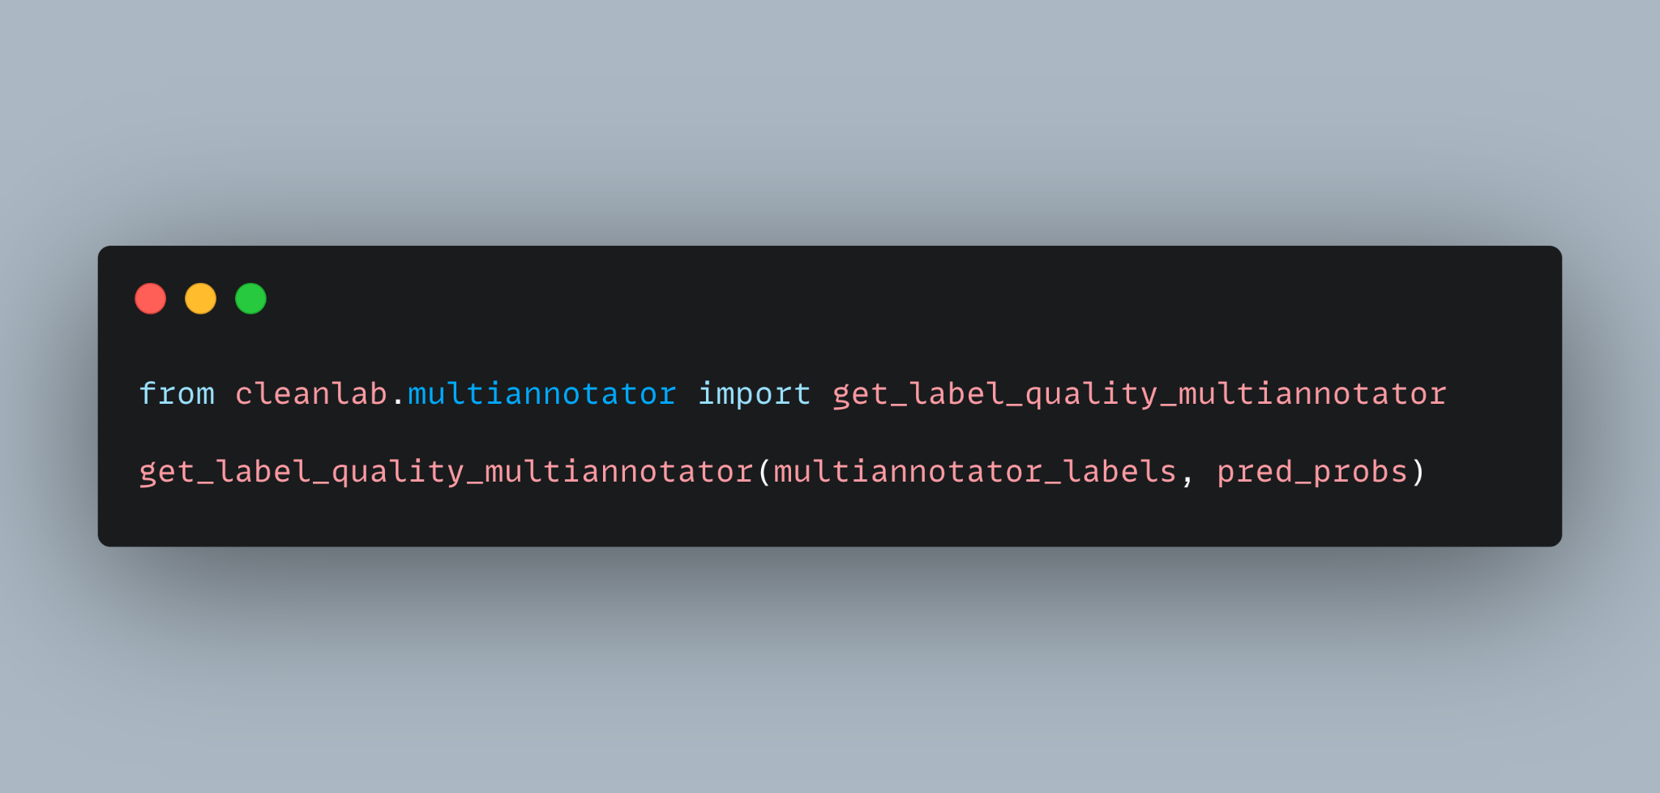
Find consensus labels for your dataset (1 import + 1 line of code)
https://github.com/cleanlab/cleanlab

