Slide 1
Data-centric Evaluation of ML Models
Lecture 3 - Dataset Curation

Slide 2
Most Machine Learning applications
Collect data and define the appropriate ML task
Explore data to see if it has problems
Preprocess data into a format suitable for ML modeling
Train a straightforward ML model that is expected to perform reasonably.
Notes:
Need to see a real-world result. Use color coded.

Slide 3
Most Machine Learning applications
Collect data and define the appropriate ML task
Explore data to see if it has problems
Preprocess data into a format suitable for ML modeling
Train a straightforward ML model that is expected to perform reasonably.
Investigate shortcomings of the model and the dataset
Notes:
Need to see a real-world result. Use color coded.

Slide 4
Most Machine Learning applications
Collect data and define the appropriate ML task
Explore data to see if it has problems
Preprocess data into a format suitable for ML modeling
Train a straightforward ML model that is expected to perform reasonably.
Investigate shortcomings of the model and the dataset
Improve dataset to address its shortcomings
Improve model (architecture changes, regularization, hyperparameter tuning, ensembling different models)
Deploy model and monitor subsequent data for new issues
Notes:
Need to see a real-world result. Use color coded.

Slide 5
Most Machine Learning applications
Collect data and define the appropriate ML task
Explore data to see if it has problems
Preprocess data into a format suitable for ML modeling
Train a straightforward ML model that is expected to perform reasonably.
Investigate shortcomings of the model and the dataset
Improve dataset to address its shortcomings
Improve model (architecture changes, regularization, hyperparameter tuning, ensembling different models)
Deploy model and monitor subsequent data for new issues
Notes:
Need to see a real-world result. Use color coded.

Slide 6
Topics of this lecture
Evaluation of ML models (a prerequisite for improving them)
Handling poor model performance for some particular subpopulation
Measuring the influence of individual datapoints on the model

Slide 7
Recap of Multi-class Classification
Given:

Slide 8
Recap of Multi-class Classification
Given:

Slide 9
Recap of Multi-class Classification
Given:

Slide 10
Key Assumptions

Slide 11
Evaluation of ML models
Loss function evaluates model predictions for a new example vs its given label
Loss may be function of:

Slide 12
Evaluation of ML models
Loss function evaluates model predictions for a new example vs its given label
Loss may be function of:
Examples of such classification losses: accuracy, balanced accuracy, precision, recall, …

Slide 13
Evaluation of ML models
Loss function evaluates model predictions for a new example vs its given label
Loss may be function of:
Examples of such classification losses: accuracy, balanced accuracy, precision, recall, …

Slide 14
Evaluation of ML models
Loss function evaluates model predictions for a new example vs its given label
Loss may be function of:
Examples of such classification losses: accuracy, balanced accuracy, precision, recall, …
Examples of such classification losses include: log loss, AUROC, calibration error,…

Slide 15
Reporting Model Performance
Not ideal to rely on a single score to summarize how good your model is overall
But what everybody does 🤷‍♂️

Slide 16
Reporting Model Performance
Not ideal to rely on a single score to summarize how good your model is overall
But what everybody does 🤷‍♂️
Typical score = average of over many examples held-out during training

Slide 17
Reporting Model Performance
Not ideal to rely on a single score to summarize how good your model is overall
But what everybody does 🤷‍♂️
Typical score = average of over many examples held-out during training
Alternatives:
Average Loss for examples from each class separately (eg. per-class accuracy)
Report complete confusion matrix

Slide 18
Think about HOW you will evaluate models
Invest as much as time thinking about this as:
what models to apply
how to improve them
Model evaluation has HUGE impact in real applications

Slide 19
Think about HOW you will evaluate models
Invest as much as time thinking about this as:
what models to apply
how to improve them
Model evaluation has HUGE impact in real applications
Consider Fraud vs Not-Fraud classification of credit card transactions
why not choose overall accuracy as the evaluation metric?

Slide 20
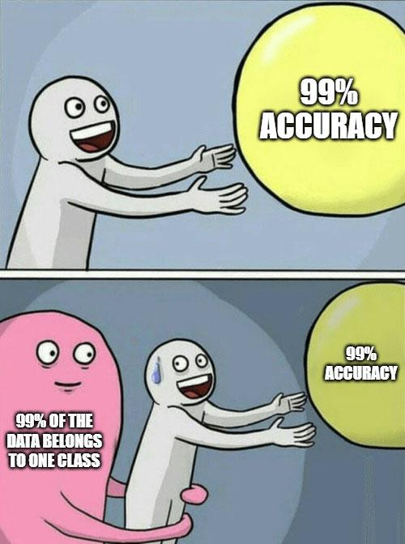
Think about HOW you will evaluate models
Invest as much as time thinking about this as:
what models to apply
how to improve them
Model evaluation has HUGE impact in real applications
Consider Fraud vs Not-Fraud classification of credit card transactions
why not choose overall accuracy as the evaluation metric?

Slide 21
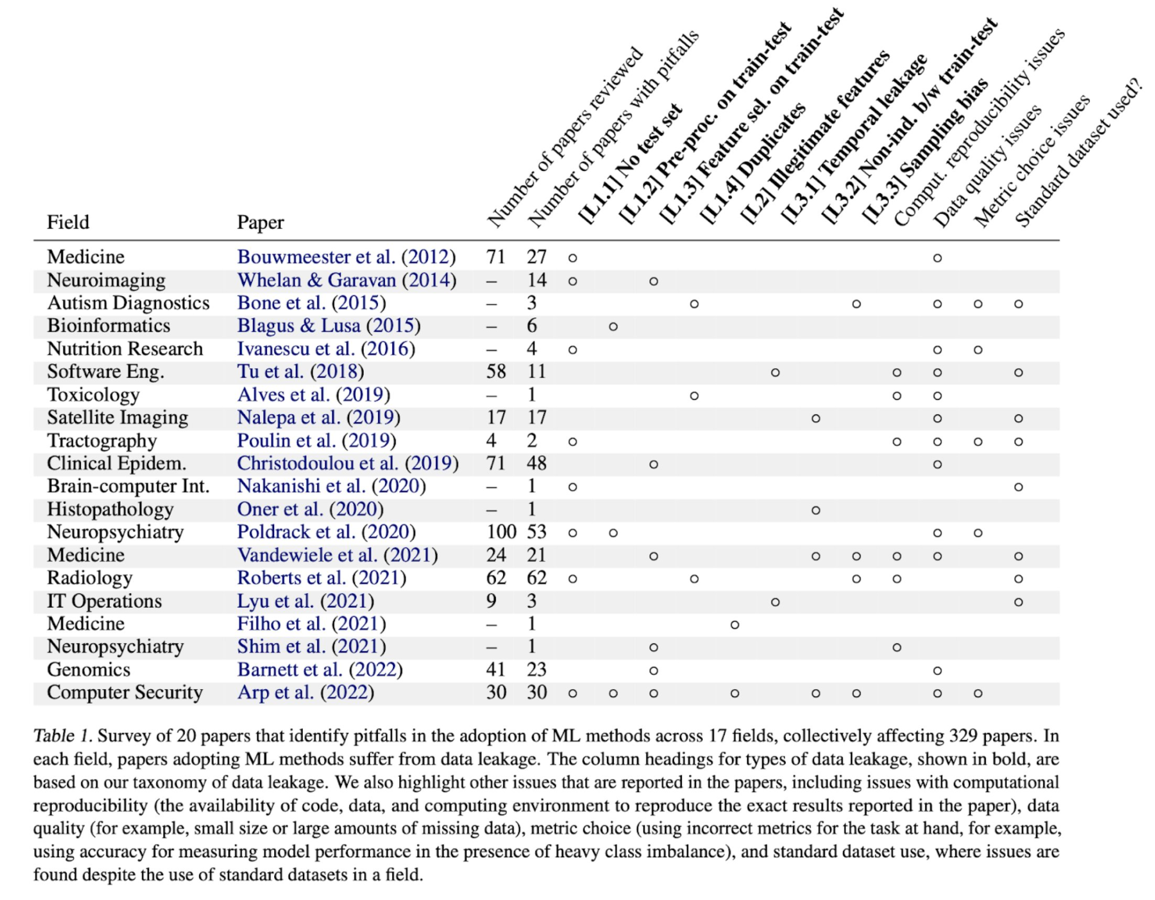
Common pitfalls when evaluating models
Failing to use truly held-out data (data leakage)

Slide 22
Common pitfalls when evaluating models
Failing to use truly held-out data (data leakage)
Reporting only average loss can under-represent severe failure cases for rare examples/subpopulations (misspecified metric)

Slide 23
Common pitfalls when evaluating models
Failing to use truly held-out data (data leakage)
Reporting only average loss can under-represent severe failure cases for rare examples/subpopulations (misspecified metric)
Validation data not representative of deployment setting (selection bias)
Some labels incorrect (annotation error)

Slide 24
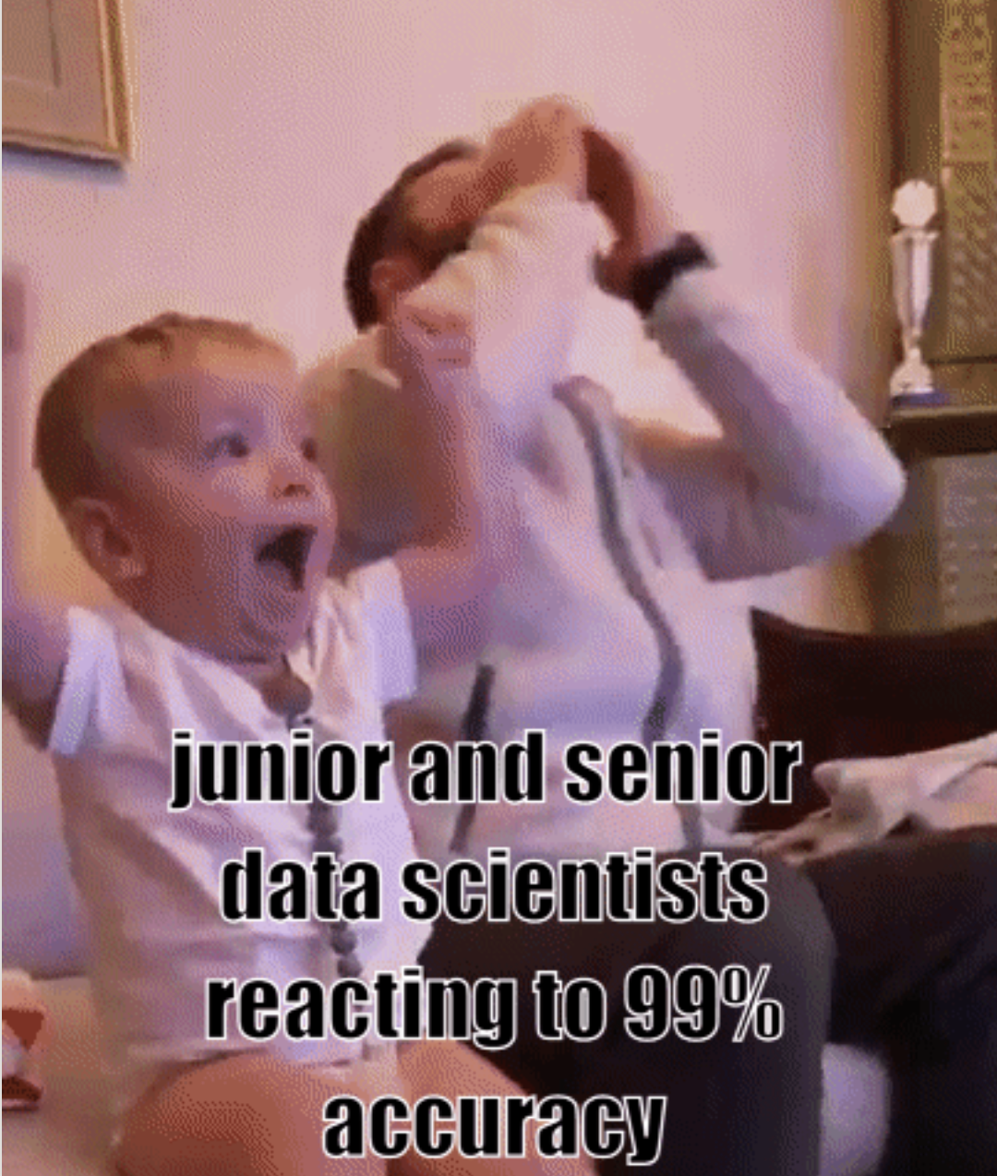
Common pitfalls when evaluating models

Slide 25
Aside: Evaluating Text Generation models
Human Eval: 👍 vs 👎 (or Likert scale 1-5)
‘vibes’

Slide 26
Aside: Evaluating Text Generation models
Human Eval: 👍 vs 👎 (or Likert scale 1-5)
‘vibes’
AI (LLM) Eval: 👍 vs 👎 (or Likert scale 1-5)
Can give evaluator multiple binary criteria to assess

Slide 27
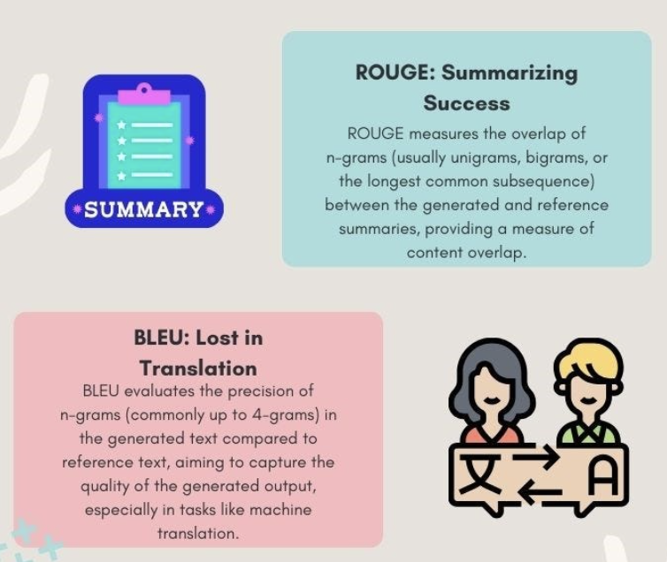
Aside: Evaluating Text Generation models
Human Eval: 👍 vs 👎 (or Likert scale 1-5)
‘vibes’
AI (LLM) Eval: 👍 vs 👎 (or Likert scale 1-5)
Can give evaluator multiple binary criteria to assess
Text similarity with target response (word overlap, ROUGE, BLEU)
LLM likelihood of target response: Perplexity

Slide 28
Aside: Evaluating Text Generation models
Human Eval: 👍 vs 👎 (or Likert scale 1-5)
‘vibes’
AI (LLM) Eval: 👍 vs 👎 (or Likert scale 1-5)
Can give evaluator multiple binary criteria to assess
Text similarity with target response (word overlap, ROUGE, BLEU)
LLM likelihood of target response: Perplexity
Challenge: Eval data seen during pre-training? (data leakage)

Slide 29
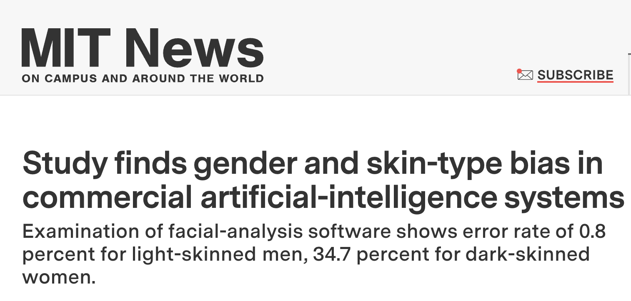
Underperforming Subpopulations

Slide 30
Underperforming Subpopulations
data slice = a subset of the dataset that shares a common characteristic
cohorts, subpopulation, or subgroup
Examples:
data captured via: one sensor vs another, one location vs another

Slide 31
Underperforming Subpopulations
data slice = a subset of the dataset that shares a common characteristic
cohorts, subpopulation, or subgroup
Examples:
data captured via: one sensor vs another, one location vs another
factors in human-centric data like:
race, gender, socioeconomics, age, …

Slide 32
Underperforming Subpopulations
data slice = a subset of the dataset that shares a common characteristic
cohorts, subpopulation, or subgroup
Examples:
data captured via: one sensor vs another, one location vs another
factors in human-centric data like:
race, gender, socioeconomics, age, …
Model predictions should not depend on which slice a datapoint belongs to
Can we just deleting slice information from our feature values before model training?

Slide 33
Underperforming Subpopulations
data slice = a subset of the dataset that shares a common characteristic
cohorts, subpopulation, or subgroup
Examples:
data captured via: one sensor vs another, one location vs another
factors in human-centric data like:
race, gender, socioeconomics, age, …
Model predictions should not depend on which slice a datapoint belongs to
Can we just deleting slice information from our feature values before model training? NO slice information can be correlated with other feature values still being used as predictors

Slide 34
Improve model performance for a particular slice
Try a more flexible ML model that has higher fitting capacity
Slice
Binary classification Dataset (red v blue)
Neural Net Model
Linear Model

Slide 35
Improve model performance for a particular slice
2. Over-sample (up-weight) examples from minority subgroup that is receiving poor predictions

Slide 36
Improve model performance for a particular slice
3. Collect additional data from the subgroup with poor performance To see if this has promise:
Re-fit model to many versions of dataset with this subgroup down-subsampled to varying degrees
Extrapolate the resulting model performance (overall and for subgroup) expected if you had more data from this subgroup

Slide 37
Improve model performance for a particular slice
4. Measure or engineer extra features that allow model to perform better for slice

Slide 38
Improve model performance for a particular slice
4. Measure or engineer extra features that allow model to perform better for slice Example: Classifying if customer will purchase some product or not, based on customer & product features
Predictions for young customers may be worse (less available history)

Slide 39
Improve model performance for a particular slice
4. Measure or engineer extra features that allow model to perform better for slice Example: Classifying if customer will purchase some product or not, based on customer & product features
Predictions for young customers may be worse (less available history)
Could add an extra feature to the dataset such as: “Popularity of this product among young customers”

Slide 40
Discovering underperforming subpopulations

Slide 41
Discovering underperforming subpopulations
Sort examples in the validation data by their loss value, and look at the examples with high loss for which your model is making the worst predictions (Error Analysis)
Apply clustering to these examples with high loss to uncover clusters that share common themes amongst these examples

Slide 42
Discovering underperforming subpopulations

Slide 43
Why did my model get a particular prediction wrong?
Given label is incorrect (and our model actually made the right prediction) Recommended action: Correct the label

Slide 44
Why did my model get a particular prediction wrong?
Given label is incorrect (and our model actually made the right prediction) Recommended action: Correct the label
Example does not belong to any of the K classes (or is fundamentally not predictable, e.g. a blurry image) Recommended actions:
Toss this example from dataset
Consider adding an “Other” class if many such examples

Slide 45
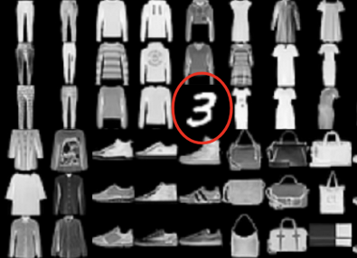
Why did my model get a particular prediction wrong?
3. Example is an outlier (no similar examples in the training data)
Recommended Actions:
??

Slide 46
Why did my model get a particular prediction wrong?
3. Example is an outlier (no similar examples in the training data)
Recommended Actions:
Toss example if similar examples would never be seen in deployment.

Slide 47
Why did my model get a particular prediction wrong?
3. Example is an outlier (no similar examples in the training data)
Recommended Actions:
Toss example if similar examples would never be seen in deployment.
Otherwise collect additional training data that looks similar if you can.

Slide 48
Why did my model get a particular prediction wrong?
3. Example is an outlier (no similar examples in the training data)
Recommended Actions:
Toss example if similar examples would never be seen in deployment.
Otherwise collect additional training data that looks similar if you can.
Otherwise apply data transformation to make outliers’ features more similar to other examples (eg. normalization of numeric feature, deleting a feature).

Slide 49
Why did my model get a particular prediction wrong?
3. Example is an outlier (no similar examples in the training data)
Recommended Actions:
Toss example if similar examples would never be seen in deployment.
Otherwise collect additional training data that looks similar if you can.
Otherwise apply data transformation to make outliers’ features more similar to other examples (eg. normalization of numeric feature, deleting a feature).
Can add synthetic data (Data Augmentation) so model becomes invariant to difference that makes this outlier stand out from other examples.

Slide 50
Why did my model get a particular prediction wrong?
3. Example is an outlier (no similar examples in the training data)
Recommended action if this example is important:
Up-weight it or duplicate it multiple times (perhaps with slight variants of its feature values)

Slide 51
Why did my model get a particular prediction wrong?
4. Type of model you’re using is suboptimal for such examples

Slide 52
Why did my model get a particular prediction wrong?
4. Type of model you’re using is suboptimal for such examples
To diagnose:
up-weight similar examples or duplicate them many times in dataset
retrain model
see if new model can classify this example correctly

Slide 53
Why did my model get a particular prediction wrong?
4. Type of model you’re using is suboptimal for such examples
To diagnose:
up-weight similar examples or duplicate them many times in dataset
retrain model
see if new model can classify this example correctly
Recommended Actions (model-centric > data-centric in this case):
fit different types of models
hyperparameter tuning
feature engineering

Slide 54
Why did my model get a particular prediction wrong?
5. Dataset has other examples with (nearly) identical features but different label

Slide 55
Why did my model get a particular prediction wrong?
5. Dataset has other examples with (nearly) identical features but different label Recommended Actions:
Define classes more distinctly
Measure extra features to enrich the data

Slide 56
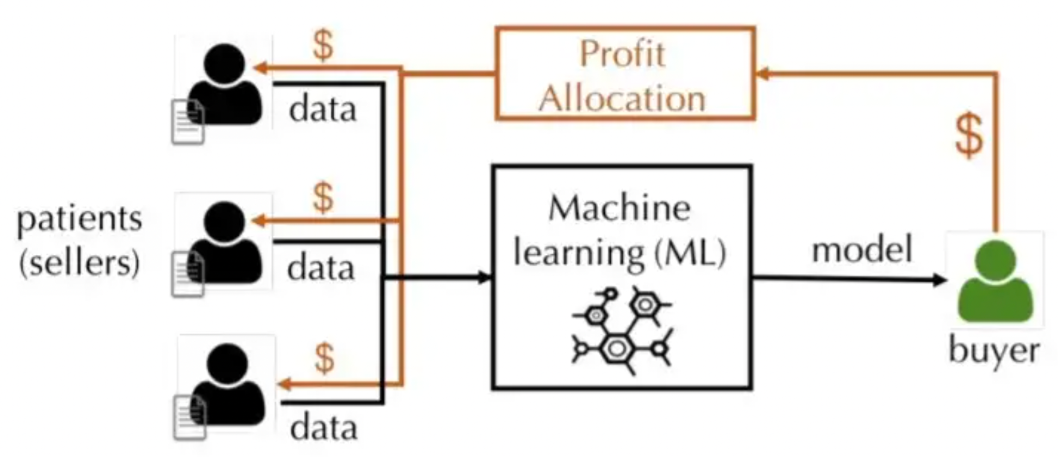
Influence of individual datapoints on the model

Slide 57
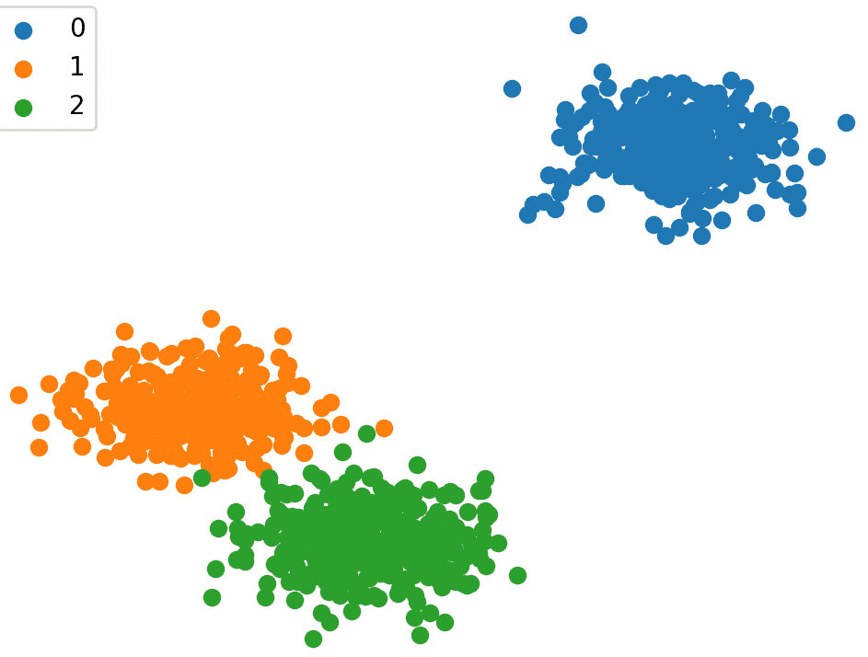
Leave-one-out Influence
How would model change if retrained after omitting datapoint (x, y) from dataset?
Trained Model has 98.5% validation accuracy

Slide 58
Leave-one-out Influence
How would model change if retrained after omitting datapoint (x, y) from dataset?
Trained Model has 98.5% validation accuracy
Trained Model has 98.3% validation accuracy

Slide 59
Leave-one-out Influence (LOO)
How would model change if retrained after omitting datapoint (x, y) from dataset?
Impact = 0.2%
Trained Model has 98.5% validation accuracy
Trained Model has 98.3% validation accuracy

Slide 60
Data Shapely
Compute LOO influence of datapoint (x, y) in a subset of the dataset that contains (x, y). Then average these values over all such possible subsets.

Slide 61
Data Shapely
Compute LOO influence of datapoint (x, y) in a subset of the dataset that contains (x, y). Then average these values over all such possible subsets. Example: Suppose there are two identical datapoints in dataset and omitting both severely harms model accuracy but omitting one does not.

Slide 62
Data Shapely
Compute LOO influence of datapoint (x, y) in a subset of the dataset that contains (x, y). Then average these values over all such possible subsets. Example: Suppose there are two identical datapoints in dataset and omitting both severely harms model accuracy but omitting one does not. LOO Influence: ?? Data Shapely: ??

Slide 63
Data Shapely
Compute LOO influence of datapoint (x, y) in a subset of the dataset that contains (x, y). Then average these values over all such possible subsets. Example: Suppose there are two identical datapoints in dataset and omitting both severely harms model accuracy but omitting one does not. LOO Influence: neither datapoint is too influential Data Shapely: both are fairly influential

Slide 64
Approximating Influence via Monte Carlo

Slide 65
Approximating Influence via Monte Carlo

Slide 66
Approximating Influence via Monte Carlo

Slide 67
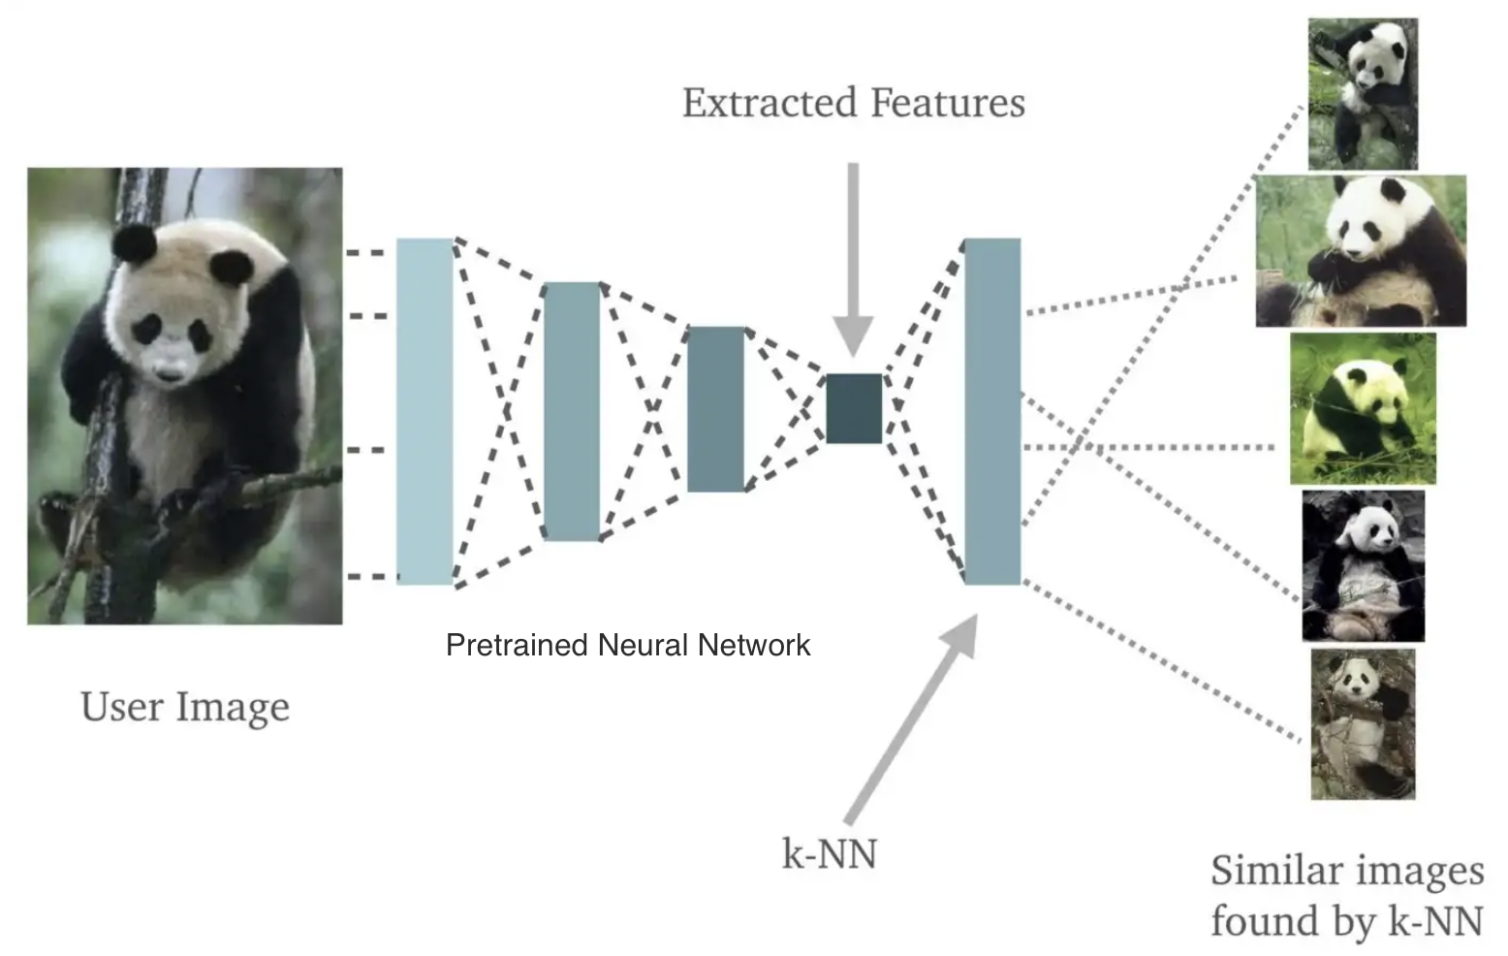
Closed-form Computation of Influence
Can be done in regression (mean-squared-error loss) with linear regression model
Called Cook’s Distance
Can be done for K-Nearest Neighbors classifier
in O(n logn) time

Slide 68
Reviewing Influential Samples
Influence reveals which data points have greatest impact on the model.
Correcting a mislabeled datapoint with high influence can boost model accuracy more than correcting a mislabeled datapoint with low influence

Slide 69
Reviewing Influential Samples
Influence reveals which datapoints have greatest impact on the model.
Correcting a mislabeled datapoint with high influence can boost model accuracy more than correcting a mislabeled datapoint with low influence
Finding mislabeled data may be hard sorting only by influence instead of using confident learning as well

