Slide 1
Lecture 3 - Dataset Creation
and Curation
Lecture 3 - Dataset Curation

Slide 2
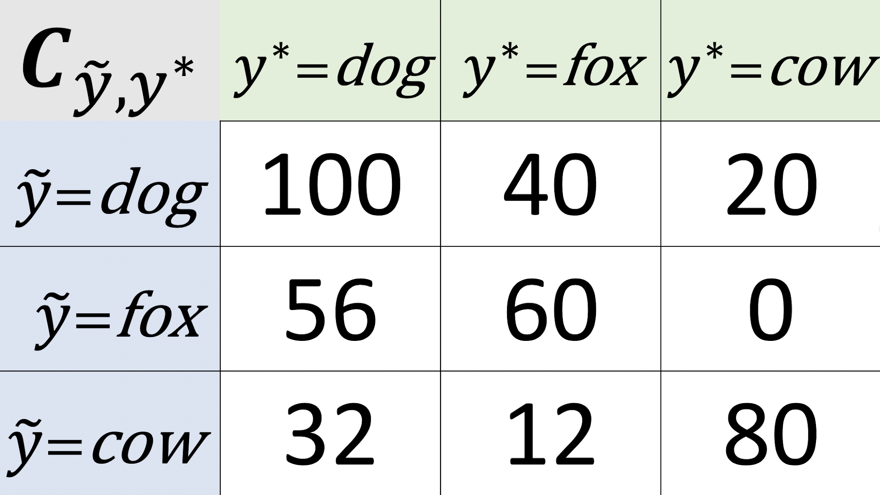
After looking through the entire dataset, we have:
Notes:
Need to see a real-world result. Use color coded.

Slide 3
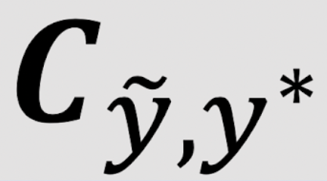
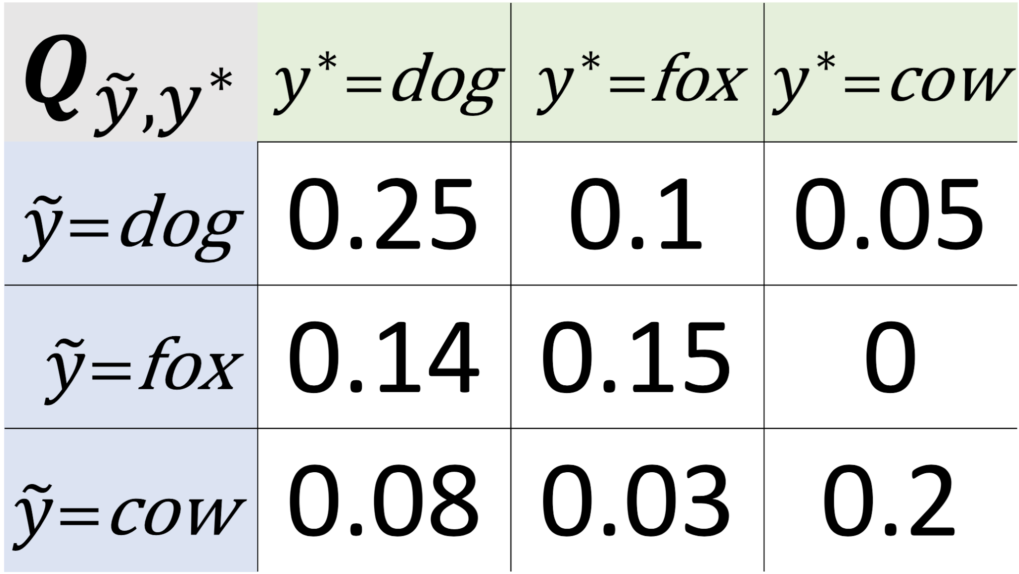
From we obtain the joint distribution of label noise
Estimated
Notes:
estimate

Slide 4
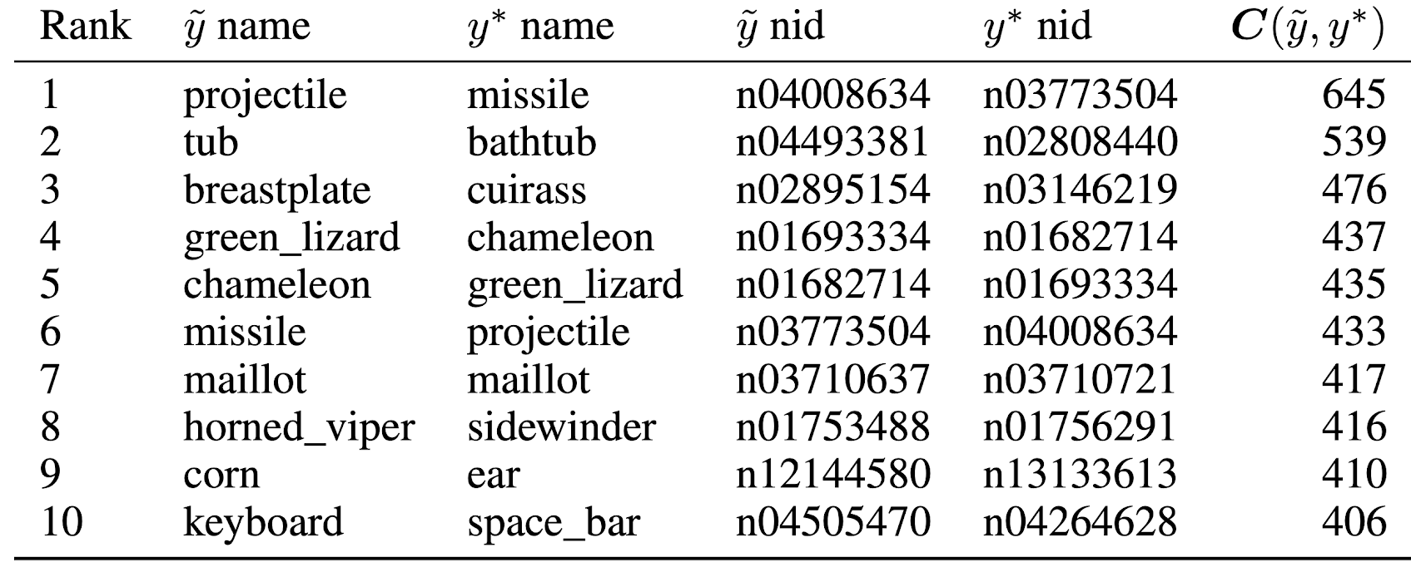
Dataset Curation: ImageNet Train Set
The largest off-diagonals of
reveal ontological issues. Note the (is a) and (has a) relationships
is a
is a
is a
Does this also work for val/test sets?

Slide 5
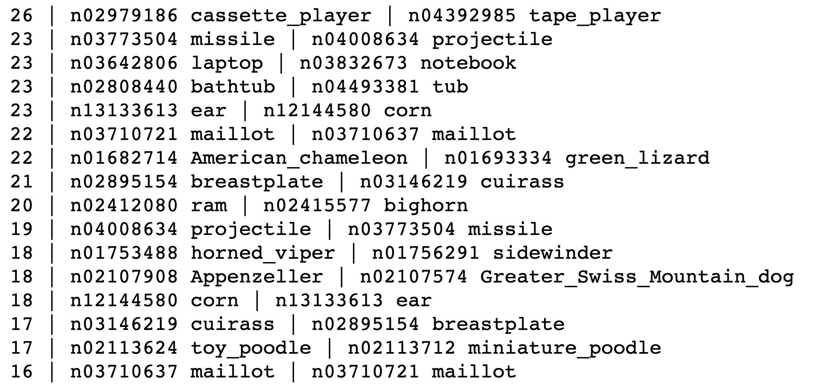
Dataset Curation: ImageNet Val Set

Slide 6
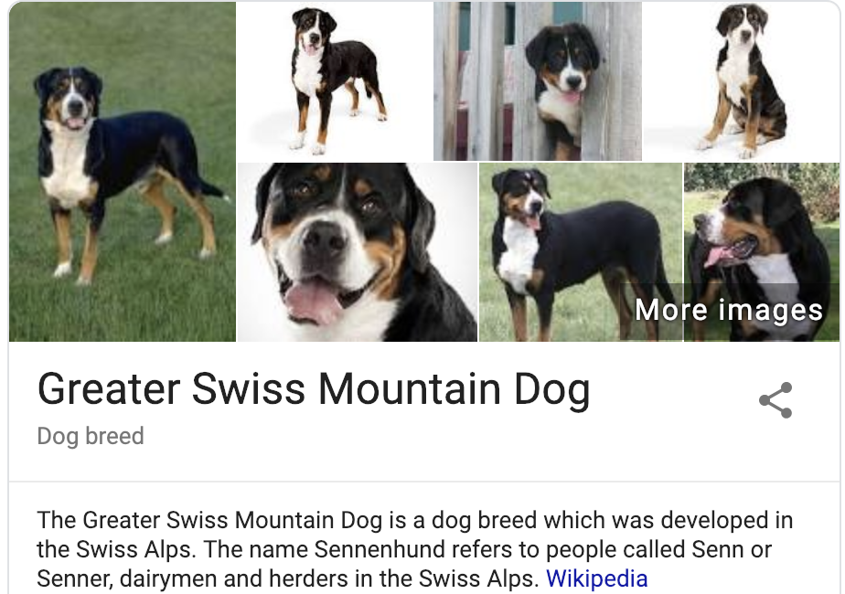
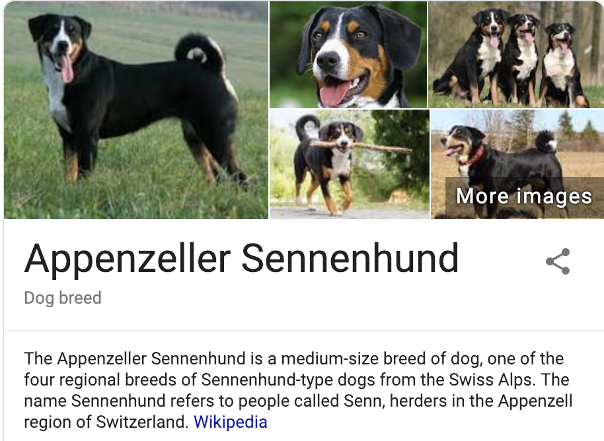
There are indistinguishable examples in these classes
Can you spot the difference?

Slide 7
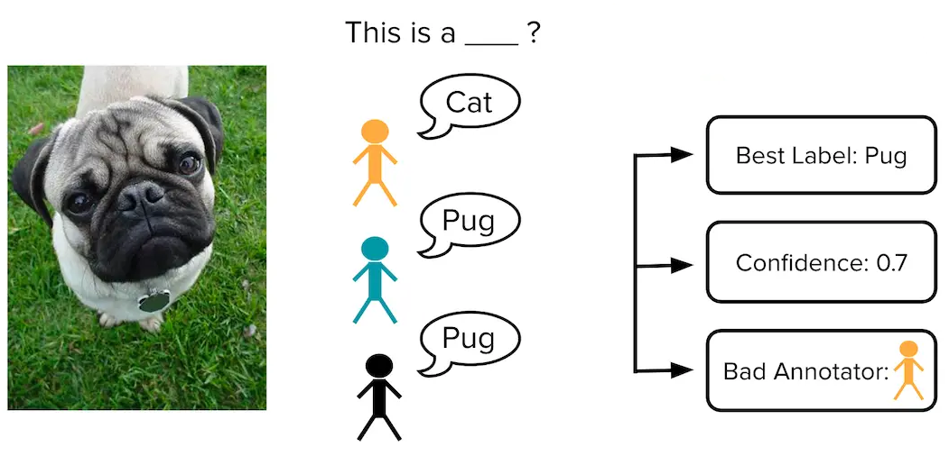
Rest of Lecture
Concerns when sourcing the data
selection bias
confounding
distribution shift
Concerns when sourcing the labels
how to work with multiple data annotators and assess quality
Good Textbook: Human-in-the-loop Machine Learning by R. Munro, R. Monarch

Slide 8
Key questions when sourcing training data
How will the resulting ML model be used?
- On what population will model be making predictions and when
Hypothetical edge cases where we need model to make the right prediction?
- High stakes scenarios, rare events

Slide 9
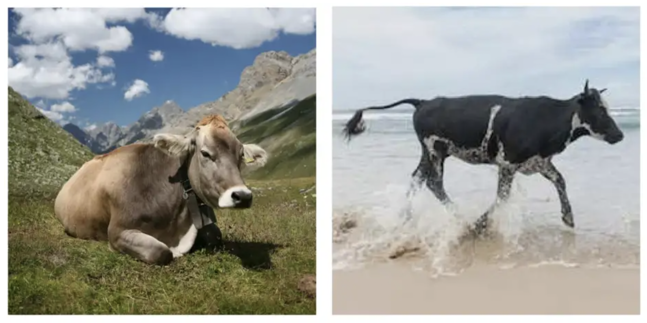
Trained image classifier predicts the left image contains a cow, but this model fails to make same prediction for the right image
Beery et al. 2018

Slide 10
This slide intentionally left blank

