Slide 2
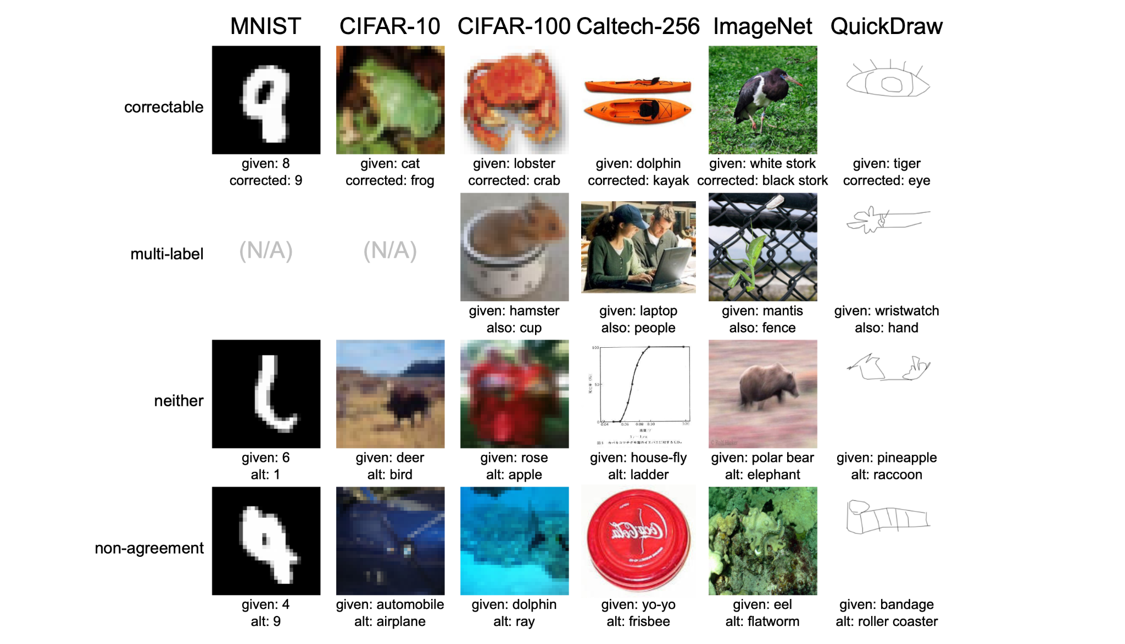
Examples from
https://labelerrors.com/
‘Hard’ Examples

Slide 3
Examples from
https://labelerrors.com/
Potentially out of distribution

Slide 4
Examples from
https://labelerrors.com/
More than one label for each data point

Slide 5
One correct label
Focus of this lecture.
Examples from
https://labelerrors.com/

Slide 6
In this lecture, you will learn
about label issues (kinds, why they matter, etc)
noise processes and types of label noise
how to find label issues
mathematical intuition for why the methods work
how to rank data by likelihood of having a label issue
how to estimate the total number of label issues in a dataset
how to train a model on data with noisy labels
label errors in test sets and the impact on ML benchmarks
This lecture covers these two papers:
Confident learning (JAIR 2021)
Pervasive label errors (NeurIPS 2021)
Overall goal of this lecture:
improve ML models trained on data with label issues

Slide 7
Finding label errors by sorting data by loss?
Sure you can sort examples by loss, but what’s the cut-off? How are you supposed to know how many label errors there are in the dataset without checking the errors by hand? How do you automate this for large datasets?

Slide 8
Confident learning roadmap:
What is confident learning?
Situate confident learning
Noise + Other methods
How does CL work? (methods)
Comparison with other methods
Why does CL work? (theory)
Intuitions
Principles
Label errors on ML benchmarks

Slide 9
What is Confident learning (CL)?
Northcutt, Jiang, & Chuang (JAIR, 2021)
Confident learning (CL) is a framework of theory and algorithms for:
Finding label errors in a dataset
Ranking data by likelihood of being a label issue
Learning with noisy labels
Complete characterization of label noise in a dataset
Dataset curation (next lecture!)
Key Idea:
With confident learning, you can use ANY model’s predicted probabilities to find label errors. (data-centric, modal-agnostic)

Slide 10
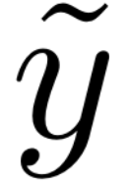
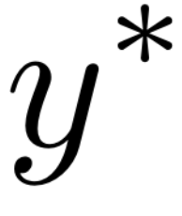
Notation
- observed, noisy label
- unobserved, latent, correct label
- set of examples with noisy observed label i, but actually belong to class j
- counts in each set
- joint distribution of noisy labels and true labels (estimated by normalizing )
- transition probability that label j is flipped to label i

Slide 11
Where are we?:
What is confident learning?
Situate confident learning
Noise + Other methods
How does CL work? (methods)
Comparison with other methods
Why does CL work? (theory)
Intuitions
Principles
Label errors on ML benchmarks
✓
✓

Slide 12
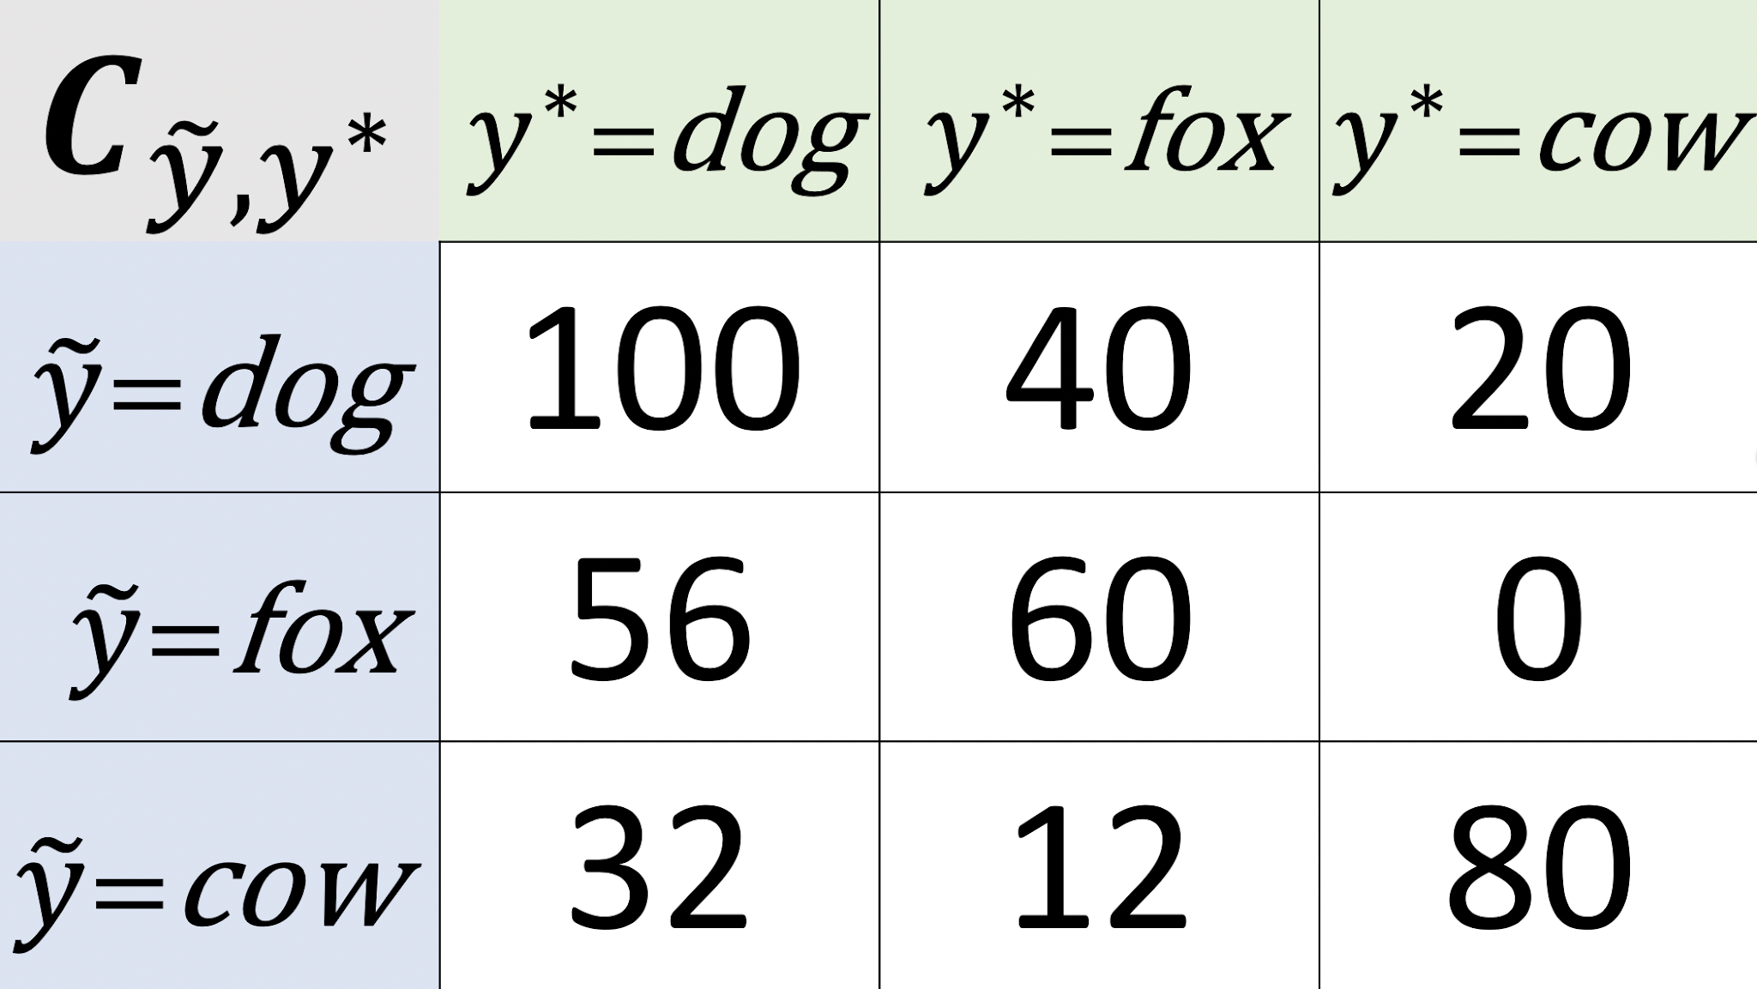
Where do noisy labels come from?
Clicked the wrong button (upvote/downvote, 1 star instead of 5 stars)
Mistakes
Mismeasurement
Incompetence
Another ML model’s bad predictions
Corruption and a million other places
All of these result in labels being flipped to other labels.
Examples of label flippings:
Image of a Dog is labeled Fox,
Tweet “Hi welcome to the team!” is labeled Toxic language

Slide 13
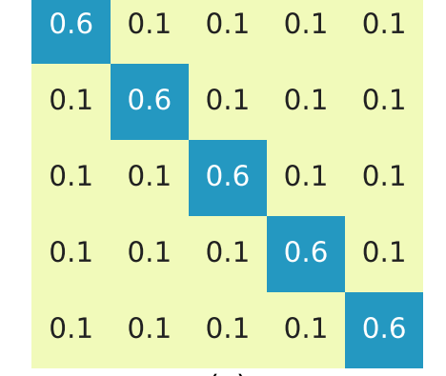
Types of label noise (how noisy labels are generated)
Uniform/symmetric class-conditional label noise
Da d d and
Goldberger and BenReuven (2017); Arazo et al. (2019); Huang et al. (ICCV, 2019); Chen et al. (ICML, 2019)
Systematic/Asymmetric Class-Conditional Label Noise
Asdfas asd d can be any valid distribution ← Focus of this lecture
Wang et al. (2019), Natarajan et al. (2017), Lipton et al. (2018), Goldberger & Ben-Reuven (2017), Sukhbaatar et al. (2015)
Instance-Dependent Label noise
Requires a lot of assumptions on data distribution.
Out of scope for this lecture
Menon et al. (2016), Xia et al. (2020), Cheng et al. (2020), Berthon et al. (2020), Wang et al. (2021)
Least assuming

Slide 14
What’s Uncertainty?
Uncertainty is the opposite of confidence.
It’s the “lack of confidence” (how uncertain) a model is about its class prediction for a given datapoint.
Uncertainty depends on:
the ‘difficulty’ of an example (aleatoric)
a model’s inability to understand the example (epistemic)
E.g. model has never seen an example like that before
E.g. model is too simple
Notes:
There are other types of uncertainty – correlated and uncorrelated

Slide 15
What’s Uncertainty? Epistemic vs Aleatoric Uncertainty
Example: machine learning with noisy labels
Aleatoric Uncertainty: Label Noise (labels have been flipped to other classes)
Epistemic Uncertainty: Model Noise (erroneous predicted probabilities)

Slide 16
Is a label noise process assumption necessary? (yes)
Consider the predicted probabilities of a model
expresses both:
noisy model outputs (epistemic uncertainty)
label noise of every example (aleatoric uncertainty)
No noise process assumption → cannot disambiguate the two sources of noise
To disambiguate epistemic uncertainty from aleatoric uncertainty, we use a reasonable assumption to remove the dependency on

Slide 17
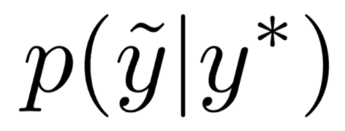
CL assumes class-conditional label noise
We assume labels are flipped based on an unknown transition matrix that depends only on pairwise noise rates between classes, not the data
This assumption is reasonable for real-world data. Let’s look at some...
- observed, noisy label
- unobserved, latent, correct label
Class-conditional noise process first introduced by Angluin and Laird (1988)

Slide 18
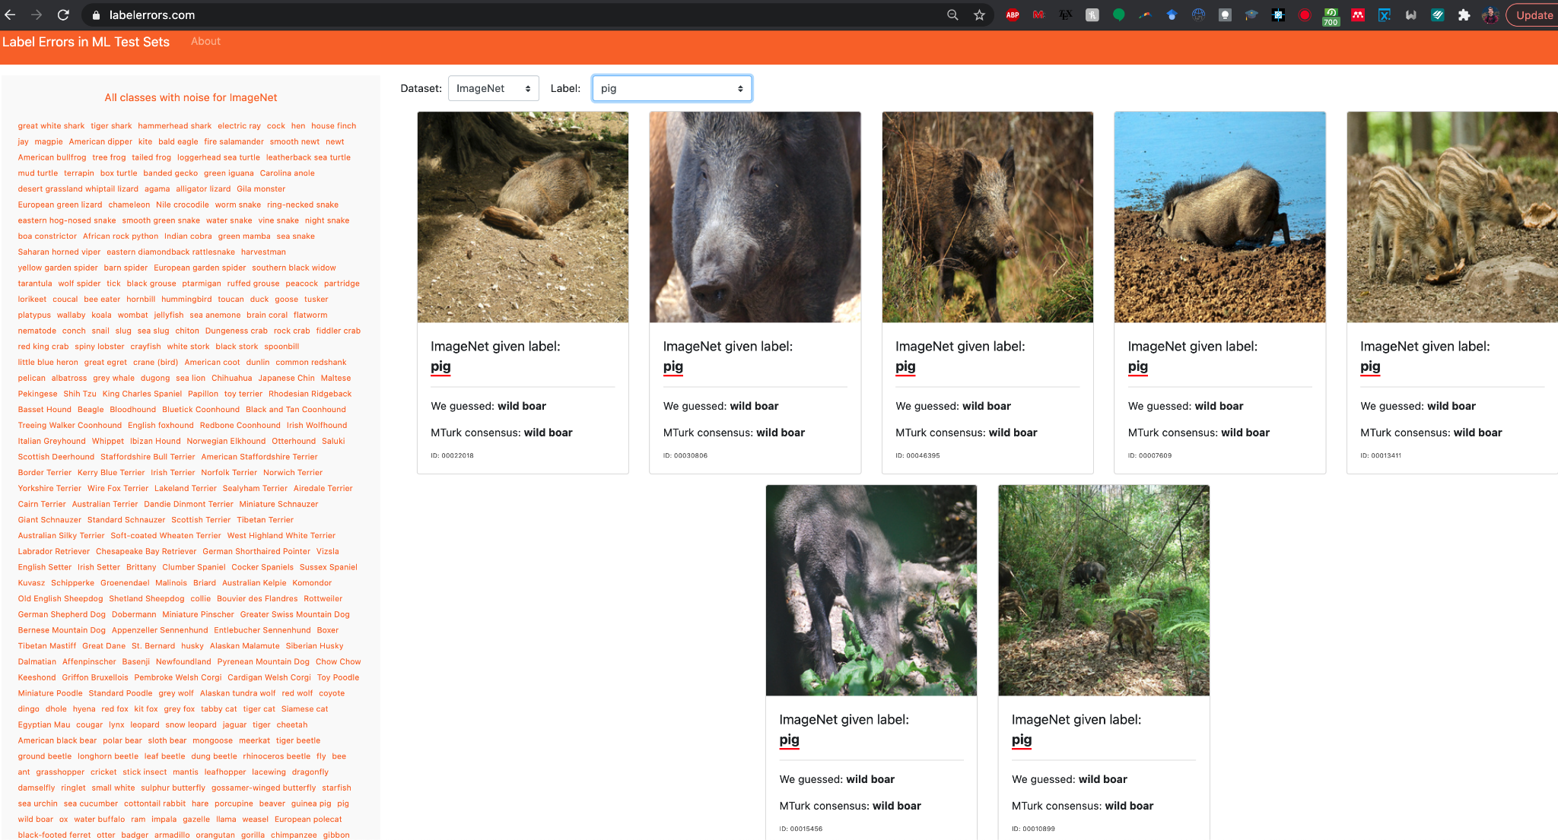
CL assumes class-conditional label noise
In real-world images, lots of “boars” were mislabeled as “pigs”
But no “missiles” or “keyboards” were mislabeled as “pigs”
This “class-conditional” label noise depends on the class, not the image data (what the pig looks like)
Given its realistic nature, we choose to solve for “class-conditional noise” in CL.

Slide 19
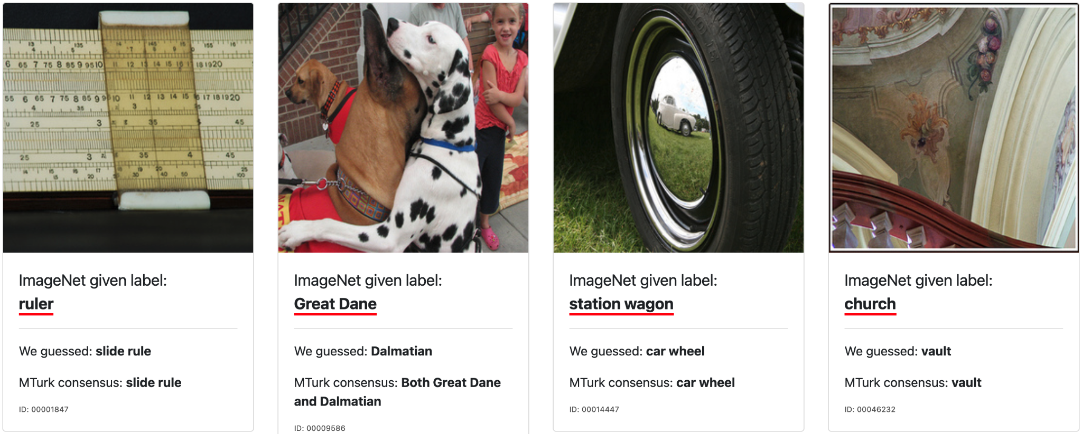
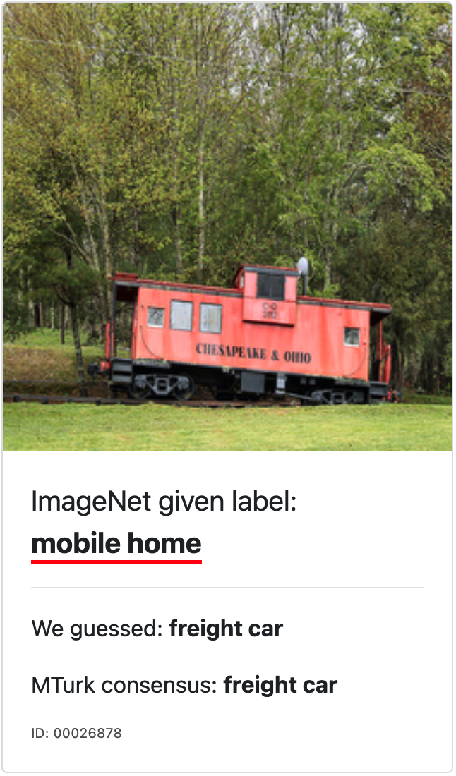
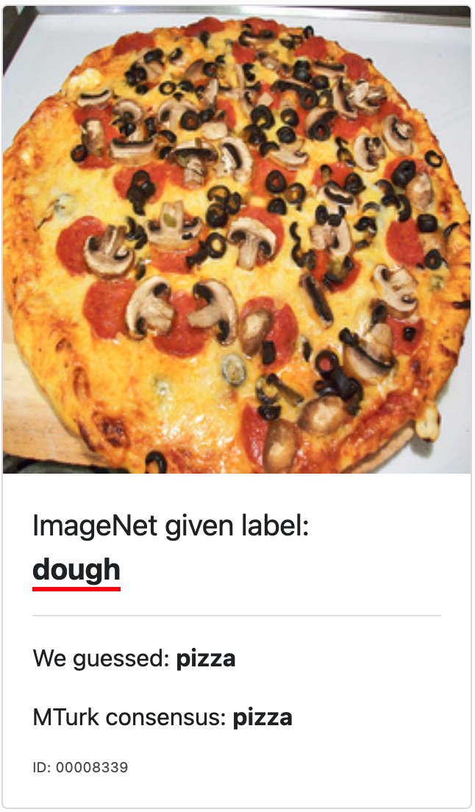
CL assumes class-conditional label noise
What does uniform label noise look like?
Goldberger and BenReuven (2017) Arazo et al. (2019)
Fictitious examples
(not naturally occurring)

Slide 20
Does label noise matter? Deep learning is robust to label noise… right?
(Jindal et al. ICDM 2016), (Krause et al. ECCV 2016) suggest that “with enough data, learning is possible with arbitrary amounts of uniformly random label noise”
Quotes across the literature:
“label noise may be a limited issue if networks are trained on billions of images” (Mahajan et al. ECCV 2018)
“it seems the scale of data can overpower noise in the label space” (Sun et al. ICCV 2017)
“Successful learning is possible with an arbitrary amount of noise” (Rolnick et al. arXiv 2017)
“[Neural networks] miraculously avoid bad minima [caused by label errors].” (Huang et al. PMLR 2019)
These results assume uniformly random label noise and usually don’t apply to real-world settings.
Notes:
Jacob Steinhardt, Pang Wei W Koh, and Percy S Liang. Certified defenses for data poisoning attacks. In Advances in neural information processing systems, 2017.
Chen Zhu, W Ronny Huang, Ali Shafahi, Hengduo Li, Gavin Taylor, Christoph Studer, and Tom Goldstein. Transferable clean-label poisoning attacks on deep neural nets. International Conference on Machine Learning, 2019.
@misc{huang2019understanding,
title={Understanding Generalization through Visualizations},
author={W. Ronny Huang and Zeyad Emam and Micah Goldblum and Liam Fowl and Justin K. Terry and Furong Huang and Tom Goldstein},
year={2019},
eprint={1906.03291},
archivePrefix={arXiv},
primaryClass={cs.LG}
}

Slide 21
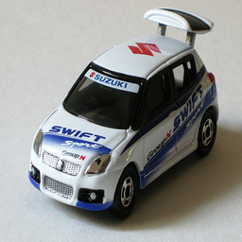
Types of Noise that we will NOT cover in this lecture.
Noise in Data
Blurry images, adversarial examples, typos in text, background noise in audio
Annotator Label Noise
1
Annotation: Sports Car
Annotation: Toy Car
Annotation: Toy Car
2
3
Label: Sidewalk
Dawid and Skene (1979)
CL assumes labels are noisy, not data.
CL assumes one annotation per example

Slide 22
Types of methods for Learning with Noisy Labels
Model-Centric Methods
“Change the Loss”
Use loss from another network
Co-Teaching (Han et al., 2018)
MentorNet (Jiang et al., 2017)
Modify loss directly
SCE-loss (Wang et al., 2019)
Importance reweighting
(Liu & Tao, 2015; Patrini et al., 2017; Reed et al., 2015; Shu et al., 2019; Goldberger & Ben-Reuven, 2017)
Data-Centric Methods
“Change the Data”
Find label errors in datasets
Then learn with(out) noisy labels by providing cleaned data for training
(Pleiss et al., 2020; Yu et al., ICML, 2019; Li et al., ICLR, 2020; Wei et al., CVPR, 2020, Northcutt et al., JAIR, 2021)
This lecture
We’ll see later why these approaches
propagate error to the learned model
Notes:
CL does other things besides being data-centric, but this is one aspect of confident learning

Slide 23
Organization for this part of the talk:
What is confident learning?
Situate confident learning
Noise + related work
How does CL work? (methods)
Comparison with other methods
Why does CL work? (theory)
Intuitions
Principles
Label errors on ML benchmarks
✓
✓

Slide 24
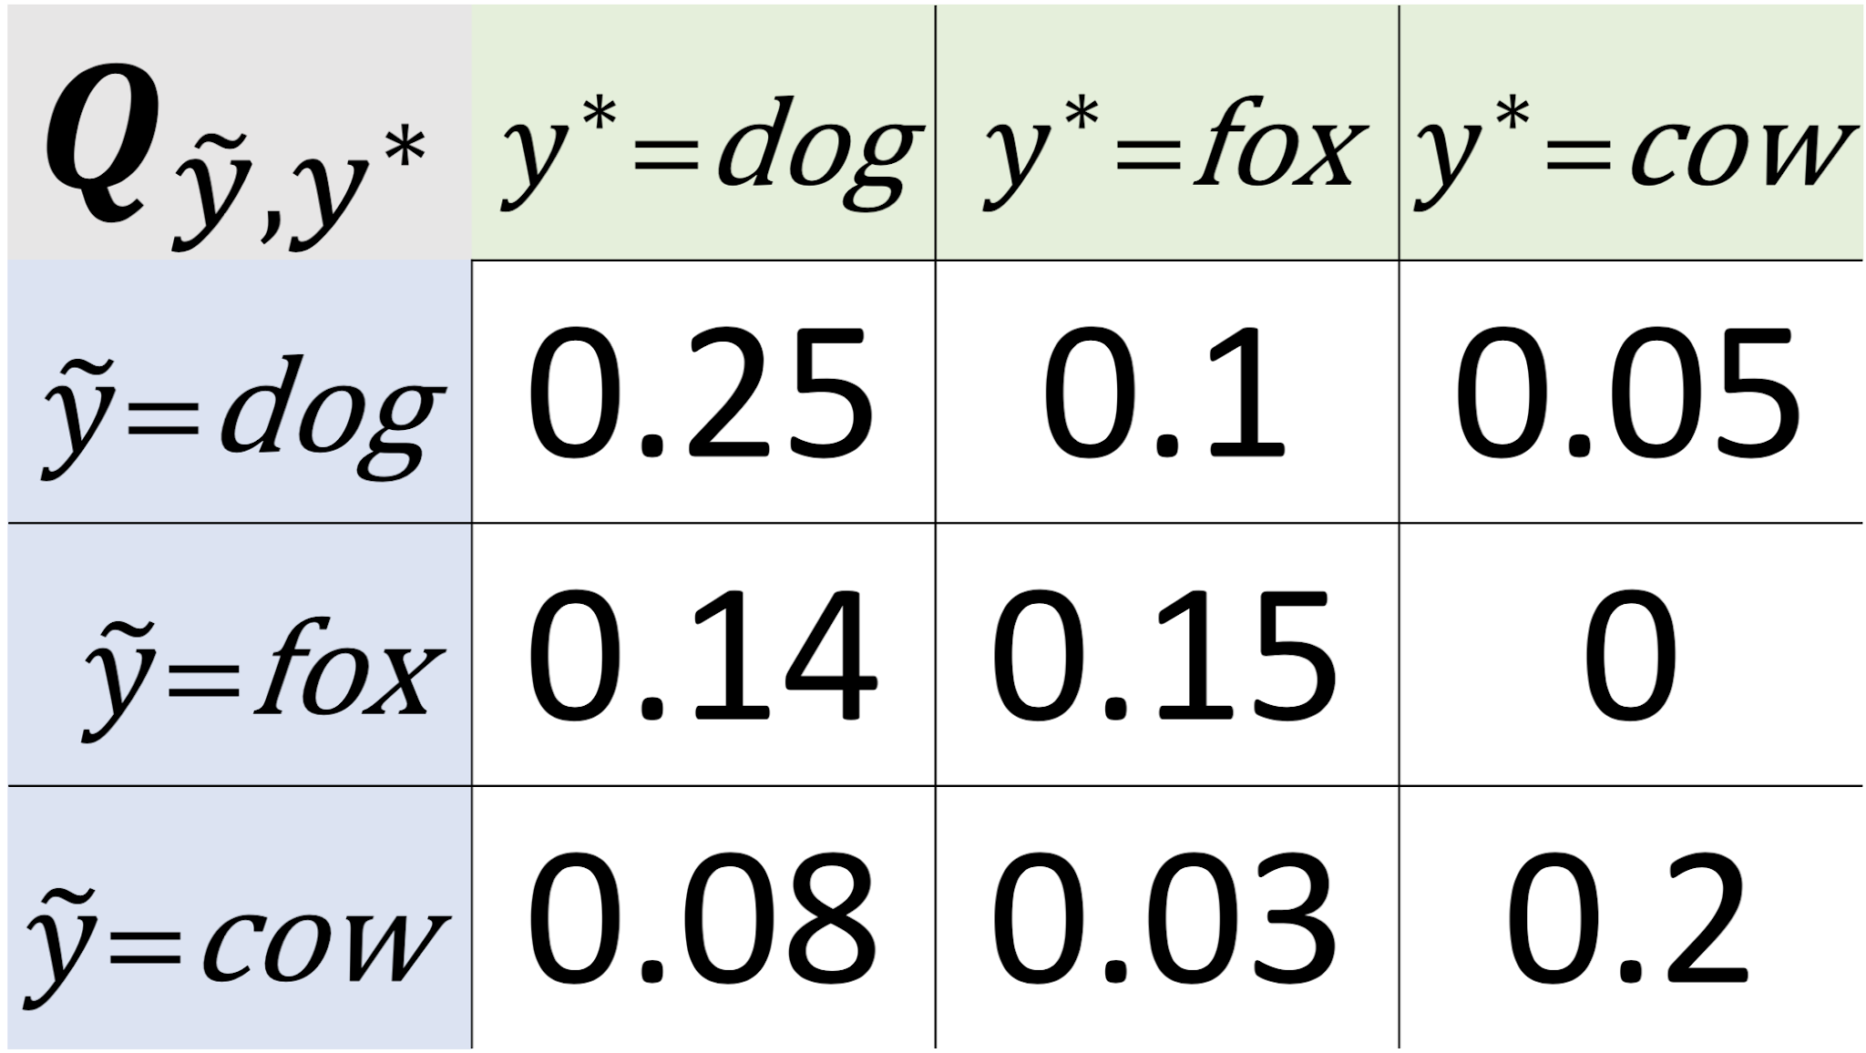
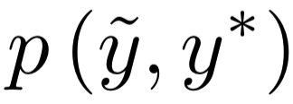
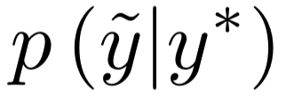
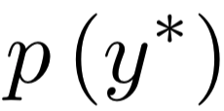
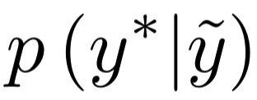
How does confident learning work?
Directly estimate the joint distribution of observed noisy labels and latent true labels.
Off-diagonals tell you what fraction of your dataset is mislabeled. Example -- “3% of your cow images are actually foxes”
Notes:
From this statistic, we can: Find label errors Learn with noisy labels by providing clean data for training Find ontological issues in the way datasets are labeled.
From the joint distribution, you can obtain via marginals and conditionals
Related work depends on the prior and transition matrix
This is the first work that solves the joint, providing those key statistics for noisy learning
This is the key contribution of confident learning

Slide 25
How does confident learning work?
To estimate and find label errors, confident learning requires two inputs:
Noisy labels,
Predicted probabilities,
Note: CL is scale-invariant w.r.t. outputs, i.e. raw logits work as well

Slide 26
How does confident learning work?
Key idea: First we find thresholds as a proxy for the machine’s self-confidence, on average, for each task/class

Slide 27
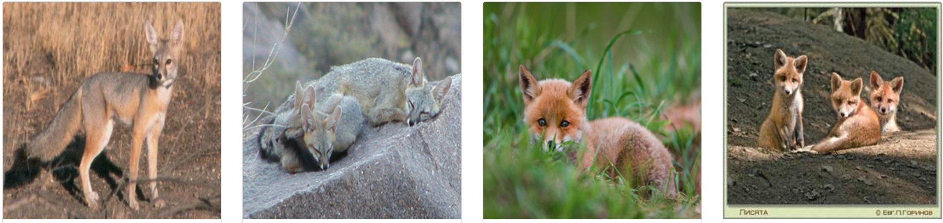
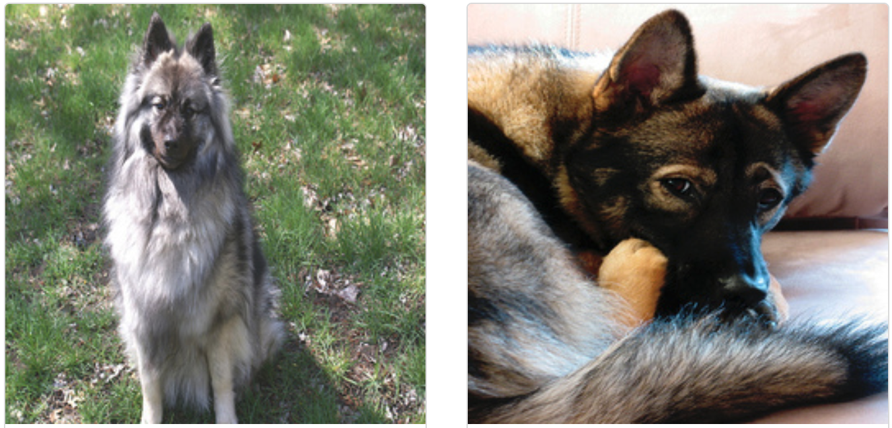
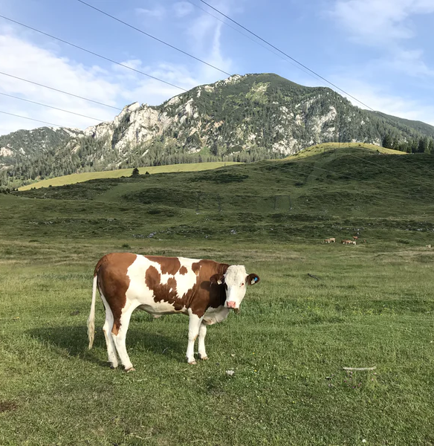
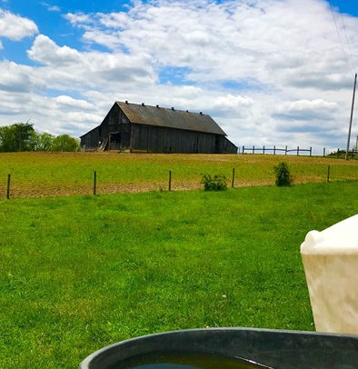
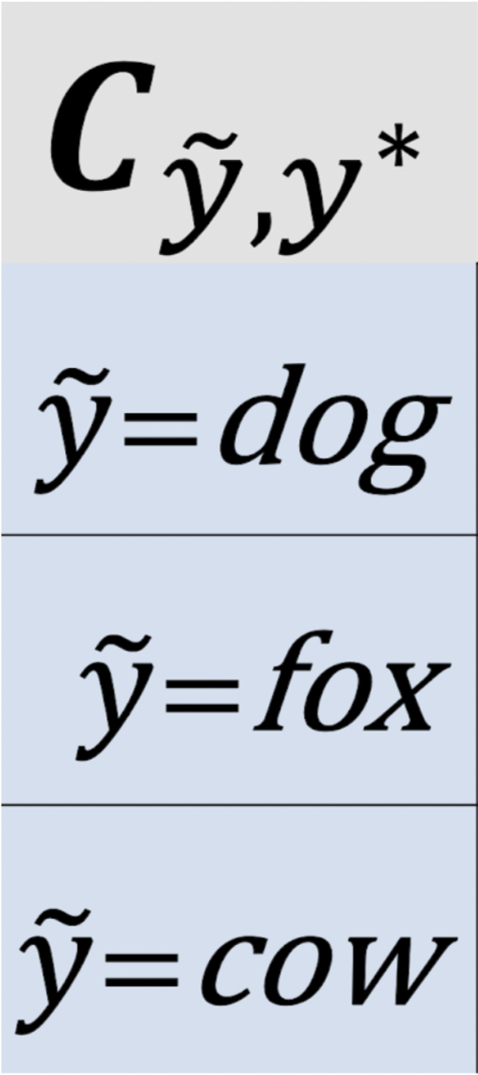
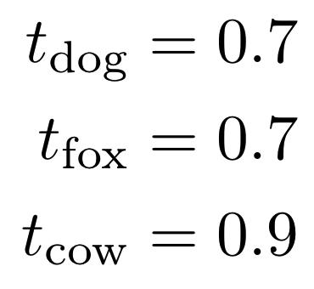
How does confident learning work?
Noisy label: dog
Noisy label: fox
Noisy label: fox
Noisy label: fox
Noisy label: fox
Noisy label: dog
Noisy label: cow
Noisy label: cow
0.7
0.7
0.9
0.8
0.7
0.9
0.9
0.3
0.3
0.3
0.3
0.5
0.2
0.2
0.2
Before confident learning starts, a model is trained on this data using cross-validation, to produce , the out-of-sample predicted probabilities
0.0
0.0
0.1
0.0
0.0
0.1
0.1
0.0
0.1
0.0
0.0
0.0
dog
fox
cow
dog
fox
cow
dog
fox
cow
dog
fox
cow
dog
fox
cow
dog
fox
cow
dog
fox
cow
dog
fox
cow
CL estimates sets of label errors for each pair of
(noisy label i, true label j)
Creating a matrix of counts to estimate the unnormalized joint distribution
The confident joint , counts the size of each set →

Slide 28
How does confident learning work?
Noisy label: dog
Noisy label: fox
Noisy label: fox
Noisy label: fox
Noisy label: fox
Noisy label: dog
Noisy label: cow
Noisy label: cow
0.7
0.7
0.9
0.8
0.7
0.9
0.9
0.3
0.3
0.3
0.3
0.5
0.1
0.2
0.2
0.1
0.1
0.1
0.2
0.0
0.0
0.0
0.0
0.0
0.0
0.0
0.0
dog
fox
cow
dog
fox
cow
dog
fox
cow
dog
fox
cow
dog
fox
cow
dog
fox
cow
dog
fox
cow
dog
fox
cow
 | 0 | 0 | 0
 | 0 | 0 | 0
 | 0 | 0 | 0
0.3 ≱ 0.7
0
- class self-confidence thresholds - out-of-sample predicted probabilities

Slide 29
How does confident learning work?
Noisy label: dog
Noisy label: fox
Noisy label: fox
Noisy label: fox
Noisy label: fox
Noisy label: dog
Noisy label: cow
Noisy label: cow
0.7
0.7
0.9
0.8
0.7
0.9
0.9
0.3
0.3
0.3
0.3
0.5
0.1
0.2
0.2
0.1
0.1
0.1
0.2
0.0
0.0
0.0
0.0
0.0
0.0
0.0
0.0
dog
fox
cow
dog
fox
cow
dog
fox
cow
dog
fox
cow
dog
fox
cow
dog
fox
cow
dog
fox
cow
dog
fox
cow
 | 0 | 0 | 0
 | 0 | 0 | 0
 | 0 | 0 | 0
✓
0.7 ≥ 0.7
1

Slide 30
How does confident learning work?
Noisy label: dog
Noisy label: fox
Noisy label: fox
Noisy label: fox
Noisy label: fox
Noisy label: dog
Noisy label: cow
Noisy label: cow
0.7
0.7
0.9
0.8
0.7
0.9
0.9
0.3
0.3
0.3
0.3
0.5
0.1
0.2
0.2
0.1
0.1
0.1
0.2
0.0
0.0
0.0
0.0
0.0
0.0
0.0
0.0
dog
fox
cow
dog
fox
cow
dog
fox
cow
dog
fox
cow
dog
fox
cow
dog
fox
cow
dog
fox
cow
dog
fox
cow
 | 0 | 1 | 0
 | 0 | 0 | 0
 | 0 | 0 | 0
0.0 ≱ 0.9
0

Slide 31
How does confident learning work?
Noisy label: dog
Noisy label: fox
Noisy label: fox
Noisy label: fox
Noisy label: fox
Noisy label: dog
Noisy label: cow
Noisy label: cow
0.7
0.7
0.9
0.8
0.7
0.9
0.9
0.3
0.3
0.3
0.3
0.5
0.1
0.2
0.2
0.1
0.1
0.1
0.2
0.0
0.0
0.0
0.0
0.0
0.0
0.0
0.0
dog
fox
cow
dog
fox
cow
dog
fox
cow
dog
fox
cow
dog
fox
cow
dog
fox
cow
dog
fox
cow
dog
fox
cow
Skipping columns that don’t hit threshold
 | 0 | 1 | 0
 | 0 | 0 | 0
 | 0 | 0 | 0
✓
0.7 ≥ 0.7
1

Slide 32
How does confident learning work?
Noisy label: dog
Noisy label: fox
Noisy label: fox
Noisy label: fox
Noisy label: fox
Noisy label: dog
Noisy label: cow
Noisy label: cow
0.7
0.7
0.9
0.8
0.7
0.9
0.9
0.3
0.3
0.3
0.3
0.5
0.1
0.2
0.2
0.1
0.1
0.1
0.2
0.0
0.0
0.0
0.0
0.0
0.0
0.0
0.0
dog
fox
cow
dog
fox
cow
dog
fox
cow
dog
fox
cow
dog
fox
cow
dog
fox
cow
dog
fox
cow
dog
fox
cow
 | 0 | 1 | 0
 | 0 | 1 | 0
 | 0 | 0 | 0
✓
0.9 ≥ 0.7
2

Slide 33
How does confident learning work?
Noisy label: dog
Noisy label: fox
Noisy label: fox
Noisy label: fox
Noisy label: fox
Noisy label: dog
Noisy label: cow
Noisy label: cow
0.7
0.7
0.9
0.8
0.7
0.9
0.9
0.3
0.3
0.3
0.3
0.5
0.1
0.2
0.2
0.1
0.1
0.1
0.2
0.0
0.0
0.0
0.0
0.0
0.0
0.0
0.0
dog
fox
cow
dog
fox
cow
dog
fox
cow
dog
fox
cow
dog
fox
cow
dog
fox
cow
dog
fox
cow
dog
fox
cow
 | 0 | 1 | 0
 | 0 | 2 | 0
 | 0 | 0 | 0
✓
0.8 ≥ 0.7
3

Slide 34
How does confident learning work?
Noisy label: dog
Noisy label: fox
Noisy label: fox
Noisy label: fox
Noisy label: fox
Noisy label: dog
Noisy label: cow
Noisy label: cow
0.7
0.7
0.9
0.8
0.7
0.9
0.9
0.3
0.3
0.3
0.3
0.5
0.1
0.2
0.2
0.1
0.1
0.1
0.2
0.0
0.0
0.0
0.0
0.0
0.0
0.0
0.0
dog
fox
cow
dog
fox
cow
dog
fox
cow
dog
fox
cow
dog
fox
cow
dog
fox
cow
dog
fox
cow
dog
fox
cow
 | 0 | 1 | 0
 | 0 | 3 | 0
 | 0 | 0 | 0
✓
0.7 ≥ 0.7
1

Slide 35
How does confident learning work?
Noisy label: dog
Noisy label: fox
Noisy label: fox
Noisy label: fox
Noisy label: fox
Noisy label: dog
Noisy label: cow
Noisy label: cow
0.7
0.7
0.9
0.8
0.7
0.9
0.9
0.3
0.3
0.3
0.3
0.5
0.1
0.2
0.2
0.1
0.1
0.1
0.2
0.0
0.0
0.0
0.0
0.0
0.0
0.0
0.0
dog
fox
cow
dog
fox
cow
dog
fox
cow
dog
fox
cow
dog
fox
cow
dog
fox
cow
dog
fox
cow
dog
fox
cow
 | 0 | 1 | 0
 | 1 | 3 | 0
 | 0 | 0 | 0
✓
0.9 ≥ 0.7
1

Slide 36
How does confident learning work?
Noisy label: dog
Noisy label: fox
Noisy label: fox
Noisy label: fox
Noisy label: fox
Noisy label: dog
Noisy label: cow
Noisy label: cow
0.7
0.7
0.9
0.8
0.7
0.9
0.9
0.3
0.3
0.3
0.3
0.5
0.1
0.2
0.2
0.1
0.1
0.1
0.2
0.0
0.0
0.0
0.0
0.0
0.0
0.0
0.0
dog
fox
cow
dog
fox
cow
dog
fox
cow
dog
fox
cow
dog
fox
cow
dog
fox
cow
dog
fox
cow
dog
fox
cow
 | 1 | 1 | 0
 | 1 | 3 | 0
 | 0 | 0 | 0
✓
0.9 ≥ 0.9
1

Slide 37
How does confident learning work?
Noisy label: dog
Noisy label: fox
Noisy label: fox
Noisy label: fox
Noisy label: fox
Noisy label: dog
Noisy label: cow
Noisy label: cow
0.7
0.7
0.9
0.8
0.7
0.9
0.9
0.3
0.3
0.3
0.3
0.5
0.1
0.2
0.2
0.1
0.1
0.1
0.2
0.0
0.0
0.0
0.0
0.0
0.0
0.0
0.0
dog
fox
cow
dog
fox
cow
dog
fox
cow
dog
fox
cow
dog
fox
cow
dog
fox
cow
dog
fox
cow
dog
fox
cow
 | 1 | 1 | 0
 | 1 | 3 | 0
 | 0 | 0 | 1
0.5 ≱ 0.9
Out of distribution
1

Slide 38
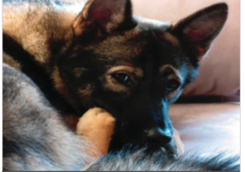
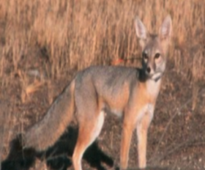
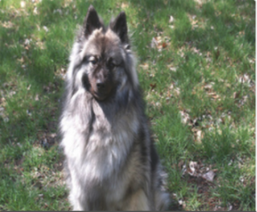
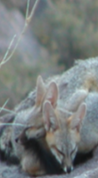
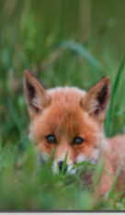
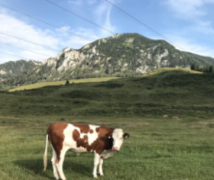
How does confident learning work? (in 10 seconds)
Noisy label: dog
Noisy label: fox
Noisy label: fox
Noisy label: fox
Noisy label: fox
Noisy label: dog
Noisy label: cow
Noisy label: cow
0.7
0.7
0.9
0.8
0.7
0.9
0.9
0.3
0.3
0.3
0.3
0.5
0.1
0.2
0.2
0.1
0.1
0.1
0.2
0.0
0.0
0.0
0.0
0.0
0.0
0.0
0.0
dog
fox
cow
dog
fox
cow
dog
fox
cow
dog
fox
cow
dog
fox
cow
dog
fox
cow
dog
fox
cow
dog
fox
cow
 | 1 | 1 | 0
 | 1 | 3 | 0
 | 0 | 0 | 1
Off diagonals are CL-guessed label errors

Slide 39
After looking through the entire dataset, we have:
Notes:
Need to see a real-world result. Use color coded.

Slide 40
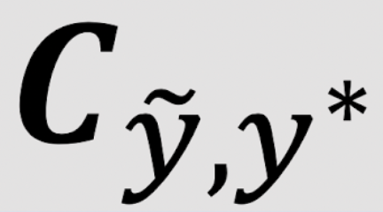
From we obtain the joint distribution of label noise
Estimated
Notes:
estimate

Slide 41
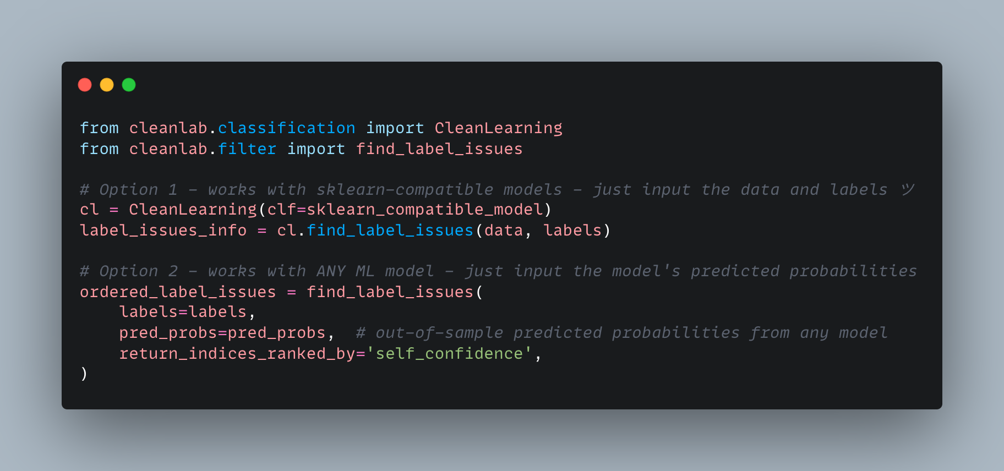
You can do this in 1 import and 1 line of code
https://github.com/cleanlab/cleanlab

Slide 42
Ranking label errors
self-confidence (chalk board)
Normalized margin (chalk board)

Slide 43
Organization for this part of the talk:
What is confident learning?
Situate confident learning
Noise + related work
How does CL work? (methods)
Comparison with other methods
Why does CL work? (theory)
Intuitions
Principles
Label errors on ML benchmarks
✓
✓
✓

Slide 44
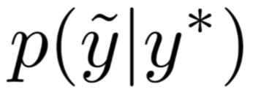
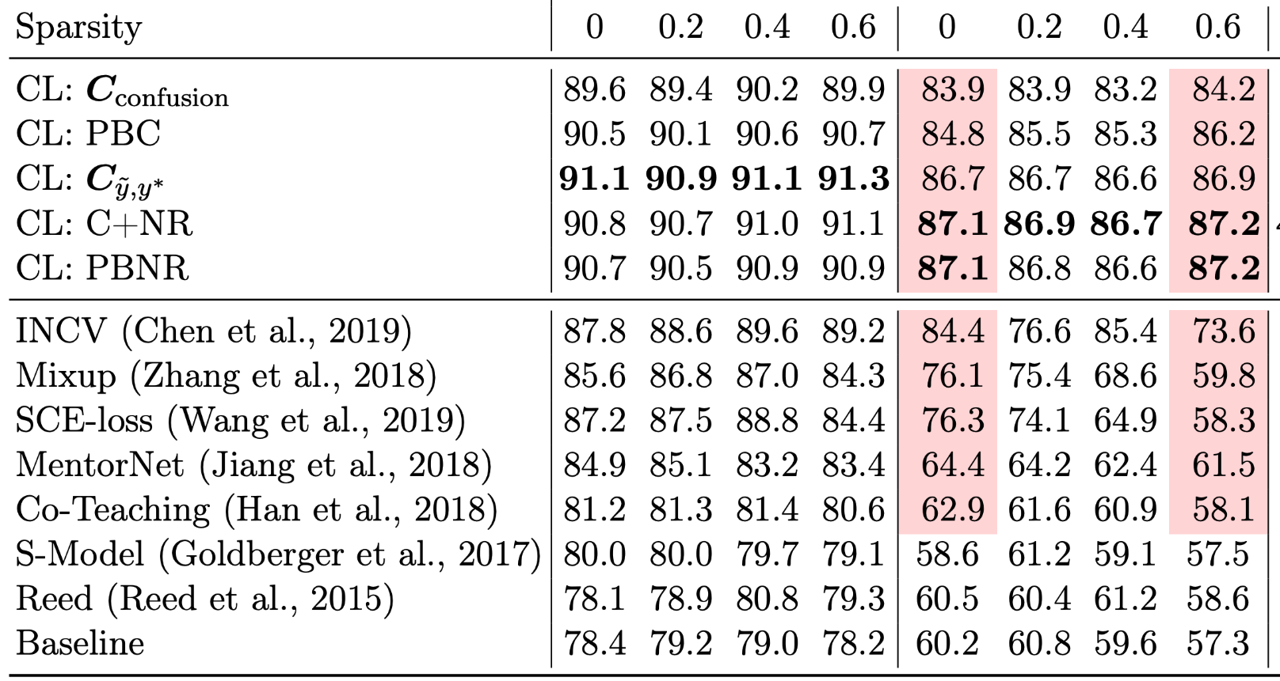
Compare Accuracy: Learning with 40% label noise in CIFAR-10
Fraction of zeros in the off-diagonals of
← More realistic (e.g. ImageNet)
Baseline (remove prediction != label)
Data-centric
Train with errors removed
“Change the dataset”
Confident learning methods
Same perf
Model-centric
Train with errors
“adjust the loss”
Perf drop-off
Notes:
ORDER TO PRESENT THINGS IN THIS SLIDE:
Noise 40% in cifar-10
Cl is robust to change in sparsity
Cl methods perform well compared to recent top performing approaches
(now hit enter and show how data-centric vs model-centric)
Show that the baseline which is simple actually does quite well
Evidence that data-centric thinking is fruitful
Data-centric vs model-centric? What about both?
In practice...
CL methods remove errors first, then use co-teaching for the final training to combine the benefits of both approaches

Slide 45
Organization for this part of the talk:
What is confident learning?
Situate confident learning
Noise + related work
How does CL work? (methods)
Comparison with other methods
Why does CL work? (theory)
Intuitions
Principles
Label errors on ML benchmarks
✓
✓
✓
✓

Slide 46
Theory of Confident Learning
To understand CL performance, we studied conditions where CL exactly finds label errors, culminating in the following Theorem:
As long as examples in class i are labeled i more than any other class, then...
We prove realistic sufficient conditions (allowing significant error in all model outputs)
Such that CL still exactly finds label errors.

Slide 47
Intuition: CL theory builds on three principles
The Prune Principle
remove errors, then train
Chen et al. (2019), Patrini et al. (2017), Van Rooyen et al. (2015)
The Count Principle
use ratios of counts, not noisy model outputs
Page et al. (1997), Jiang et al. (2018)
The Rank Principle
use rank of model outputs, not the noisy values
Natarajan et al. (2017), Forman (2005, 2008), Lipton et al. (2018)
Notes:
assembles prior work

Slide 48
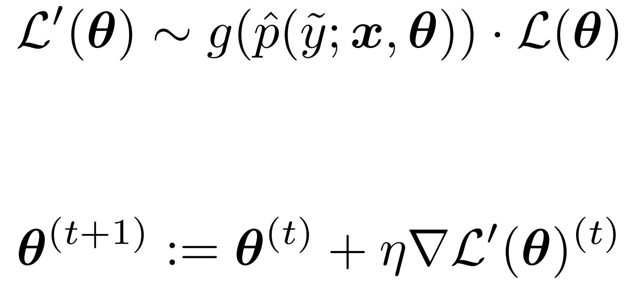
CL Robustness Intuition 1: Prune
Key Idea:
Pruning enables robustness to stochastic/imperfect predicted probabilities
Prior work modifies the loss: (e.g. importance reweighting) (Liu & Tao, 2015; Patrini et al., 2017; Reed et al., 2015; Shu et al., 2019; Goldberger & Ben-Reuven, 2017)
Pred probs are stochastic/erroneous for real-world models!!
Takeaway
CL methods
↓
Prune Label Errors
↓
Avoid loss reweighting
↓
Avoid this form of error propagation
Error propagation
SGD weights update:
Error propagation
Notes:
We prove this in the paper, but here is the key idea.

Slide 49
CL Robustness Intuition 2: Count & Rank
Takeaway
CL methods
↓
Robust statistics to estimate with counts based on rank
↓
Robust to imperfect probabilities from model
Same idea: Counting and Ranking enable robustness to erroneous probabilities
But this time: Let’s look at noise transition estimation
Other methods: (Elkan & Noto, 2008; Sukhbaatar et al., 2015)
Confident Learning:
Enables CL to disambiguate aleatoric (label noise) from epistemic (model noise)
Robust statistic w/ counts + rank (1 step removed erroneous probs)
e.g. Median of Means
Notes:
Consider the median of the means
Same concept is true of thresholds, counts, ranks -- allows you to avoid the effects of outliers.
Look for the class of these methods - names for them

Slide 50
What do “ideal” (non-erroneous) predicted probs look like?
Equipped with this understanding of ideal probabilities
And the prune, count, and rank principles of CL
We can see the intuition for our theorem (exact error finding with noisy probs)

Slide 51
Theorem Intuition
Let “ideal” = 0.9.
The model can be up to (0.9 - 0.6) / 0.9 = 33% wrong in its estimate of
And will be correctly counted.
Does this result still hold for systematic miscalibration (common in neural networks)?
Guo, Pleiss, Sun, & Weinberger (2017) “On Calibration of Modern Neural Networks.” ICML

Slide 52
Final Intuition: Robustness to miscalibration
Exactly finds label errors for “ideal” probabilities
(Ch. 2, Thm 1, in thesis)
But neural networks have been shown (Guo et al., 2017) to be over-confident for some classes:
What happens to ?
→ is unchanged - still exactly finds errors

Slide 53
Enough intuition, let’s see some results
First we’ll look at examples for dataset curation in ImageNet.
Then we’ll look at CL with various distributions/models
Then we’ll look at failure modes
Finally, we’re ready for part 3: “label errors”
Organization for this part of the talk:
What is confident learning?
Situate confident learning
Noise + related work
How does CL work? (methods)
Comparison with other methods
Why does CL work? (theory)
Intuitions
Principles
Label errors on ML benchmarks
✓
✓
✓
✓
✓

Slide 54
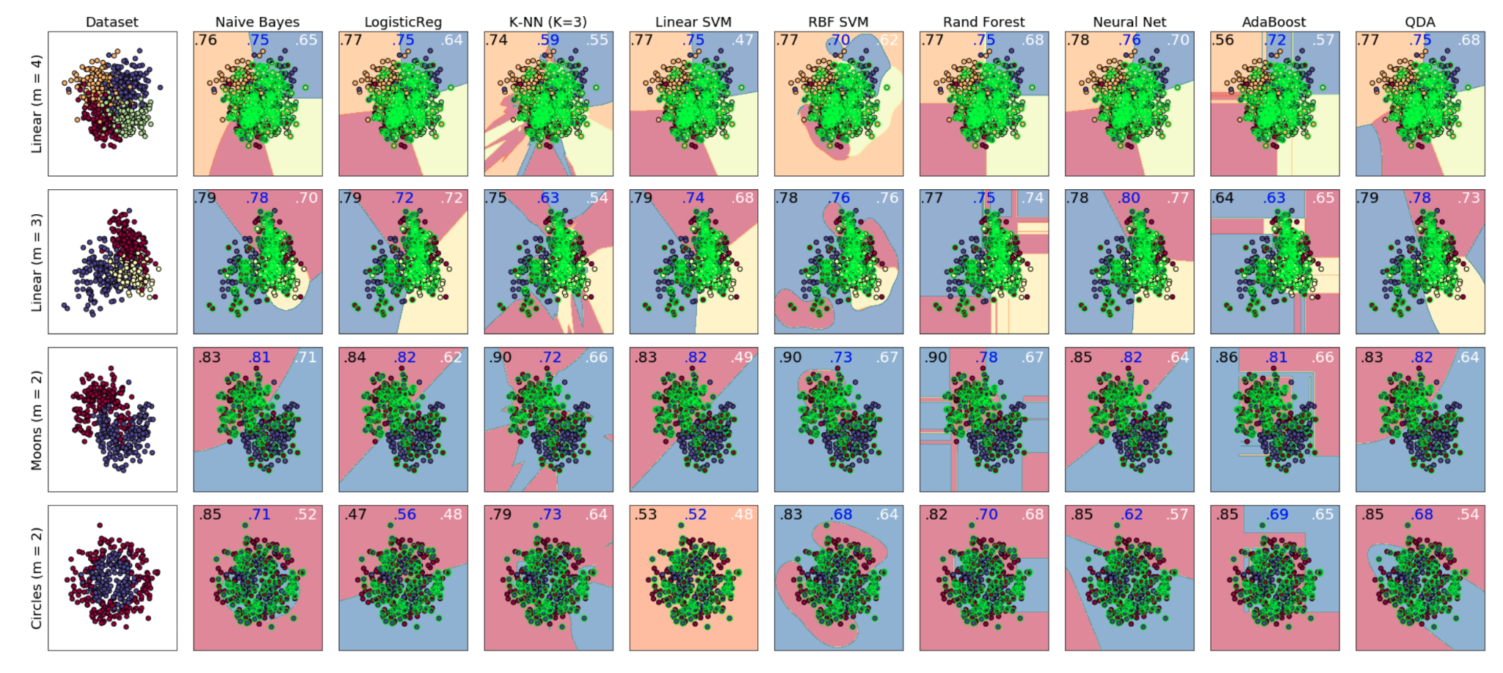
CL is model-agnostic
9 different types of models x 4 types of distributions
In each of case, CL increases accuracy
compared with learning with the given noisy (class-conditional) labels.

Slide 55
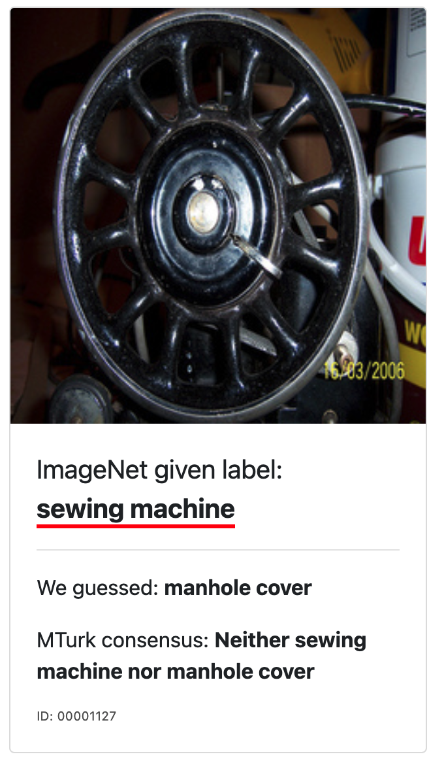
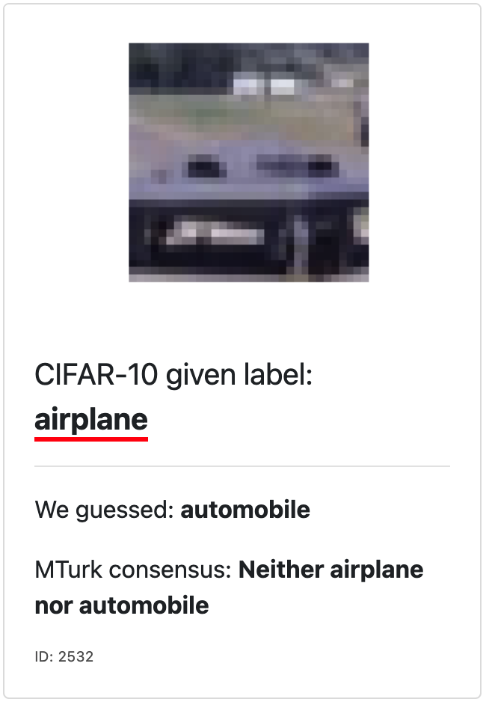
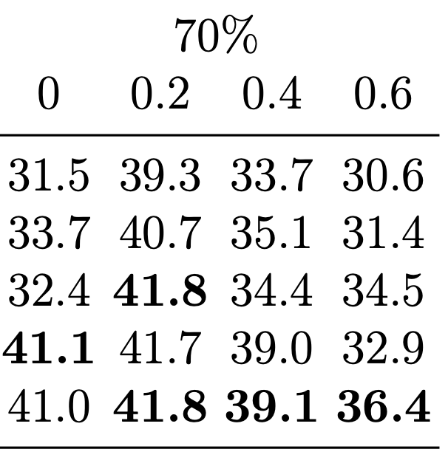
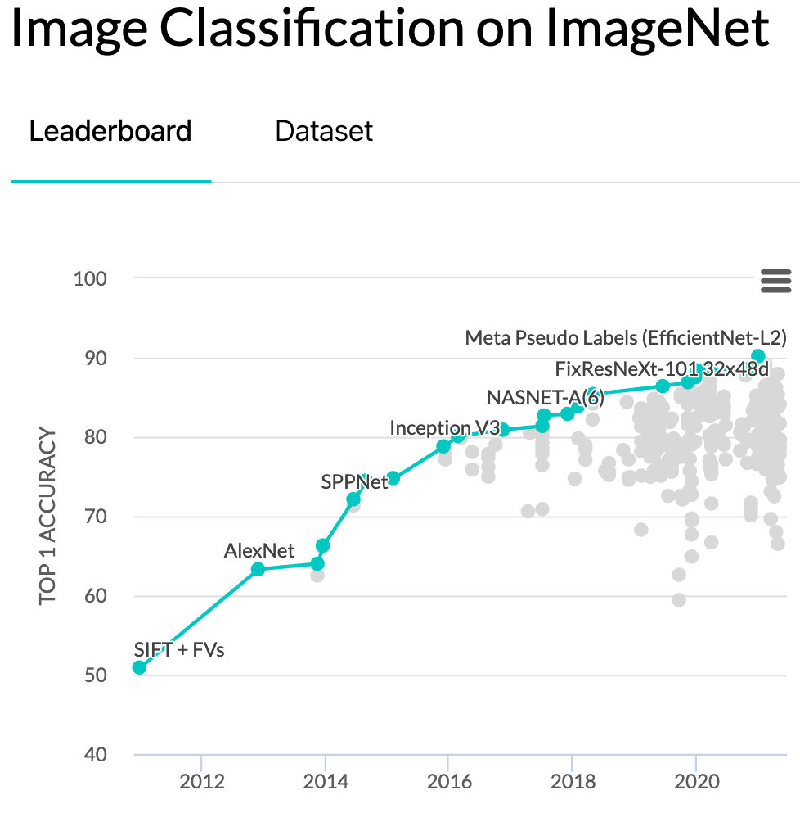
Failure Modes (when does CL fail?)
When the error in exceeds the threshold margins.
When might this happen?
Acc. of CL-based methods for 70% noise for various settings.
(really) hard examples
too much (70+%) noise
inappropriate model

Slide 56
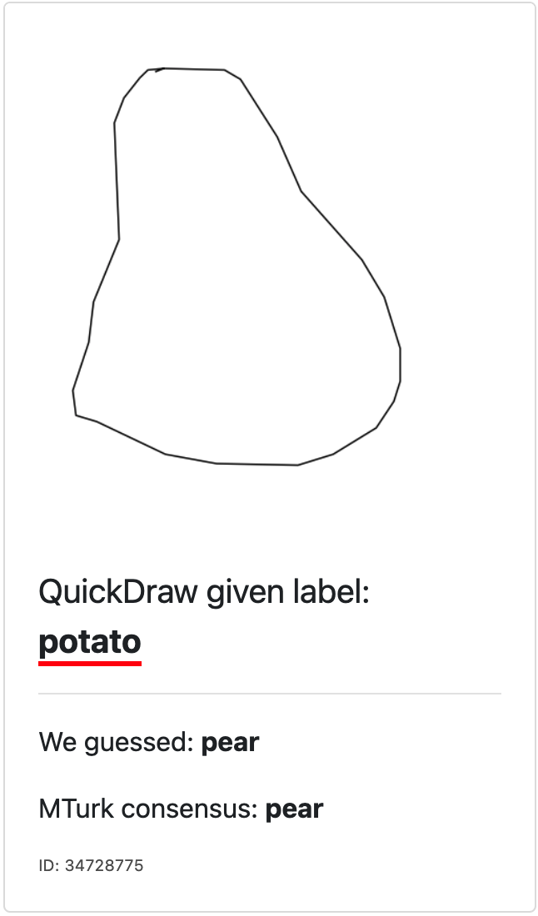
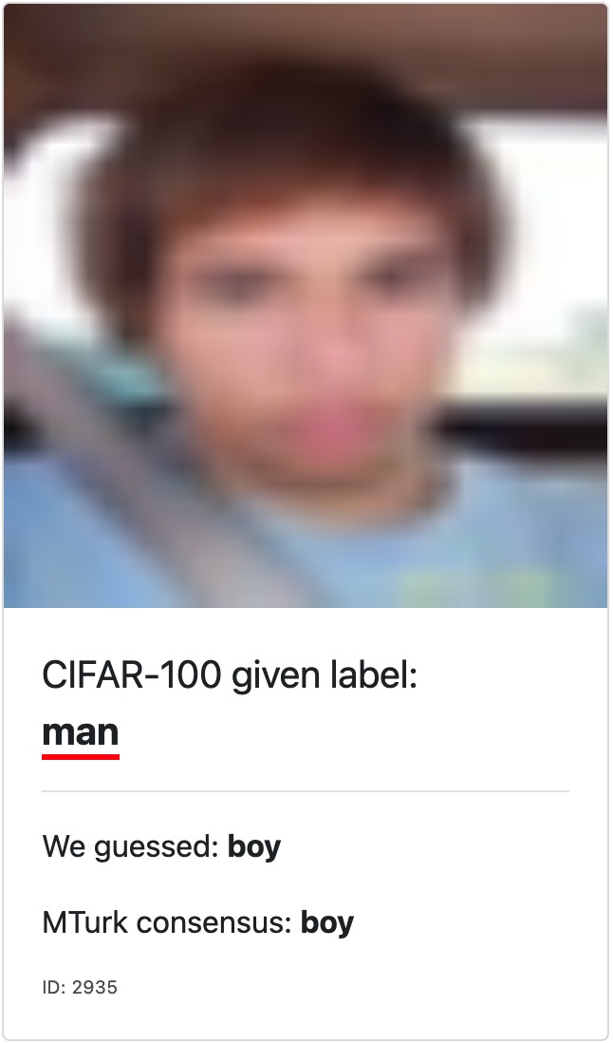
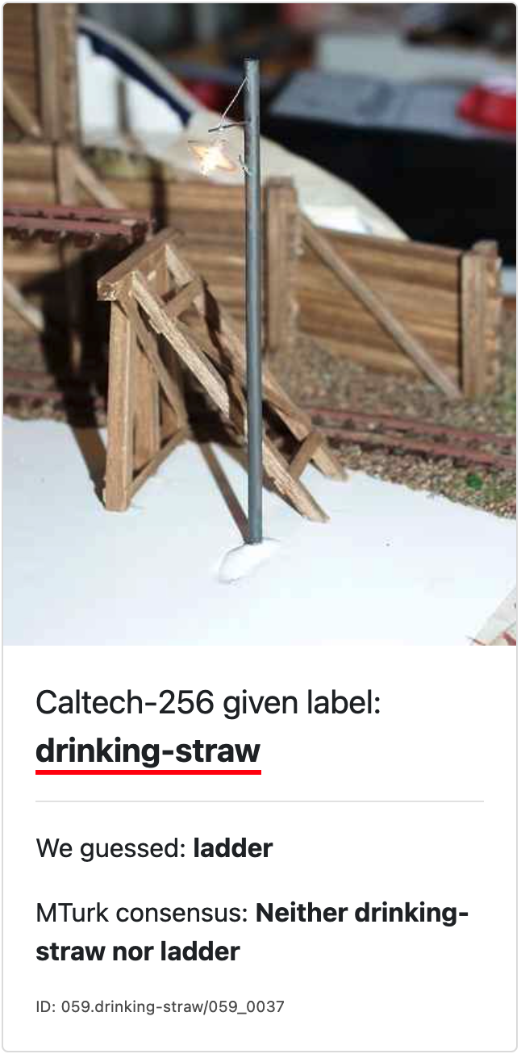
Hard examples. Often there is no good ‘true’ label.
(a)
(b)
(c)
(d)
(e)
(f)

Slide 57
3.4% of labels in popular ML test sets are erroneous
https://labelerrors.com/
Images →
Text →
Audio →
There are pervasive label errors in test sets, but what are the implications for ML?

Slide 58
Are practitioners unknowingly benchmarking ML using erroneous test sets?
To answer this, let’s consider how ML traditionally creates test sets...
and why it can lead to problems for real-world deployed AI models.

Slide 59
A traditional view
Data Set

Slide 60
A traditional view
Train Set
Test Set

Slide 61
A traditional view
Train Set
Test Set

Slide 62
A traditional view
Train Set
Test Set
GREEN
RED
BLUE

Slide 63
A traditional view
Train Set
Test Set
GREEN
GREEN
RED
RED
BLUE
BLUE

Slide 64
A real-world view
Data Set

Slide 65
A real-world view
Data Set

Slide 66
A real-world view
Train Set
Test Set

Slide 67
A real-world view
Train Set
Test Set

Slide 68
A real-world view
Train Set
Test Set

Slide 69
A real-world view
Train Set
Test Set
GREEN
RED
BLUE

Slide 70
A real-world view
Train Set
Test Set
GREEN
GREEN
100% accuracy!
RED
RED
BLUE
BLUE

Slide 71
A real-world view
Trained Model with 100% test accuracy.
GREEN
RED
BLUE

Slide 72
A real-world view
Trained Model with 100% test accuracy.
Real-world distribution (the test set you actually care about)
GREEN
GREEN
BLUE
RED
RED
BLUE

Slide 73
A real-world view
Trained Model with 100% test accuracy.
Real-world accuracy ~ 67%
Key Takeaway:
Need to benchmark on a corrected test set
GREEN
GREEN
BLUE
RED
RED
BLUE

Slide 74
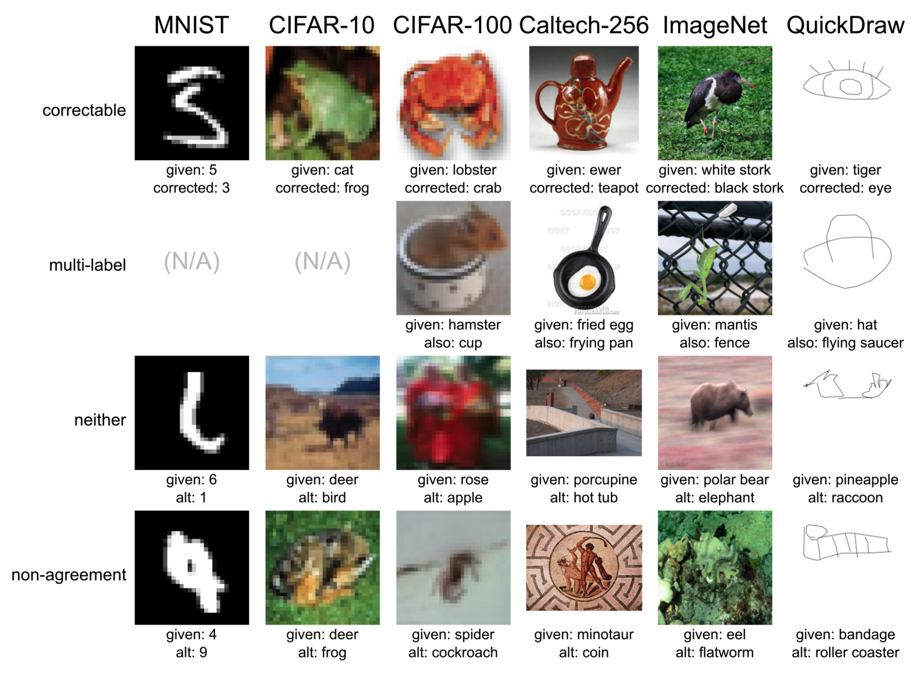
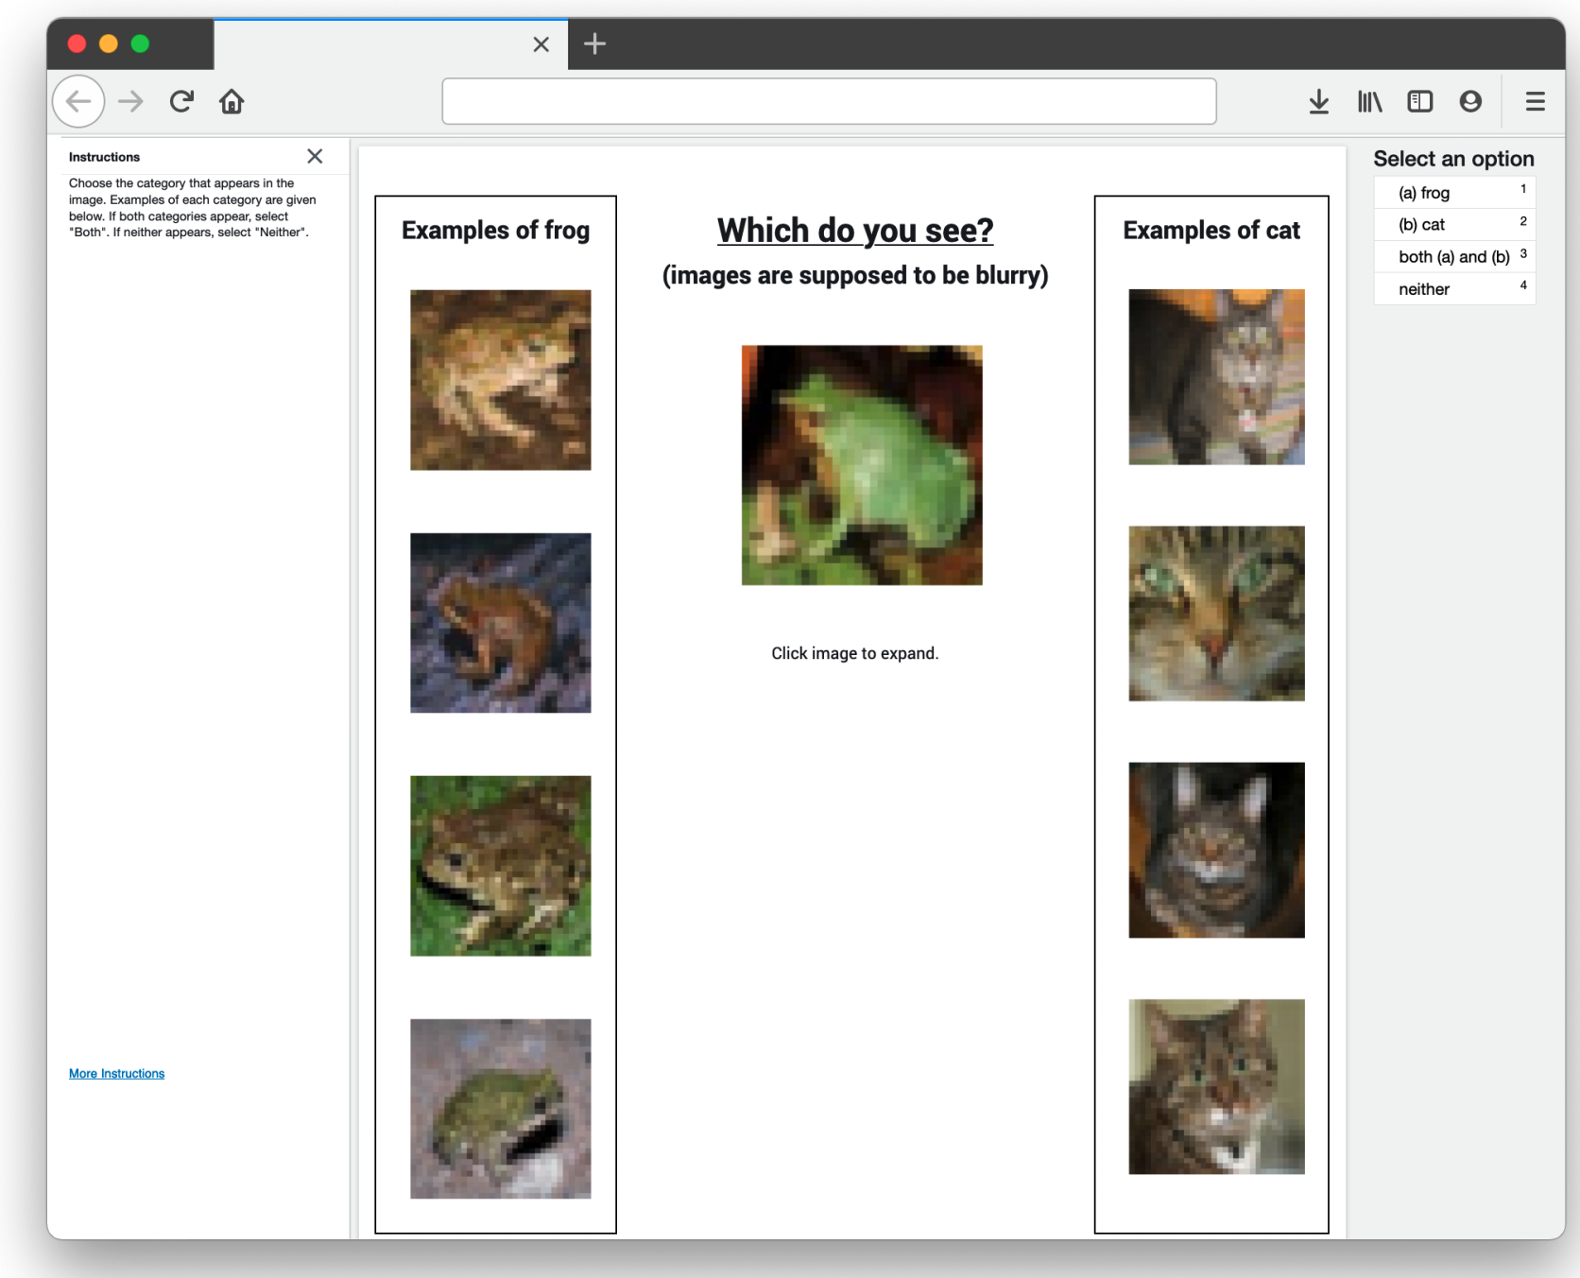
Correcting the test set

Slide 75
Correcting the test sets
Correct the label if a majority of reviewers:
agree on our proposed label
Do nothing if a majority of reviewers:
agree on the original label
Prune the example from the test set if the consensus is:
Neither
Both (multi-label)
Reviewers cannot agree

Slide 76
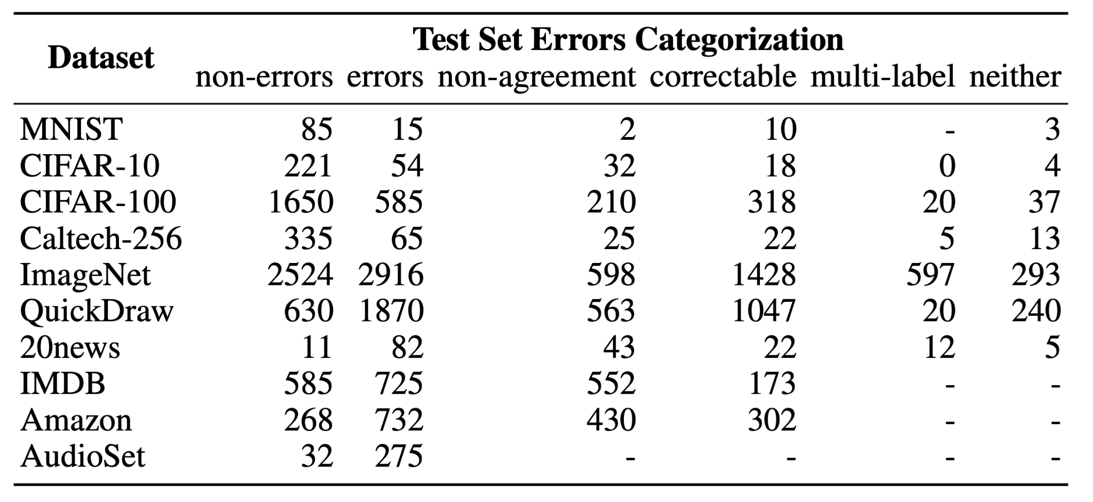
Test Set Errors Categorization
Remember our two questions? Now we have the tools (corrected test sets) to answer Q2:

Slide 77
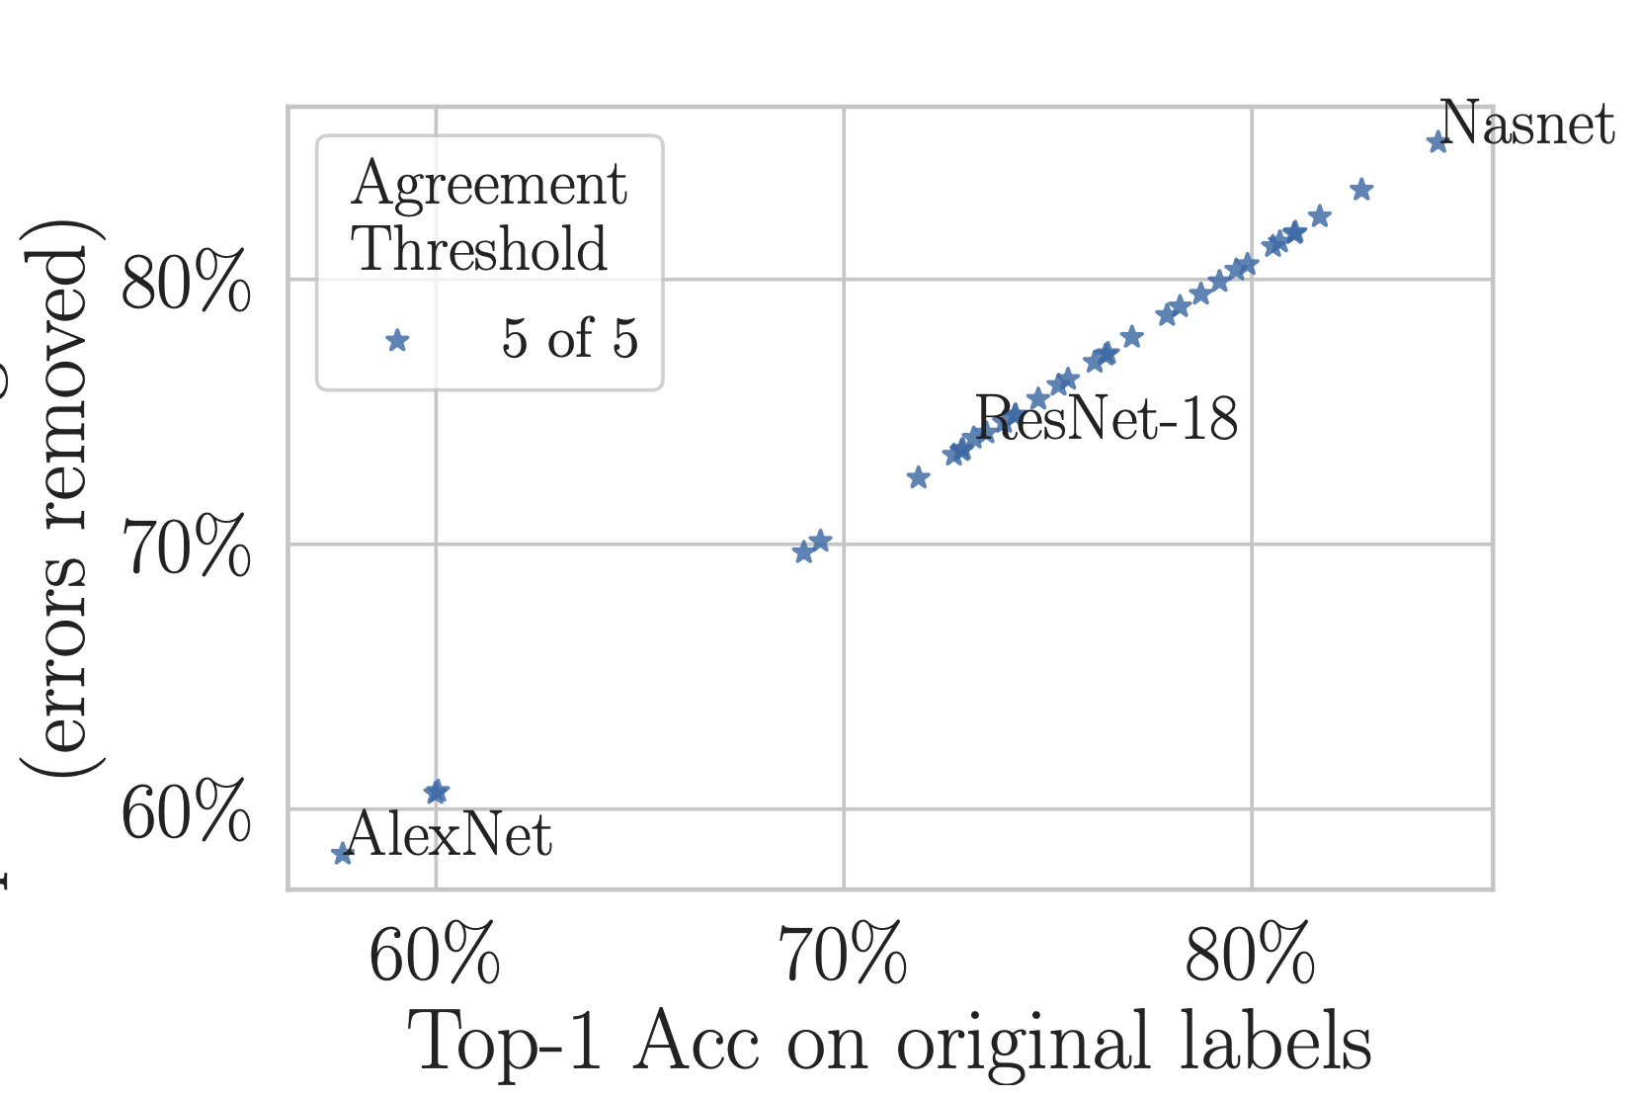
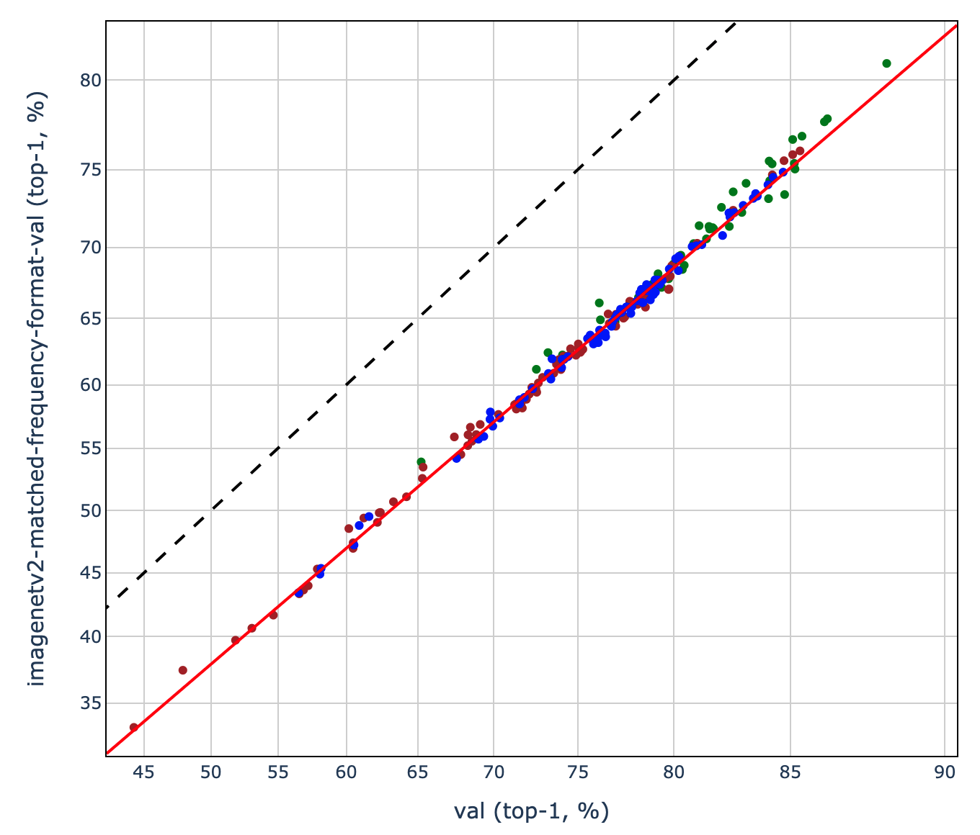
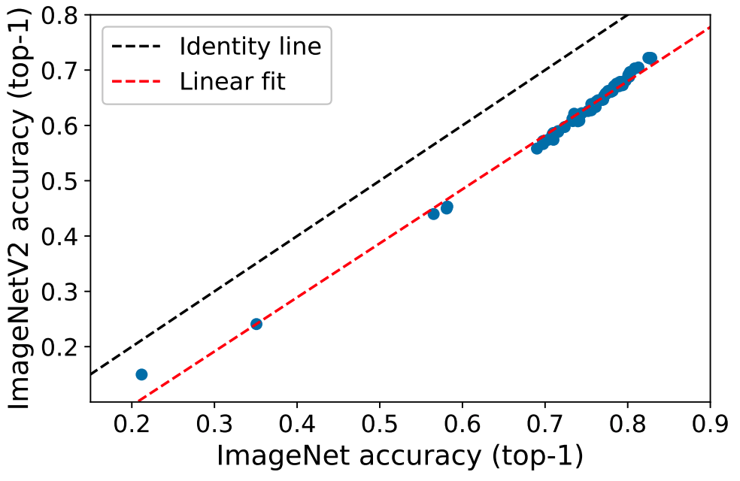
34 pre-trained black-box models on ImageNet
But what if instead of looking at the entire validation set, we compare performance on the (much smaller) subset of examples with corrected labels?
Pervasive Label Errors in Test Sets Destabilize Machine Learning Benchmarks
(Northcutt, Athalye, & Mueller 2021)
Measuring Robustness to Natural
Distribution Shifts in Image Classification
(Taori, Dave, Shankar, Carlini,
Recht, & Schmidt, 2021)
From ImageNet to Image Classification: Contextualizing Progress on Benchmarks
(Tsipras, Santurkar, Engstrom, Ilyas, Madry, 2020)
Do ImageNet classifiers generalize to ImageNet?
(Recht, Roelofs, Schmidt, & Shankar, 2019)
Why do classifier accuracies show linear trends under distribution shift?
(Mania & Sra, 2021)
Notes:
http://proceedings.mlr.press/v97/recht19a/recht19a.pdf
Do ImageNet Classifiers Generalize to ImageNet?
Benjamin Recht, Rebecca Roelofs, Ludwig Schmidt, Vaishaal Shankar
http://proceedings.mlr.press/v119/shankar20c/shankar20c.pdf

Slide 78
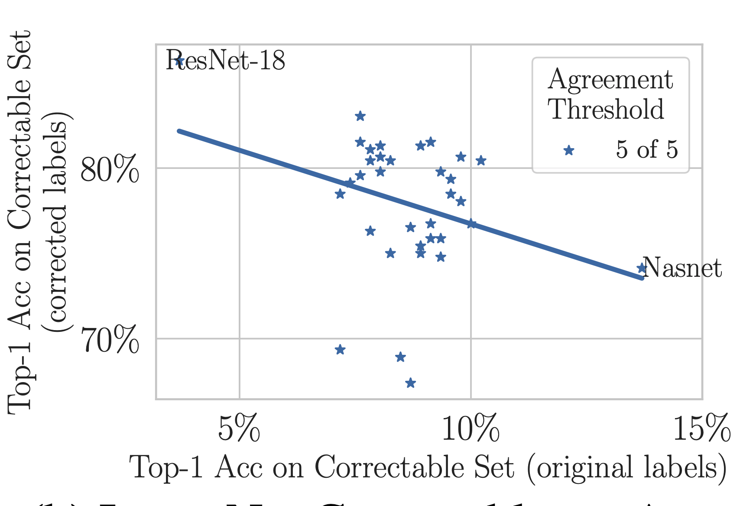
34 pre-trained black-box models on ImageNet
Is the result is specific to ImageNet?

Slide 79
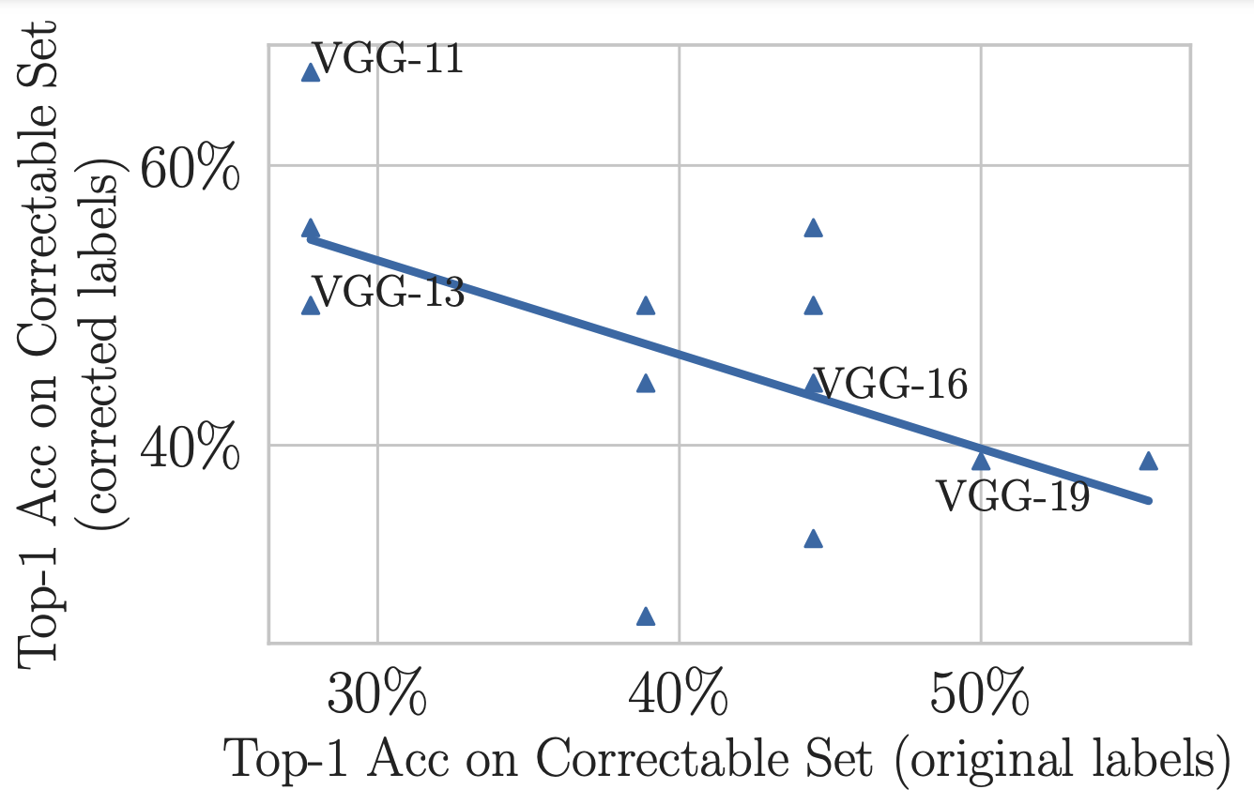
The same finding, this time on CIFAR-10

Slide 80
2.9% noise prevalence ~50k examples
100% noise prevalence
~1.5k examples
At what noise prevalence do the rankings start to change?

Slide 81
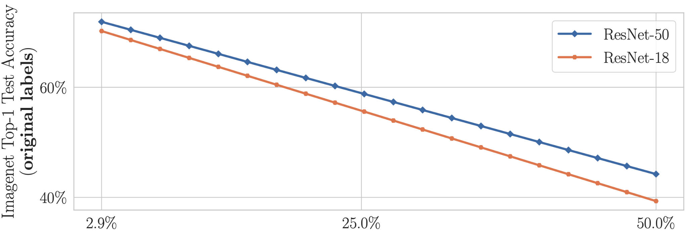
Two pre-trained ImageNet models tested on original (noisy) labels
What happens when we
correct the test labels?
Notes:
Explain how noise is increased on this slide (not later)
Interpolating toward the smaller subset
Define x axis at very beginning (context with suvrits work)

Slide 82
But when we correct the test set, benchmark rankings destabilize

Slide 83
But when we correct the test set, benchmark rankings destabilize
Again we asked, is the result is specific to ImageNet?

Slide 84
Same story on CIFAR-10 benchmark rankings

Slide 85
Are practitioners unknowingly benchmarking ML using erroneous test sets?
Conclusions
Model rankings can change with just 6% increase in noise prevalence (even in these highly-curated test sets)
ML practitioners cannot know this unless they benchmark with corrected test set labels.
The fact that simple models regularize (reduce overfitting to label noise) is not surprising. (Li, Socher, & Hoi, 2020)
The surprise -- test sets are far noisier than the ML community thought (labelerrors.com)
An ML practitioner’s “best model” may underperform other models in real-world deployment.
For humans to deploy ML models with confidence -- noise in the test set must be quantified
confident learning addresses this problem with realistic sufficient conditions for finding label errors -- and we have shown its efficacy for ten of the most popular ML benchmark test sets.
Notes:
Real world deployment which can have dire consequences for self driving cars

Slide 86
Today’s Lab: improve a model trained with bad labels.

Slide 87
THIS SLIDE
INTENTIONALLY LEFT BLANK

Slide 88
Find label errors in your own dataset (1 import + 1 line of code)
https://github.com/cleanlab/cleanlab

Slide 89
Find data errors in your own dataset (1 import + 1 line of code)
https://github.com/cleanlab/cleanlab

Slide 90
Find consensus labels for your dataset (1 import + 1 line of code)
https://github.com/cleanlab/cleanlab

