Slide 1
IAP 2024
First lecture on 1/16 at 12:00p ET in Room 2-190

Slide 2
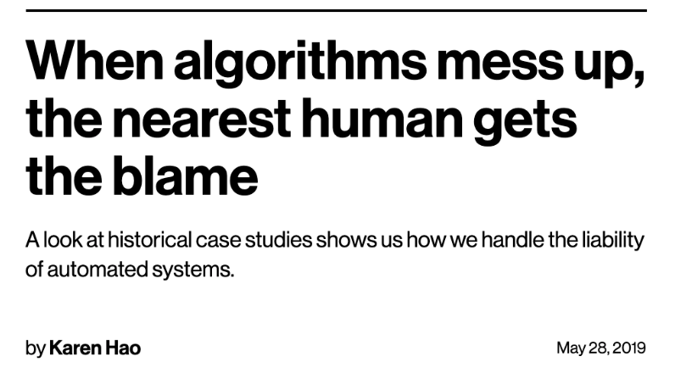
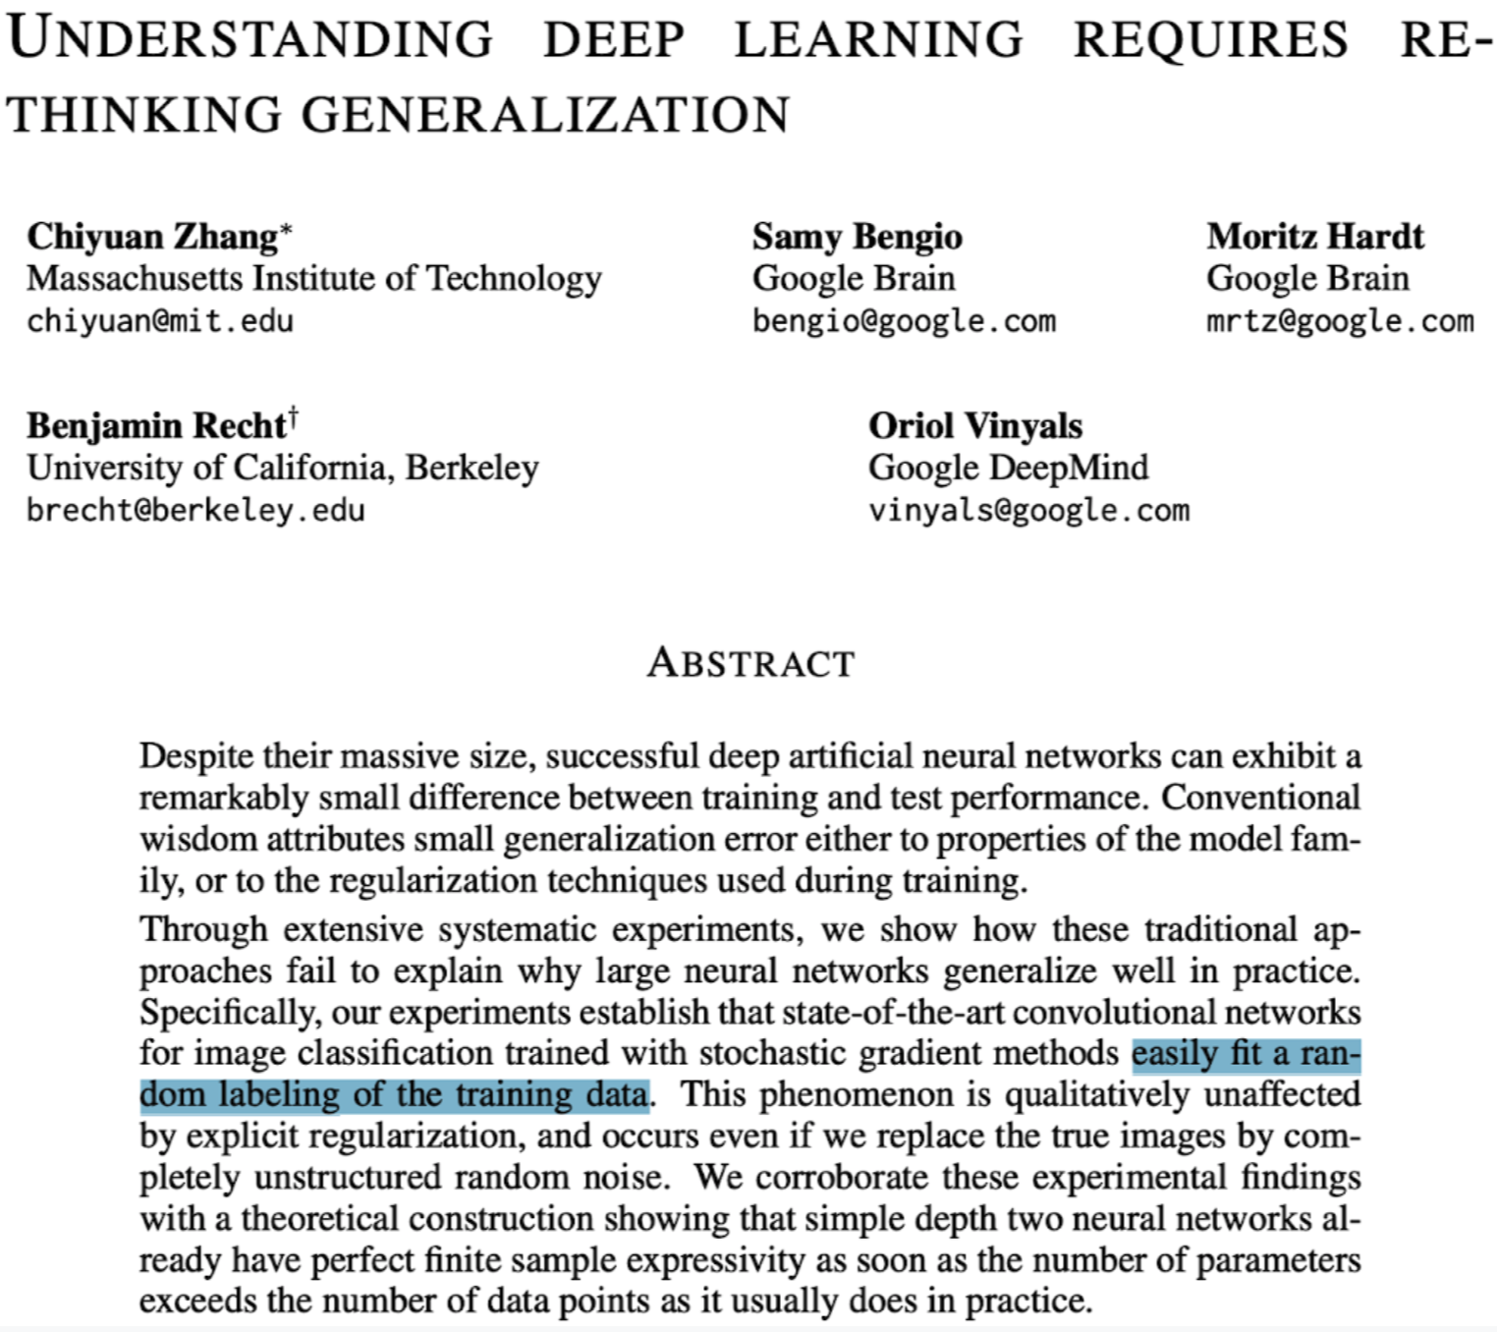
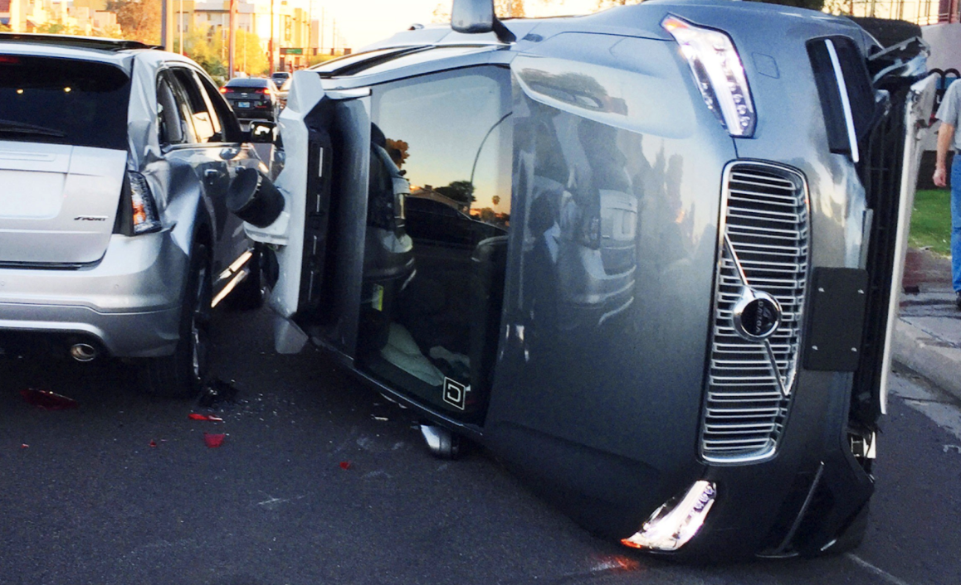
For learning, data is as important as the model
In machine learning, we tend to focus on the model
But learning depends on the quality of
the data
are trained with erroneous data`
Deep neural networks easily fit random labels.
Zhang et al. (ICLR, 2017)
Source: MIT Technology Review
(May 28, 2019)
Notes:
What should it mean for an algorithm to mess up?
Algorithms, if their assumptions are met, don’t mess up. Its the data they are trained on.
Reference: https://www.technologyreview.com/s/613578/ai-algorithms-liability-human-blame/
I met with Andrej Karpathy and he said most of the error they observe is actually do to dataset label quality.

Slide 3
Traditional Machine Learning is model-centric
When you learn ML in school… a dataset is given to you, usually fairly clean & well-curated (e.g. dog/cat images)
Your goal: produce the best model for this dataset (model-centric AI)
techniques taught in standard ML classes like 6.036/6.390
In traditional (model-centric) ML, you learn:
different types of models (eg. neural architectures)
tuning their hyperparameters
modifying the training loss function
regularization

Slide 4
In many real-world ML applications, the dataset is not fixed!
Company/user does not care what clever ML tricks you used to produce accurate predictions on highly curated data.
Real-world data tends to be messy, so consider fixing issues in the data.
Ten of the most-used ML test sets have pervasive label errors.** See: https://labelerrors.com/.
** Northcutt, Athalye, & Mueller, NeurIPS, 2021 (link to paper, code, errors found via cleanlab)
Seasoned data scientist: It’s more worthwhile to invest in exploring & fixing the data than tinkering with models. (i.e. avoid “garbage in, garbage out”)
But this process is cumbersome for large datasets 😭

Slide 5
What is data-centric AI?
Data-centric AI often takes one of two forms:
AI algorithms that understand data and use that information to improve models.
e.g. curriculum learning – train on ‘easy data’ first
Bengio et al., ICML, 2009 (link to paper)
AI algorithms that modify data to improve AI models.
e.g. confident learning – remove wrongly-labeled data prior to training
Northcutt et al., Journal of AI Research, 2021 (link to paper)

Slide 6
model-centric AI vs Data-centric AI
Model-centric AI:
Given a dataset, try to produce the best model (think 6.036/6.390)
Change the model to improve performance on an AI task
e.g. modify the loss function, hyper-parameters, etc.
Data-centric AI:
Given any model, try to improve the training dataset
Systematically/algorithmically change the dataset to improve performance on an AI task

Slide 7
Goal: start thinking about ML in terms of data, not the model.
Consider KNN (K Nearest Neighbors)
What is different about KNN and what we’ll teach in this course?

Slide 8
What is not data-centric AI?
Examples:
Hand-picking a bunch of data points you think will improve a model.
Double the size of your dataset and train an improved model on more data.
Data-centric AI versions:
Coreset selection
Dataset Augmentation

Slide 9
What are examples of Data-centric AI?
Outlier Detection and Removal (handling abnormal examples in dataset)
Error Detection and Correction (handling incorrect values/labels in dataset)
Data Augmentation (adding examples to data to encode prior knowledge)
Feature Engineering and Selection (manipulating how data are represented)
Establishing Consensus Labels (determining true label from crowdsourced annotations)
Active Learning (selecting the most informative data to label next)
Curriculum Learning (ordering the examples in dataset from easiest to hardest)

Slide 10
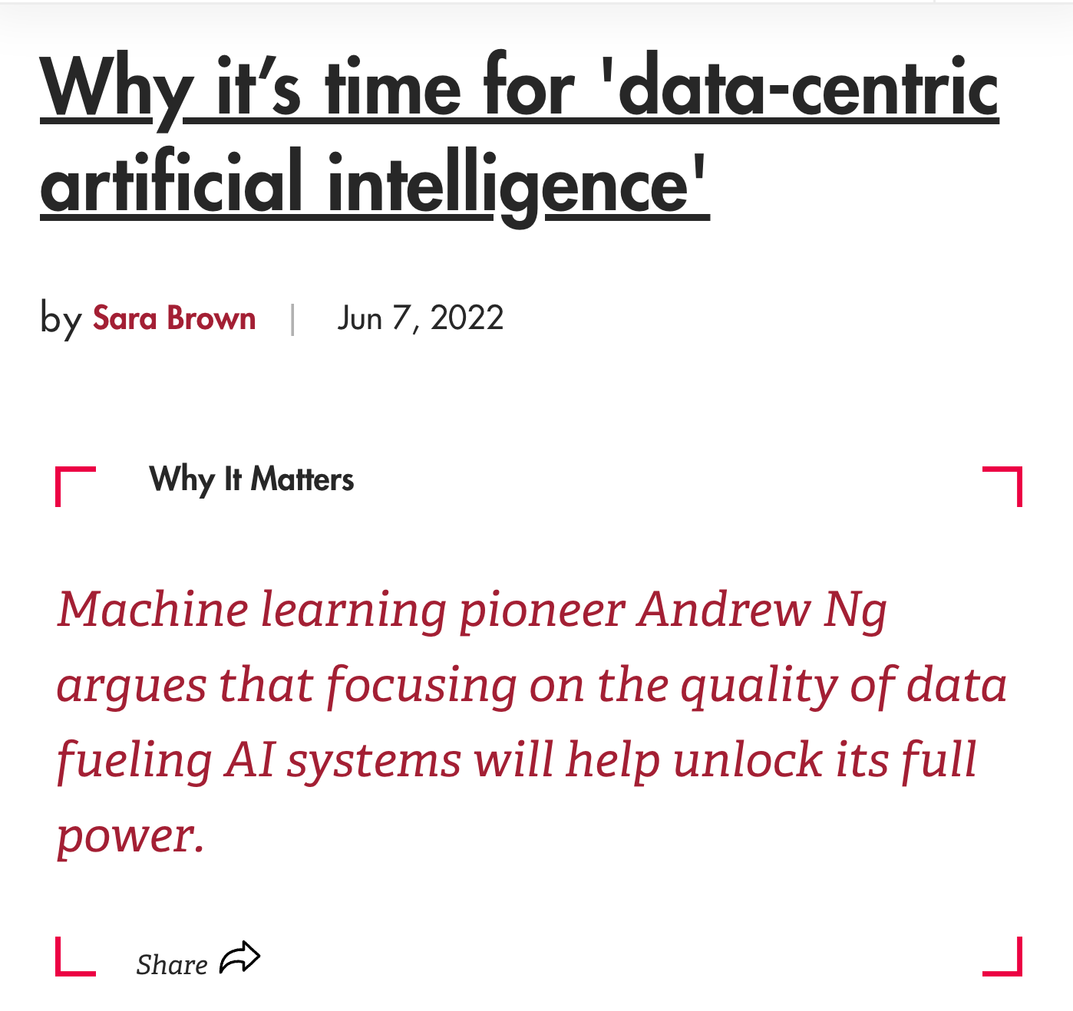
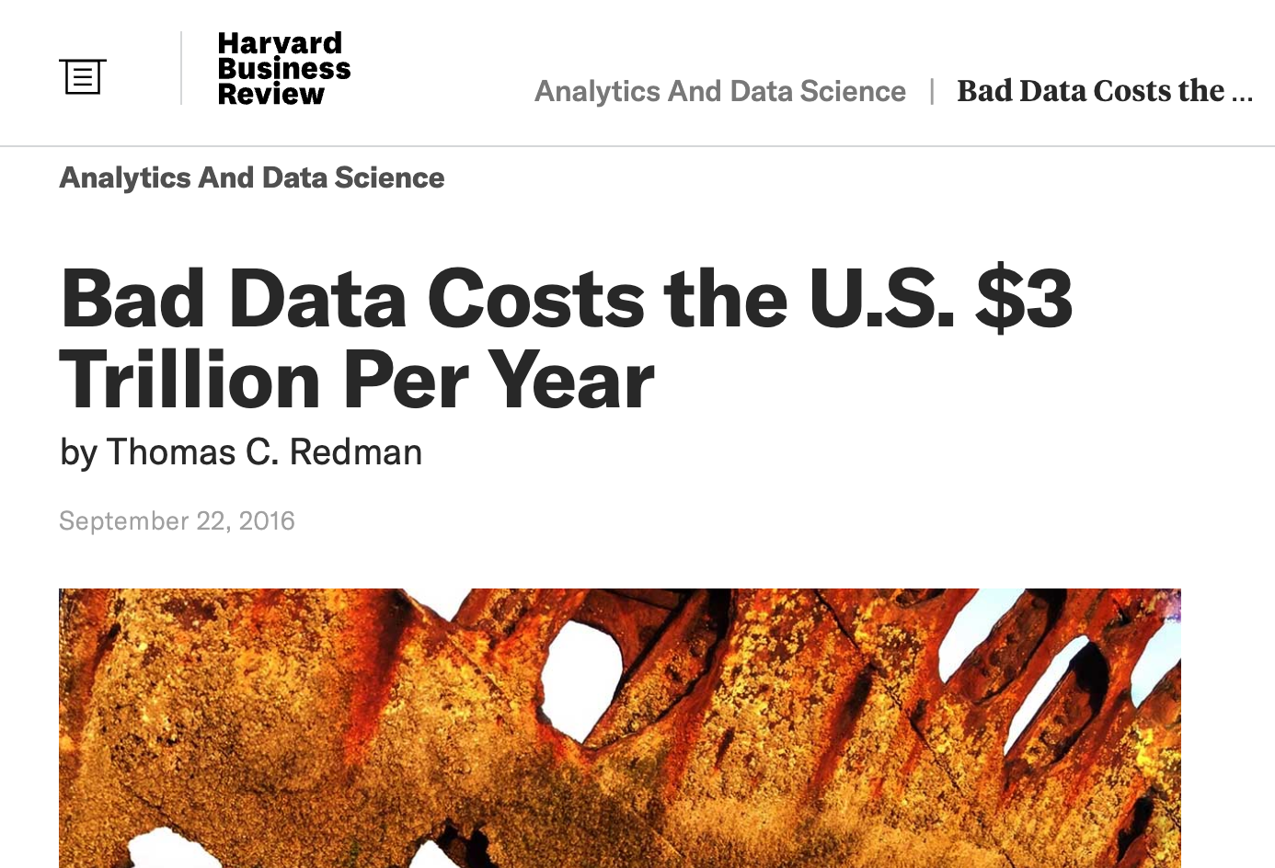
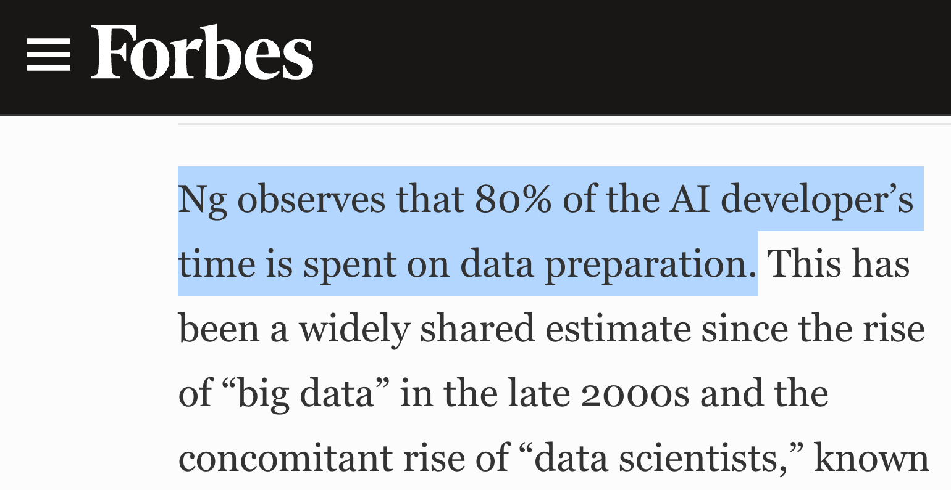
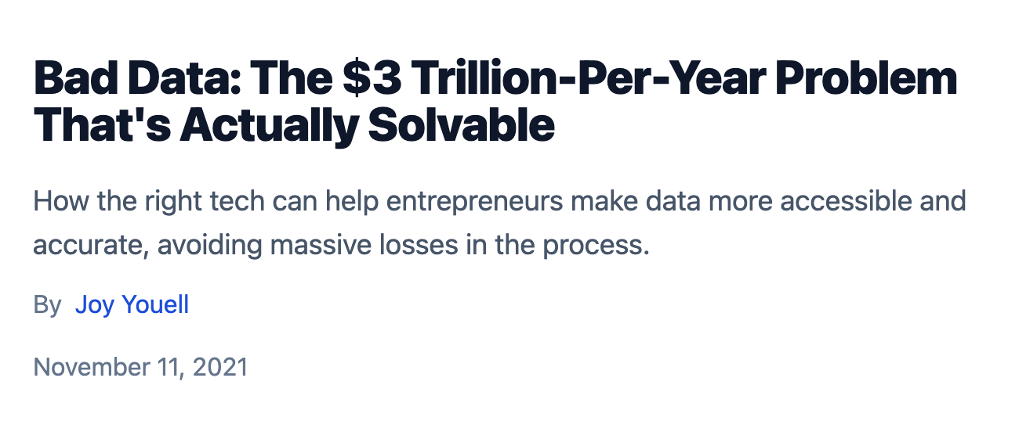
Why the hype around Data-centric AI?
Source: link
Source: link
Source: link

Slide 11
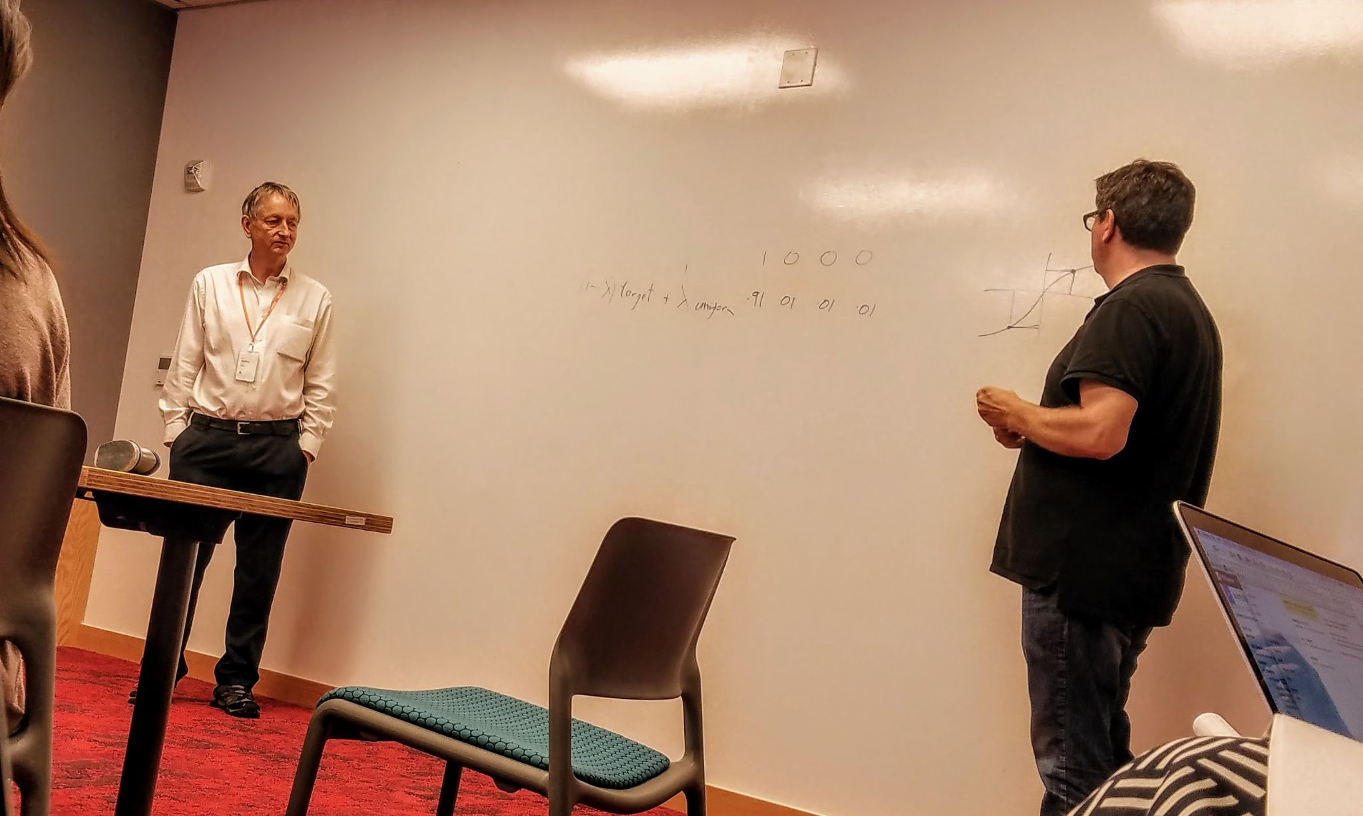
“To conclude my talk, I will show that our method finds a label error in Yann’s MNIST dataset.” - Hinton (@FAIR, NYC)
Notes:
HIGHLIGHT THIS BECAUSE:
Big thinkers in our field are asking the same questions
Just 5 years ago, finding only a single error in MNIST was the culminating point of a Hinton talk
What struck me about his talk was that add the end he showed us what he was most excited about …. A label error in MNIST

Slide 12
“To conclude my talk, I will show that our method finds a label error in Yann’s MNIST dataset.” - Hinton (@FAIR, NYC)
MNIST Given Label: 3
Notes:
HIGHLIGHT THIS BECAUSE:
Big thinkers in our field are asking the same questions
Just 5 years ago, finding only a single error in MNIST was the culminating point of a Hinton talk
What struck me about his talk was that add the end he showed us what he was most excited about …. A label error in MNIST

Slide 13
Why the hype around Data-centric AI?
OpenAI has ‘open’ly stated that one of the biggest issues with Dall-E and GPT-3 is errors in the data and labels used during training.
It’s not the model, it’s the data!
Let’s take a look at the Dall-E demo page: https://openai.com/dall-e-2/#demos

Slide 14
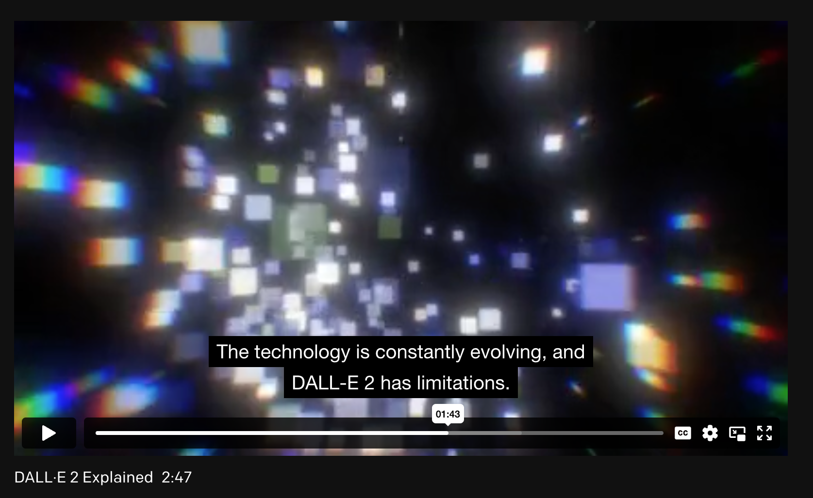
Dall-E’s big challenge → label errors at training time

Slide 15
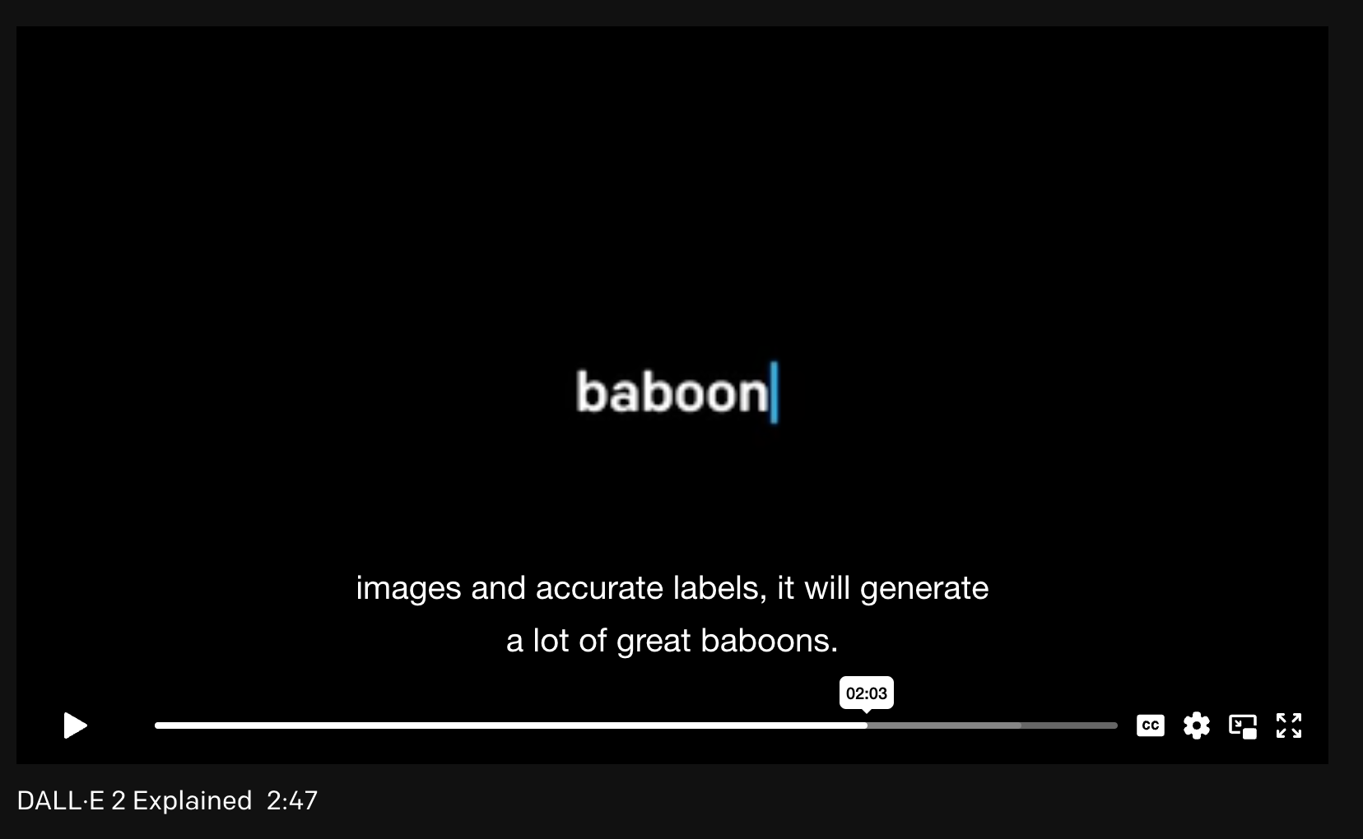
Dall-E’s big issue → label errors at training time
Takeaway: Reliability of ML models deployed in the real-world depends on quality of training data.

Slide 16
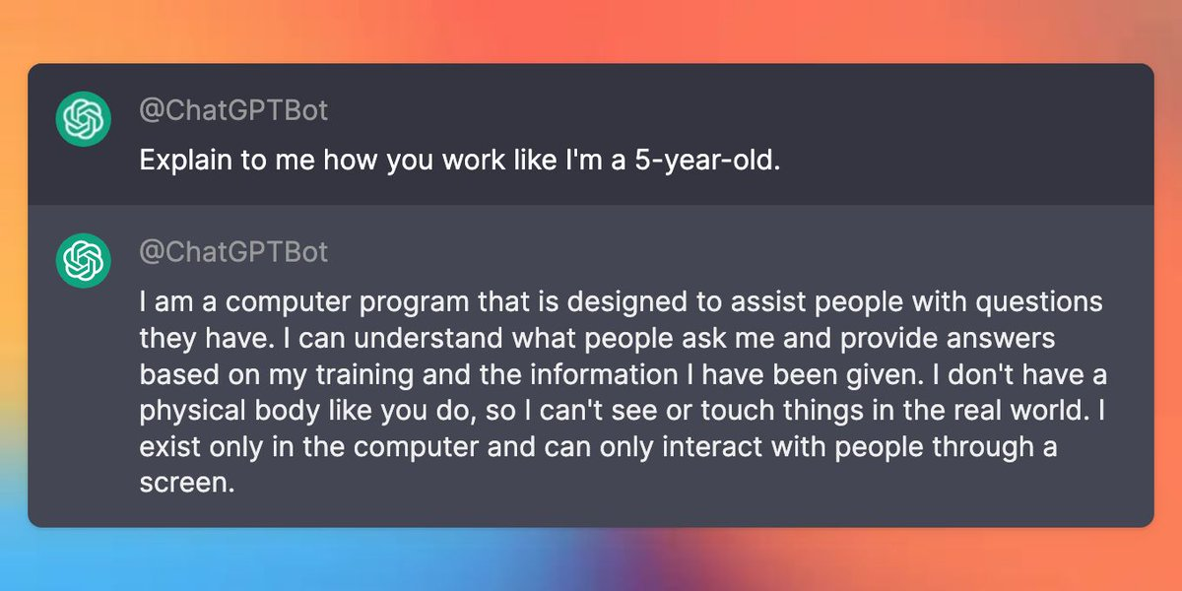
ChatGPT improved GPT-3 by improving data quality
ChatGPT was fine-tuned to:
minimize harmful, untruthful, or biased output
Used human rankings of potential outputs to put lower-weighting on ‘bad data’
Link to source. Link to blog.

Slide 17
Tesla Data Engine: use model outputs to improve training dataset
Slide from Andrej Karpathy, Tesla Director of AI (2021)

Slide 18
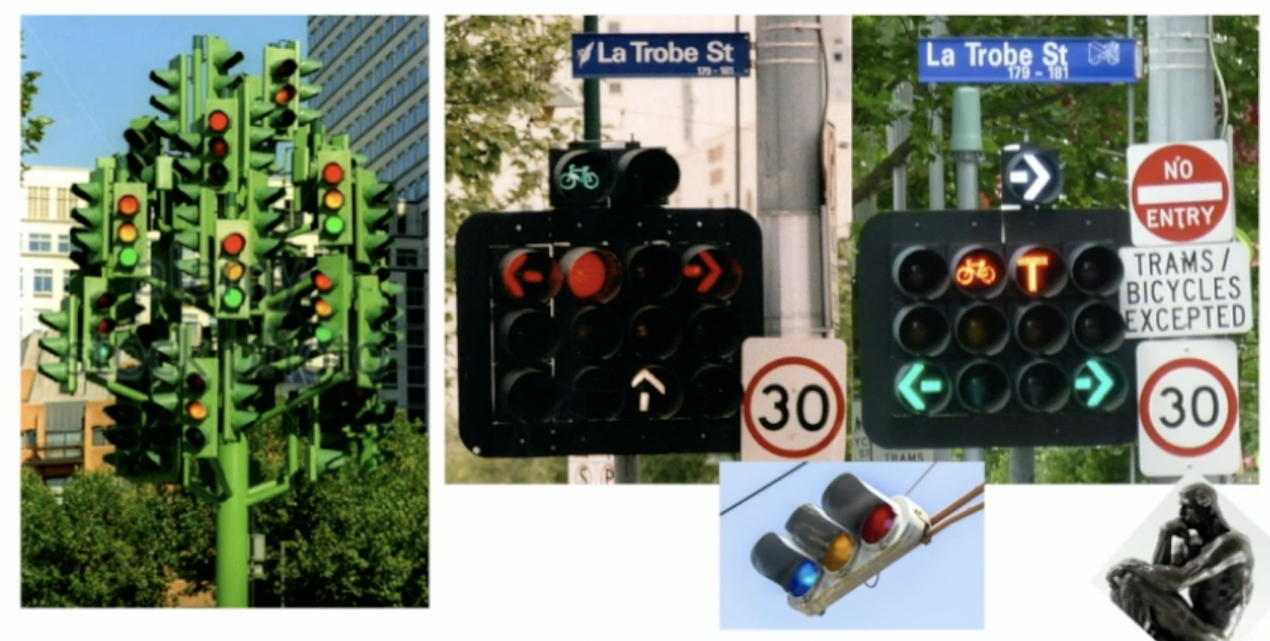
Tesla Data Engine: use model outputs to improve training dataset
Slide from Andrej Karpathy, Tesla Director of AI (2021)

Slide 19
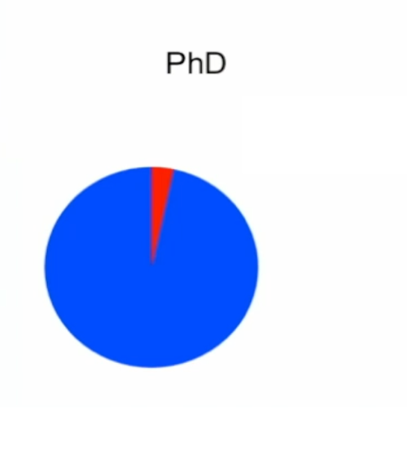
Tesla Data Engine: use model outputs to improve training dataset
Datasets
Models and algorithms
Datasets
Models and algorithms
Slide from Andrej Karpathy, Tesla Director of AI (2021)

Slide 20
Data-centric vs model-centric for learning with noisy labels
Northcutt et al., JAIR, 2021
“Confident Learning” (link to paper)

Slide 21
Before there was data-centric AI…
We relied on mostly-human-powered solutions to improve dataset quality:
Spend more $ for higher quality data or more labels
Build custom tools to evaluate specific data (e.g. Tesla data quality platform)
Fixing data inside a Jupyter notebook
Data-centric AI = systematizing these approaches to be more reliable, accurate, and generally usable on many datasets.

Slide 22
PU Learning (the “perceptron” of DCAI)
Your first exposure to the magic of systematic model improvement!

Slide 23
What we’ll cover in this course.
Week 1:
1/16 (today): Data-Centric AI vs Model-Centric AI, Perceptron of DCAI, PU Learning
1/17: Label Errors and Confident Learning
1/18: Class Imbalance, Outliers, and Distribution Shift
1/19: Advanced Confident Learning, LLM and Generative AI applications
Week 2:
1/22: Dataset Creation and Curation
1/23: Data-centric Evaluation of ML Models
1/24: Data Curation for LLMs
1/25: Cutting-edge Research, Applications, and Advanced Topics (1)
1/26: Cutting-edge Research, Applications, and Advanced Topics (2)

Slide 24
The lab for today’s lecture will cover
A text classification dataset with bad html tags scraped from the internet.
Model-centric approaches will only get you so far.
You’ll need to improve the dataset to train a better classifier.
https://github.com/dcai-course/dcai-lab
Questions: https://piazza.com/mit/spring2024/6dcai

Slide 25
Tomorrow’s lecture will cover
Label errors and how to find them automatically.
How to train classification models on data containing label errors.
How test set label errors impact ML benchmarks.

Slide 26
Course staff
Anish Athalye (MIT SB ‘17 PhD)
Lecture 3 - Imbalance, Outliers, Shift
Lecture 7 - Data Curation for LLMs
Lecture 8 - Advanced Topics 1
Lecture 9 - Advanced Topics 2
Curtis Northcutt (MIT PhD ‘21)
Lecture 1 - What is DCAI, PU Learning
Lecture 2 - Confident Learning
Lecture 4 - Adv Confident Learning, Gen AI
Jonas Mueller (MIT PhD ‘18)
Lecture 5 - Dataset Creation and Curation
Lecture 6 - Data-centric Evaluation of Models

